Slide 1
WELCOME to the information session on the
European Film Distribution call for proposals
We will start promptly at 2 pm
Please mute your microphone and switch off your camera
European Education and Culture
Executive Agency

Slide 2
Information session
European Film Distribution
9 February 2022
This info session will be recorded using WebEx for the purpose of publication on EACEA’s website. Only the presentations will be recorded: the Q&A sections will not be recorded.
Please refer to the Data Protection Notice of the event for more information.
European Education and Culture
Executive Agency

Slide 3



Overview
Key features
Structure of the call + Q&A
MEDIA database and how generate your admissions + Q&A
Introduction to the submission system in e-Grants + Q&A
Tips for proposal preparation

Slide 4

2022: positive developments!
Increase of total budget (by 11%)
Increase of co-funding rate (from 60% to 70%)
Increase of pre-financing rate to (also from 60% to 70%)
Increase of number of films for reinvestment (from 10 to 12)
Simplification – no progress reports
Simplification – one application per PIC number (multiple territories)
Support measures to tackle Covid and Brexit effect (co-efficients and reference years for admissions)
New submission system (eGrants) and MEDIA database
© European Union

Slide 5

Key features
Available budget: EUR 33 000 000
Project duration: 24 months
Deadline: 05/04/2022
Evaluation: April – September 2022
Information on evaluation results: October 2022
GA signature: December 2022
© European Union
Notes:
Pay attention to the 5pm deadline – every second counts!

Slide 6
Key features
Structure of the call + Q&A
MEDIA database - how generate your admissions + Q&A
Introduction to the submission system in e-Grants + Q&A
Tips for proposal preparation

Slide 7

Eligibility criteria (1)
Eligible participants – no changes compared to Automatic scheme
Eligible films – no changes compared to Automatic scheme
New MEDIA database (check the step-by-step guide)
Eligible admissions
admissions achieved between 2018 and 2021 (copyright n-3)
e-ticket admissions eligible if they are certified
other eligibility criteria remain unchanged (certified admissions)

Slide 8
Eligibility criteria (2)
Participating countries for European Film Distribution as of February 2022:
EU 27
Norway, Iceland, Liechtenstein
Albania, Bosnia, Montenegro, North Macedonia, Serbia

Slide 9

Generation of a potential fund (1)
Unchanged compared to Automatic scheme:
On the basis of eligible admissions certified by national authority
Co-efficients applied according to nationality of film and territory of distributor
Maximum threshold per film and per distributor
Minimum availability per country of distribution
Films with less than 200 admissions in a given year not eligible

Slide 10

Generation of a potential fund (2)
New this year: potential fund generated includes two parts
Part 1 – eligible certified admissions in 2020 and 2021
Part 2 – 50% of average of eligible admissions declared and approved in Automatic calls 27-2018 and 22-2019
All encoded in MEDIA database
Certification by national authority for 2020 and 2021
Fund capped at 1 million EUR

Slide 11
Part 1: co-efficients for 2020 and 2021
(exceptional increase due to Covid)
Country of distribution | Nationality of the film
 | France | Germany, Spain, Italy | Other eligible countries
 | 2022 coefficient* | 2022 coefficient* | 2022 coefficient*
France, Germany, Italy, Spain | 1,10 | 1,20 | 2,20
Austria, Belgium, Poland, The Netherlands | 1,20 | 1,55 | 2,20
Czech Republic, Denmark, Finland, Greece, Hungary, Norway, Portugal, Sweden. | 1,70 | 1,95 | 2,20
Other eligible countries | 1,95 | 2,20 | 2,20
*Exceptionally, the coefficients have been adjusted for 2022 taking into account the impact of the Covid crisis in the business models of the European distributors.

Slide 12
Part 2: co-efficients for 2018 and 2019
 | Nationality of the film (as per section “Eligibility” )
Country of distribution | France UK | Germany Spain Italy | Other eligible countries
Germany, Spain, France, Italy | 0,45 | 0,50 | 0,90
Austria, Belgium, The Netherlands, Poland, UK | 0,50 | 0,65 | 0,90
Czech Republic, Denmark, Finland, Greece, Hungary, Norway, Portugal, Sweden | 0,70 | 0,80 | 0,90
Other eligible countries | 0,80 | 0,90 | 0,90

Slide 13
Example of calculation of eligible admissions to calculate estimated potential fund (1)
 | PART 1 |  | PART 2
FILM XXX | 2021 | 2020 | 2019 | 2018
Certified Admissions/film per reference year | 600 | 500 | 1200 | 800
Total admissions Part 1 and Part 2 | 1100 |  | 2000
Total admissions Part 1 (sum 2020 and 2021) & Part 2 (average 2018/2019) | 1100 |  | 1000
Eligible admissions Part 1 (sum 2020 and 2021) & Part 2 (50% average 2018/2019) | 1100 |  | 500
Total eligible admissions for calculation of potential fund - subject to applicable co-efficients | 1600

Slide 14
Example of calculation of eligible admissions to calculate estimated potential fund (2)
 | PART 1 |  | PART 2
FILM XXX | 2021 | 2020 | 2019 | 2018
Certified Admissions/film per reference year | 300 | 200 | 1200 | 800
Total admissions Part 1 and Part 2 | 500 |  | 2000
Total admissions Part 1 (sum 2020 and 2021) & Part 2 (average 2018/2019) | 500 |  | 1000
Eligible admissions Part 1 (sum 2020 and 2021) & Part 2 (50% average 2018/2019) | 500 |  | 500
Total eligible admissions for calculation of potential fund – subject to applicable co-efficients | 1000

Slide 15

Part 2 – eligible admissions in 2018-2019
For distributors with declared, approved admissions in 2018 and 2019 (calls 27-2018 and 22-2019)
Pre-encoded in the system
50% of the average of all eligible admissions in 2018 and 2019 (the calculation is done in the system)

Slide 16
Eligible re-investment activities
New this year: reinvestment on maximum 12 films
Eligible activity 1: investment in co-production
Eligible activity 2: investment in acquisition of distribution rights
Eligible activity 3: promotion, marketing and advertising (at least 25% to be reinvested in this activity)
Eligible activities cannot include personnel work and travel arrangements
Notes:
Stress no staff costs or travel – budget – Stefano will show how to fill in the budget section – only costs for ‘o’ to be encoded

Slide 17
Project start date
After date of grant signature
Exceptionally, can be earlier if duly justified
Never earlier than proposal submission date
Re-submission(s) of proposal – latest date before deadline counts!
Only costs incurred during eligibility period count!

Slide 18


Questions?
Please use the chat function
Notes:
Reminder – stop recording

Slide 19
Key features
Structure of the call + Q&A
MEDIA database - how generate your admissions + Q&A
Introduction to the submission system in e-Grants + Q&A
Tips for proposal preparation
Notes:
Practical arrangements: please ask your questions in the Webex chat, we will reply to them and to oral questions at the end of this presentation.
We will record the presentation, but not the Q&A session for privacy reasons.
The recording and the slides will be available on the website of the Education Audiovisual and Culture Executive Agency. The link to this page is also available through the Funding and Tender Portal news page.
Also, please mute your microphone and deactivate your camera during the presentation.

Slide 20
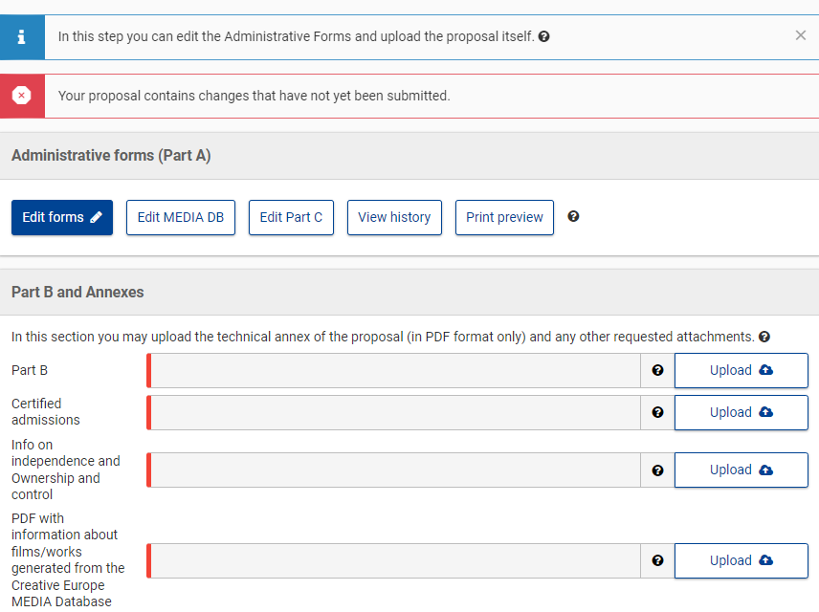
Click on ‘Edit MEDIA DB’ in the submission system
Notes:
Be familiar with project structure!
Part A (administrative forms)
B (Description of Action, max 70 pp -> excess pages will be blanked out)
C (eligibility info)
Online manual + IT how to

Slide 21
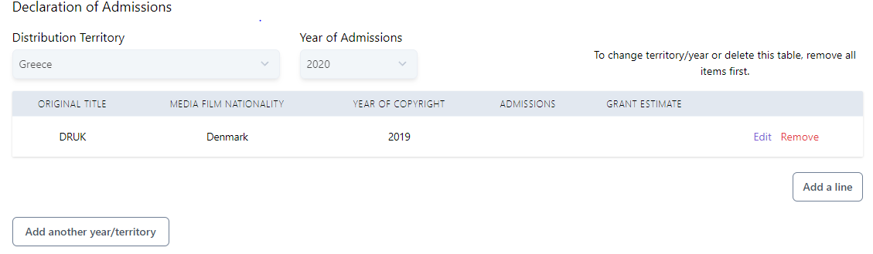
Part 1
Eligible, certified admissions in 2020 and 2021

Slide 22
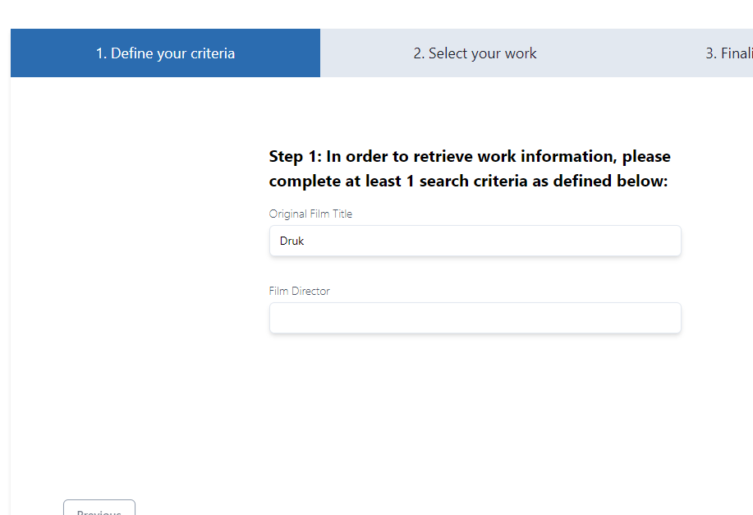
Search for your film
Notes:
specify original language

Slide 23
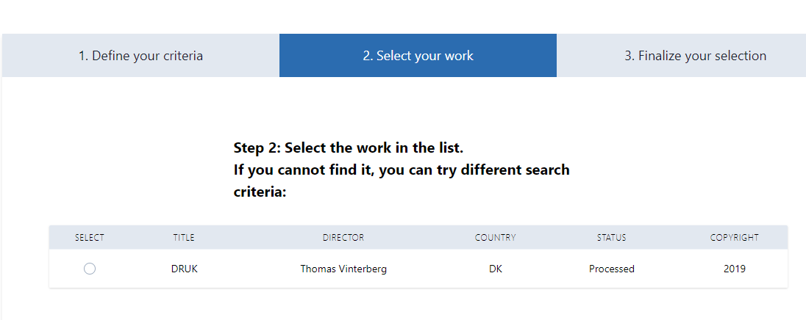
Select the film in the list

Slide 24
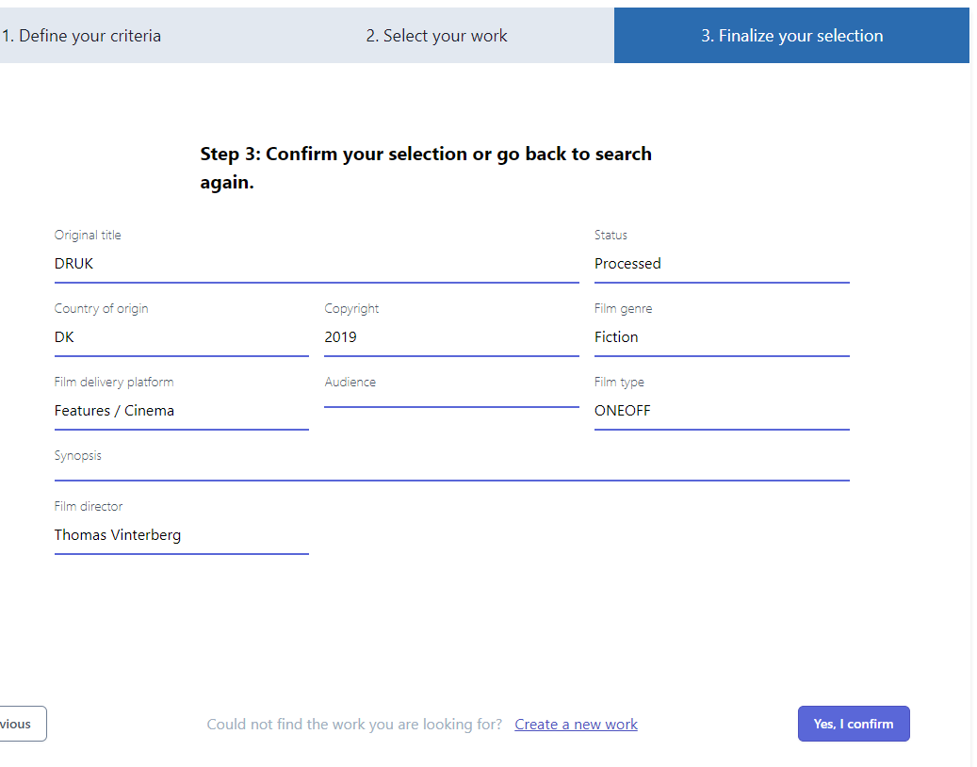
Confirm your selection

Slide 25
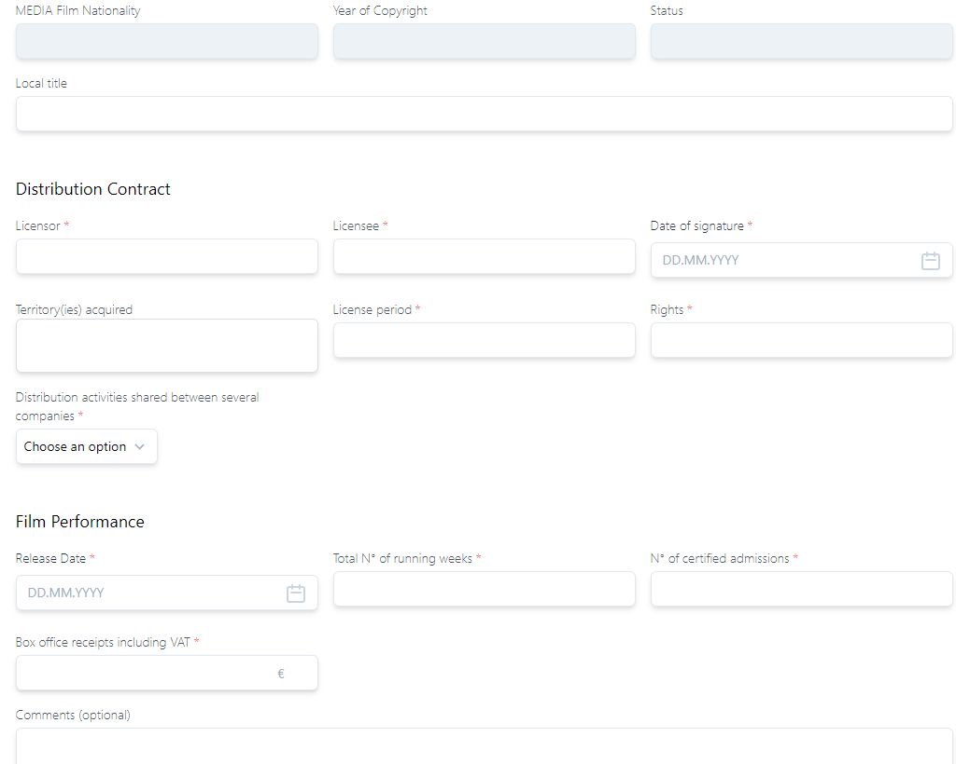
Complete all the fields for your selected film

Slide 26
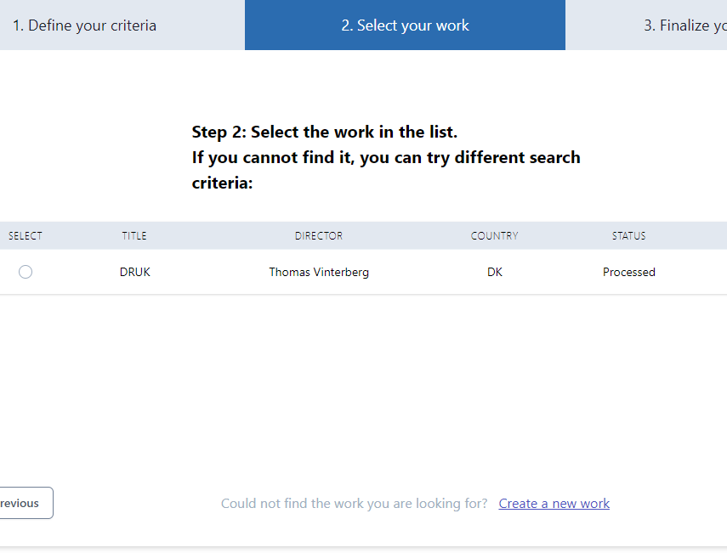
Add new films to the DB yourself by clicking on ‘Create a new work’

Slide 27
Fiction | Points | Documentary | Points | Animation | Points
Director | 3 | Director | 3 | Director | 3
Author/(Script)writer | 3 | Author/(Script)writer | 3 | Author/(Script)writer | 3
Actor 1 | 2 | Composer | 1 | Composer | 1
Actor 2 | 2 | Production Designer | 1 | Editor | 1
Actor 3 | 2 | Director of Photography | 1 | Sound | 1
Composer | 1 | Editor | 1 | Storyboard Artist | 2
Production Designer | 1 | Sound | 1 | Character Designer | 2
Director of Photography | 1 | Shooting Location | 1 | Animation Supervisor | 2
Editor | 1 | Post Production Location | 1 | Art(istic) Director | 1
Sound | 1 |  |  | Technical Director | 1
Shooting Location | 1 |  |  | Post Production Location | 1
Post Production Location | 1 |  |  | Studio Location | 1
TOTAL | 19 |  | 13 |  | 19
Notes:
Change in the allocation of points compared to Automatic

Slide 28
Selecting films with different status
‘Processed’ = the film has been reviewed, the nationality has been attributed. Before selecting, always check if country of origins and the copyright year is eligible for the Call. ‘Processed’ status ≠ eligible for your particular Call!
‘Criteria not met’ = the film has been reviewed and declared as ineligible.
‘Submitted’ and ‘Under processing’ = the film has been submitted for review but not yet validated. In order to select this film, please insert ‘Estimated nationality’ to generate the potential fund.
‘Missing information’ = the film was submitted for review in the past, but was missing elements. In order to select this film, please insert ‘Estimated nationality’ to generate the potential fund. You will be contacted by EACEA staff to provide the missing information.

Slide 29
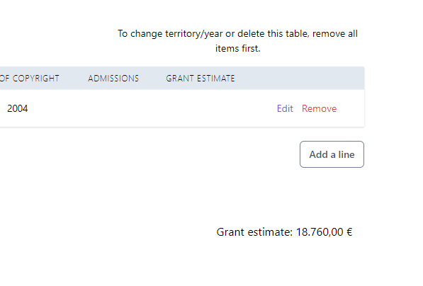
After encoding all films, the system estimates your total (estimated!) grant for 2020-2021

Slide 30

Important
Repeat for each film for which you are declaring admissions for each year and/or territory
All admissions in 2020 and 2021 must be certified by the national authority for the territory concerned
Always select your year and territory first

Slide 31

Part 2:
Eligible admissions achieved in 2018 and 2019
Admissions declared and approved in calls 27/2018 and/or 22/2019
50% of the average of all eligible admissions multiplied by the relevant co-efficient

Slide 32
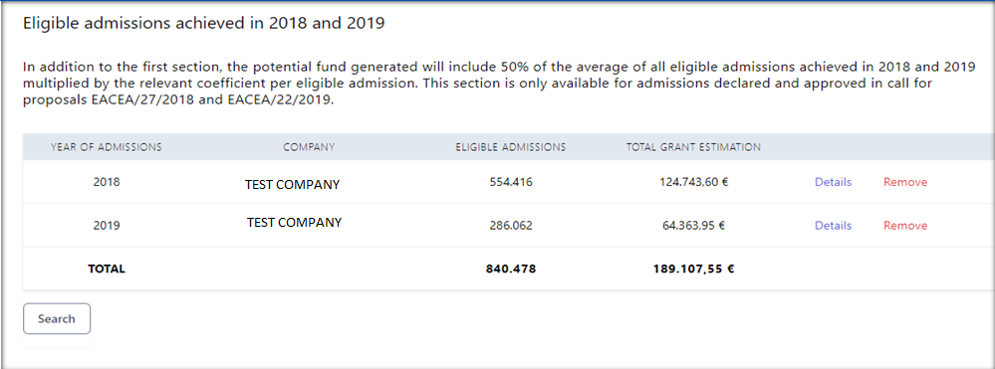
Search using
- your PIC number or
- company name

Slide 33
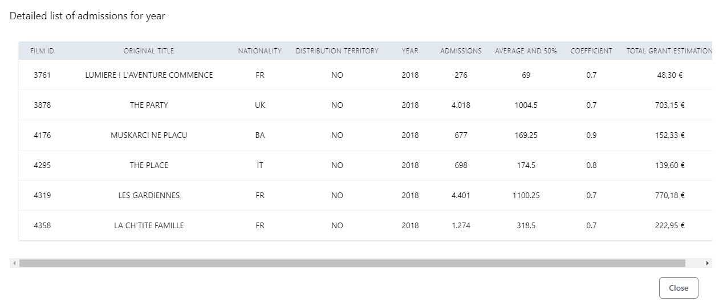
Click on ‘Details’ to see the list of films and calculation

Slide 34
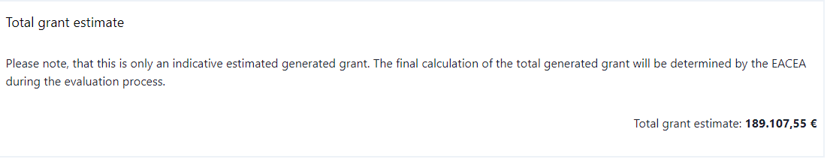
Once you have completed all these steps
The system gives you a total generated fund estimate
Save and export your dossier as a pdf document
Indicate your Total fund estimate as Purchase costs: other works, goods and services in the ‘budget’ section of the proposal
Add your pdf dossier to your annexes

Slide 35
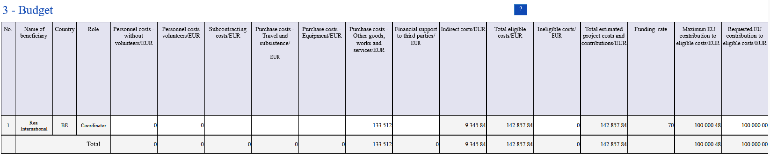
Budget table – indicate your estimated fund ONLY
2. Make sure this corresponds to the estimated grant (=potential fund) from the
MEDIA DB
NB: You should only fill in column C3! This is an amount allowing you to get the estimated grant calculated in the MEDIA DB
MANUAL FORMULA: estimated grant from MEDIA DB * 1,33512
Calculated automatically
Notes:
Budget is both in part A and B – make sure it is consistent!
Some parts are automatically calculated by the system
Please add the amount of costs (generated fund) calculated by the database (swap colour of column L and M)

Slide 36
Questions?
Please use the chat function
Notes:
Reminder – stop recording

Slide 37
Key features
Structure of the call + Q&A
MEDIA database and how generate your admissions + Q&A
Introduction to the submission system in e-Grants + Q&A
Tips for proposal preparation
Notes:
Practical arrangements: please ask your questions only in the Webex chat, we will reply to them and to oral questions at the end of this presentation.
We will record the presentation, but not the Q&A session for privacy reasons.
The recording and the slides will be available on the website of the Education Audiovisual and Culture Executive Agency.
Also, please mute your microphone and deactivate your camera during the presentation.

Slide 38
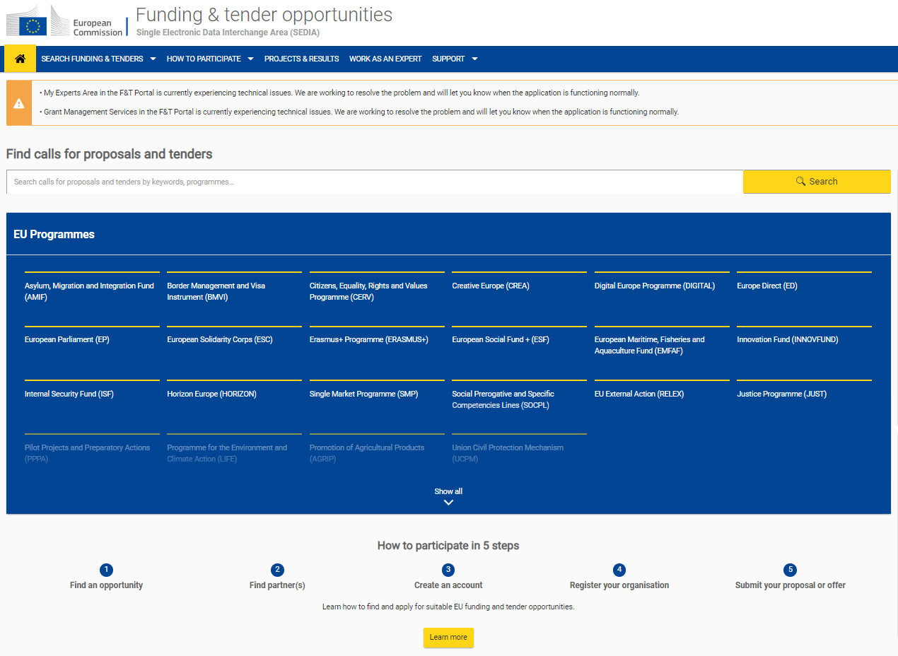

Funding and Tender Opportunities Portal
All MEDIA call for proposals are published in Funding & tender opportunities Portal (F&TP)
Notes:
Find FTOP via the EACEA website or just Google “funding and tenders”
Let’s follow the link and see a step by step

Slide 39
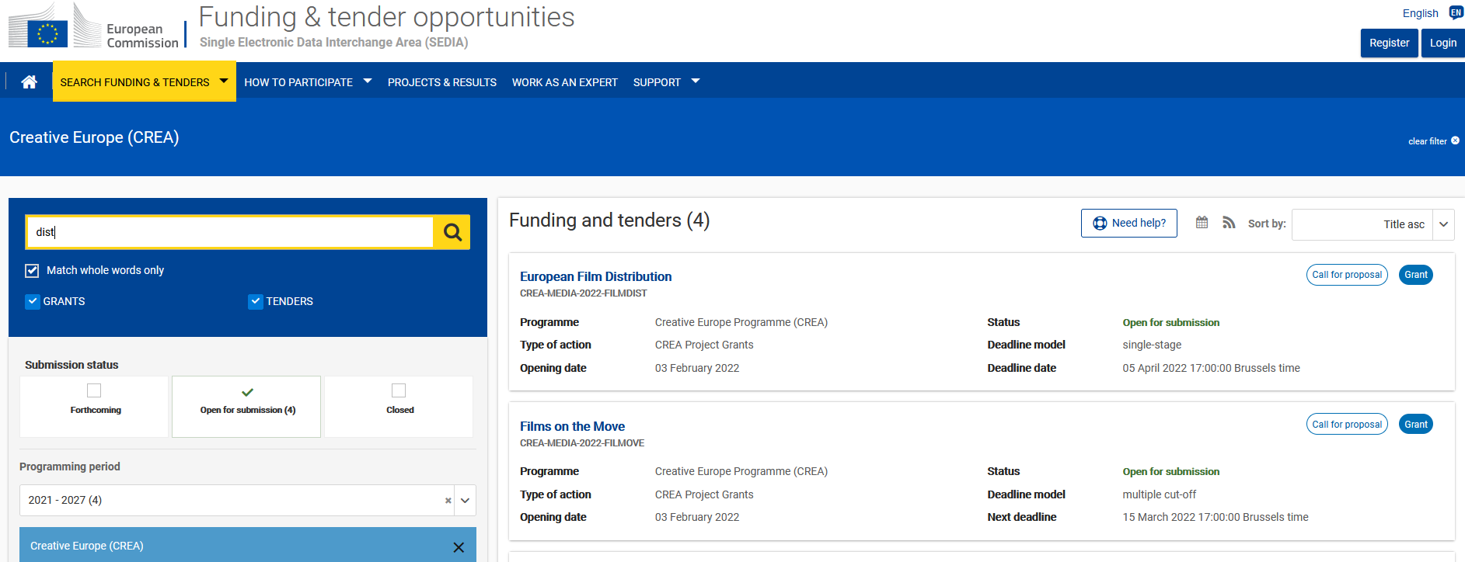
Funding and Tender Opportunities Portal
Find European Film Distribution call
Notes:
Make sure all filters are correctly chosen (status, programming period…)

Slide 40
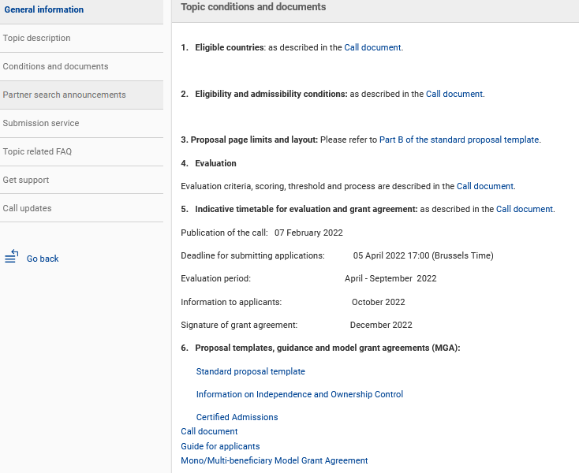
Funding and Tender Opportunities Portal
European Film Distribution call page
Notes:
All parts of the proposal can be found both in the call page in FTOP and in the submission page

Slide 41
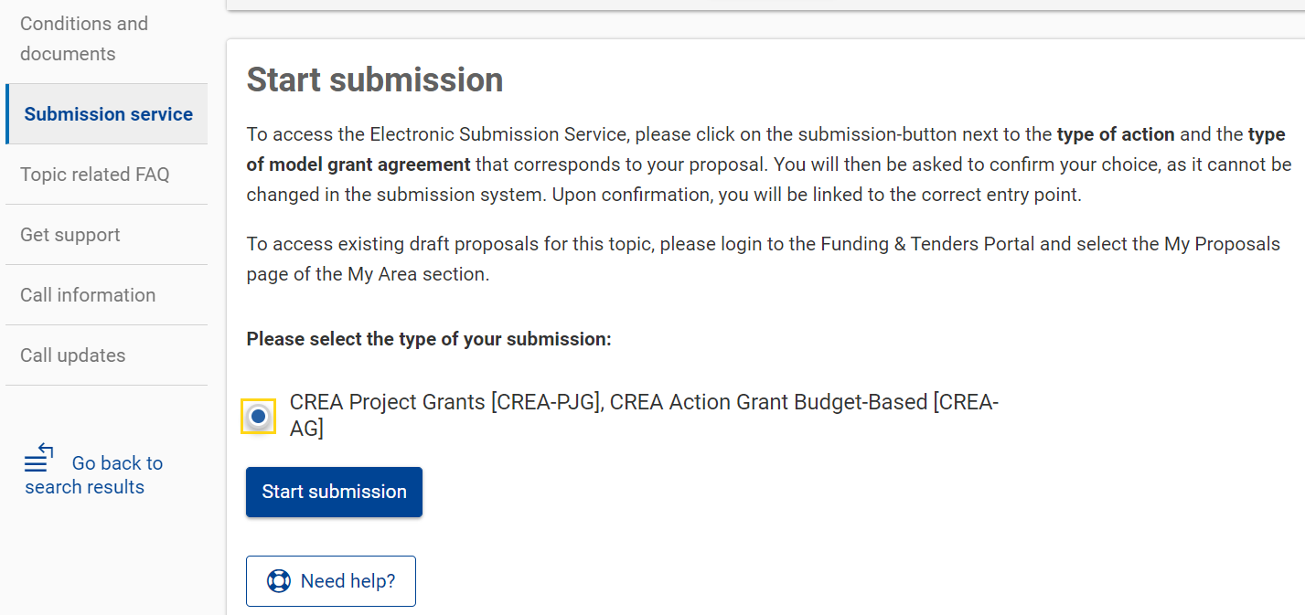
Funding and Tender Opportunities Portal
Start submission
Notes:
After selecting a call for proposal, you can start the electronic submission

Slide 42
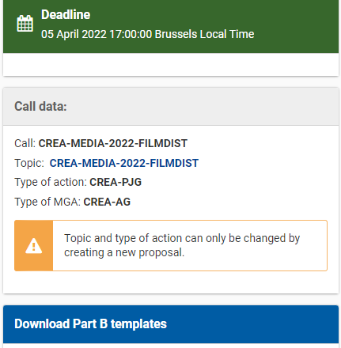
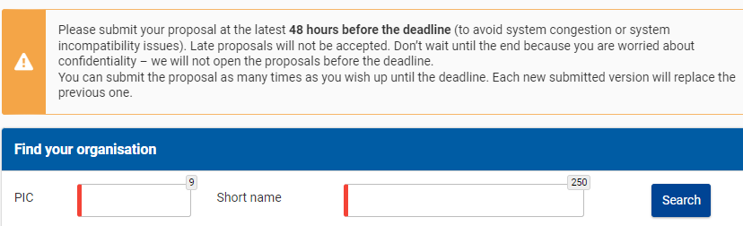
Funding and Tender Opportunities Portal
Submission system – find your organisation
Notes:
Before you can access the submission system and start your submission there are two prerequisites:
The coordinator of the project, have a valid EU Login
The coordinator’s Organization has a 9-digit PIC (Participant Identification Code)

Slide 43
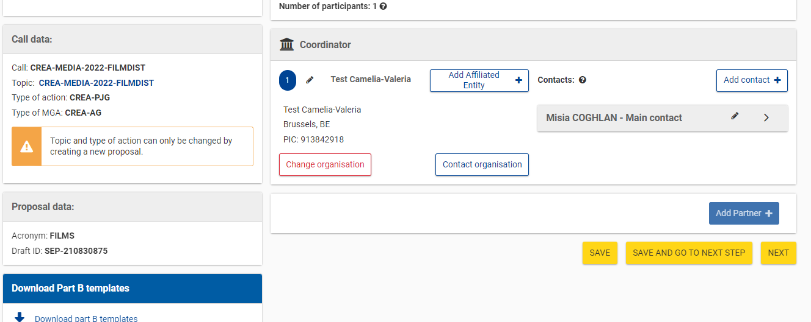
Funding and Tender Opportunities Portal
Submission system – Add main contact and contact persons
Notes:
Monobeneficiary action, therefore partners are not possible, the function ‘add partner’ is disabled
We suggest to add as many contact persons as possible, as they will have the chance to edit the proposal.
These do not correspond to the legal representatives that will be defined during the contract signature process
Download templates from here or the call page!

Slide 44
Funding and Tender Opportunities Portal
Submission system – complete all parts of the proposal
Notes:
Be familiar with the different parts of the proposal!
A (administrative forms)
B (Description of Action, max 70 pp -> excess pages will be blanked out)
C (Statistics to be filled online)
Certified admissions: download excel from submission page or from call page in FTOP, upload in .pdf
Info on independence and ownership and control: download excel from submission page or from call page in FTOP, upload in excel
MAKE SURE ALL DOCUMENTS UPLOADED AND SUBMITTED ARE READABLE (check print preview)

Slide 45
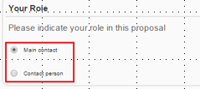
Submission system
Part A - administrative form
Who Can Fill in the proposal?
Click to access the administrative forms.
Main Contact (only one): the only person who can finalise the forms, including the budget table and all other administrative details.
Contact Person (optional, one or more): may fill in or review parts of the proposal. Main Contact can grant each Contact Person full access rights or read-only access to the forms data.
Notes:
What You Need to Know about Completing the Form
The main contact can be whoever, and does not have to be the legal signatory
Specific page on roles

Slide 46
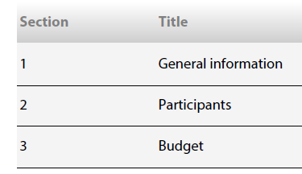
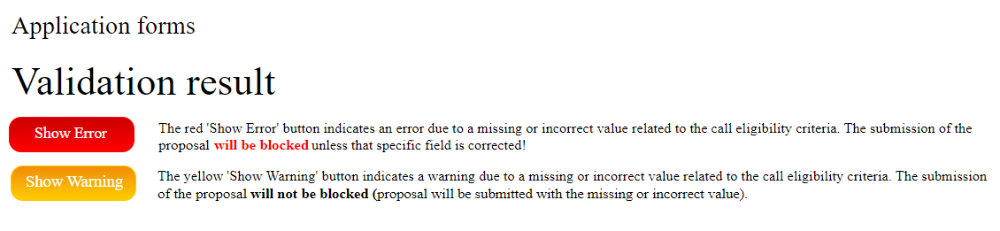
Part A – Administrative Forms
Validate each section regularly!

Slide 47
Part A – Administrative Forms
Budget – indicate ONLY your costs and estimated grant
2. Make sure this corresponds to the estimated grant (=potential fund) from the
MEDIA DB
NB: You should only fill in column C3! This is an amount allowing you to get the estimated grant calculated in the MEDIA DB
MANUAL FORMULA: estimated grant from MEDIA DB * 1,33512
Calculated automatically
Notes:
As also indicated in the call document, only one cost category is eligible for this call
Zoom out to see all columns on the right (incl. income, contributions, own resources) that should lead to a balanced budget where total estimated project income should be equal to project costs
Some parts are automatically calculated by the system
Please add the amount of costs (generated fund) calculated by the Media database
Do not add any other costs anywhere else

Slide 48
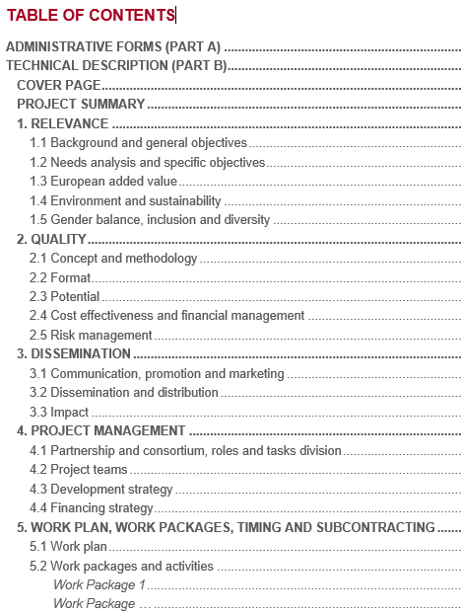


Part B
Description of Action
NB: Only three sections to be completed
Indicate the project team
Indicate only ONE work package to cover the whole reinvestment activity for the project
Notes:
Section 5 is a considerable novelty for those who already sent a proposal in past selection processes,

Slide 49
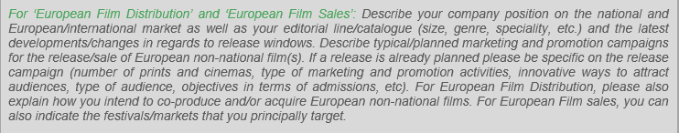
Part B - Description Of Action
Section 1.1: Only one question to be answered:
Pay attention to instructions in green: all other explanations starting with “n/a” do not concern this action
for example:
Delete instructions not relevant to this action

Slide 50
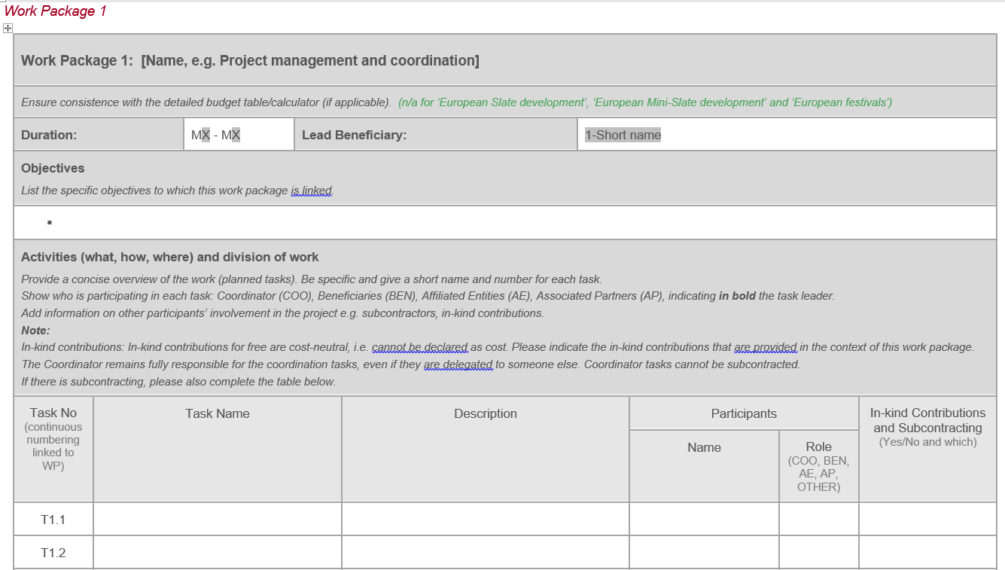
Part B - Description Of Action
Only 1 Work package
Reinvestment activities for the project
3 Tasks (1 per reinvestment activity)
Investment in co-production
Investment in acquisition of distribution rights
Promotion, marketing and advertising
Notes:
Fill in only previous section and this one
Don’t fill in anything else
No milestones / deliverables

Slide 51
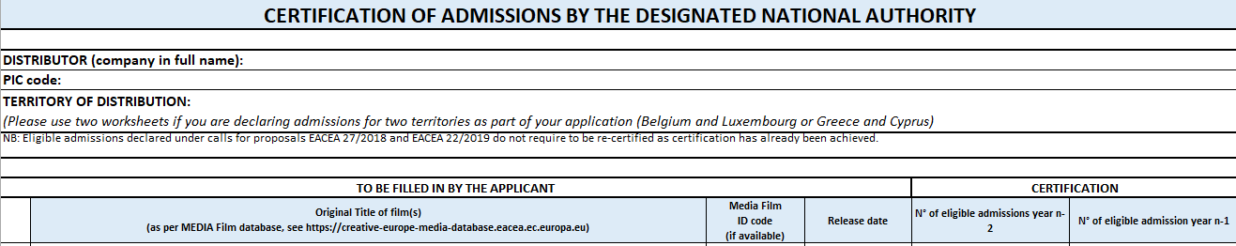
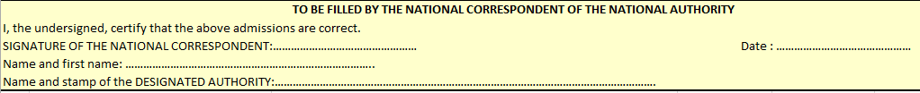
Certification of admissions
notfund
Download the excel
fill in admission numbers for 2020/21
have it signed and stamped by the national authority (yellow box at the bottom)
convert it to pdf to upload as an annex
Fill in (ONLY!) 2 COLUMNS:
2020 eligible admissions (n-2)
2021 eligible admissions (n-1)
Do not add info for 2018 / 2019 admissions!
Notes:
Certified admissions: download excel from submission page or from call page in FTOP, upload in .pdf

Slide 52
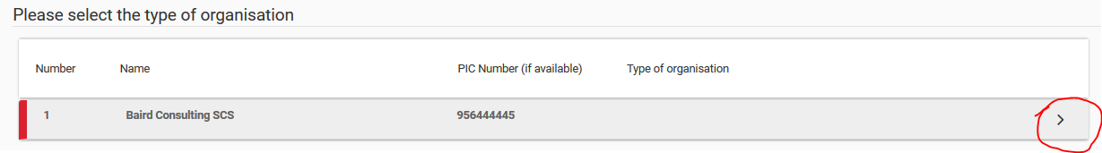
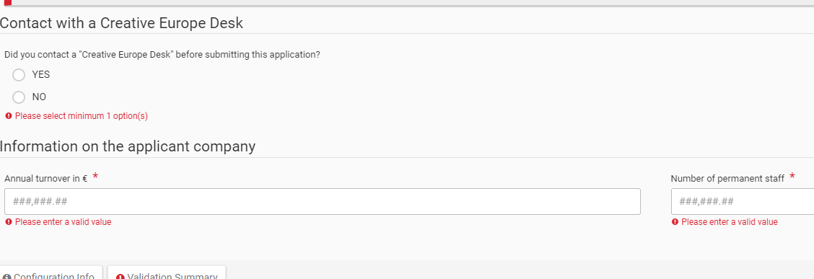
Part C Statistical data (online)
Click on the arrow to be able to select the type of organisation (otherwise the form cannot be saved)
Notes:
B Description of Action download word template and upload .pdf

Slide 53
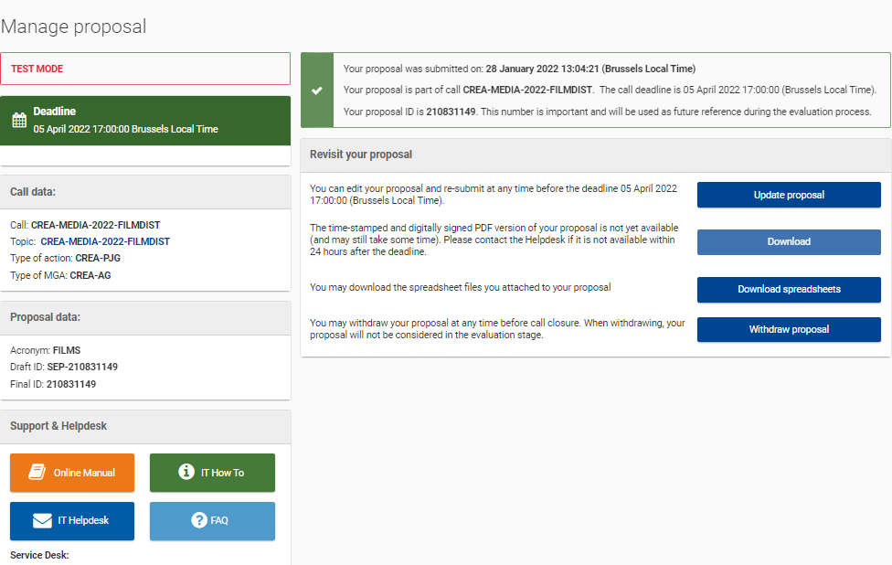
After submission, your proposal is sent to the EU services for evaluation
Notes:
before the call deadline:
You can still edit the proposal as much as you want -> don’t create duplicates!
You can also withdraw it
Download it to make sure it corresponds to what you intended to submit

Slide 54

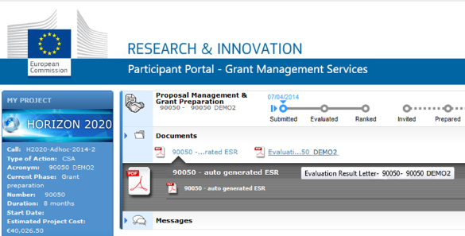
After the finalisation of the evaluation, applicants will receive the Evaluation Result Letter with the Maximum accepted Grant Amount
You can find and download your Evaluation Result Letter in “My project area”
Notifications sent by email to main and contact persons listed in proposal
Successful applicants start Grant
Agreement Preparation in
Grant Management system
What’s next after submission?
Notes:
Grant Management system will be used to cover implementation of the project, including reporting

Slide 55
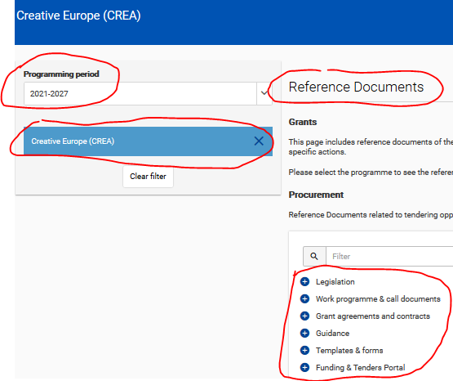
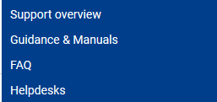
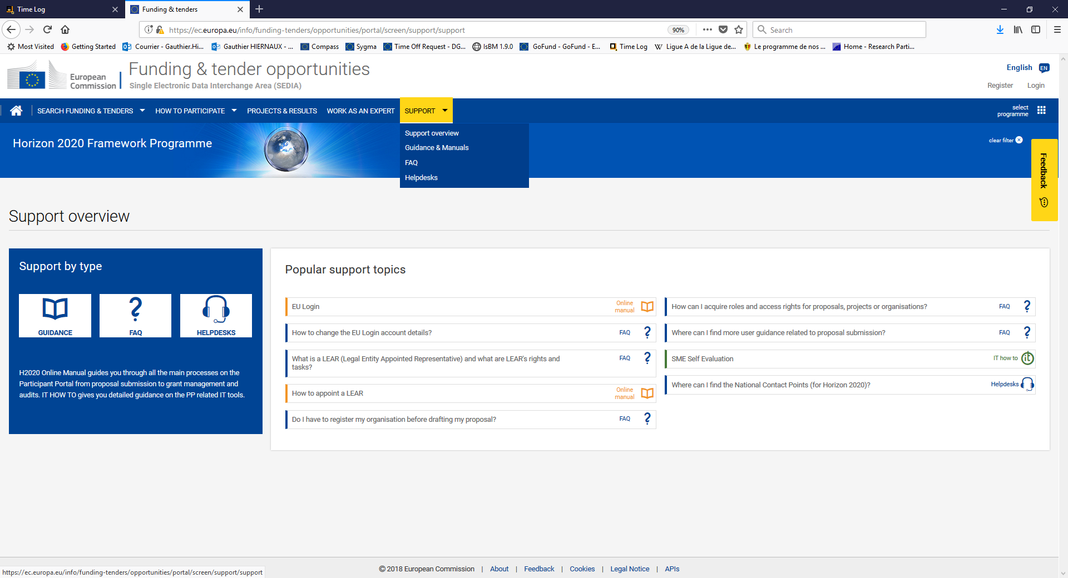
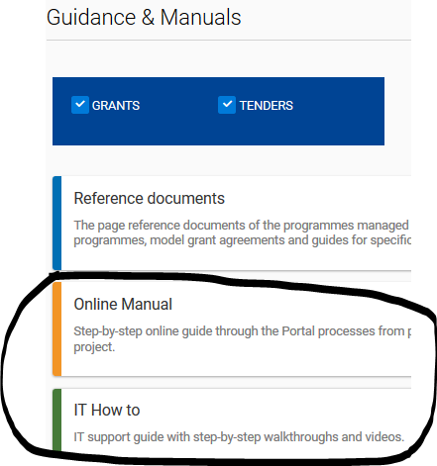
Support:
IT, FAQ and rules
Notes:
Guidance and manuals
Reference documents: can be filtered by Programme
FAQ
Type your keywords or question, or
Filter by
Category
Programme
Helpdesks:
IT How to
Europe Direct (any questions about EU and its programmes)
Participant Validation Service

Slide 56
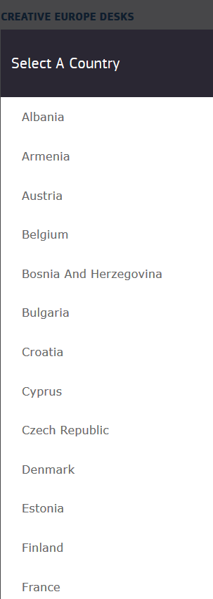
Creative Europe Desks
Your gateway to the Creative Europe Programme
https://ec.europa.eu/programmes/creative-europe/contact_en
Help to develop your project, prepare your application and build partnerships.
The Desks provide these services:
Free information and guidance on how to access funding opportunities under the Creative Europe Programme;
Regular updates on European audiovisual and culture issues;
Networking support facilitating contact between cultural operators in different countries and partner finding;
Targeted info days, workshops, seminars;
Informative websites with all the latest news.
Notes:
Select a country to find their contact details

Slide 57
Questions?
Please use the chat function
Notes:
Stop recording

Slide 58
Key features
Structure of the call + Q&A
MEDIA database - how generate your admissions + Q&A
Introduction to the submission system in e-Grants + Q&A
Tips for proposal preparation
Notes:
Practical arrangements: please ask your questions in the Webex chat, we will reply to them and to oral questions at the end of this presentation.
We will record the presentation, but not the Q&A session for privacy reasons.
The recording and the slides will be available on the website of the Education Audiovisual and Culture Executive Agency. The link to this page is also available through the Funding and Tender Portal news page.
Also, please mute your microphone and deactivate your camera during the presentation.

Slide 59

Tips for proposal preparation (1)
Get familiar with:
the submission Wizard, online manual and IT helpdesk
the structure of the application form
the templates to be filled in (part B, annexes, part C…)
Submit proposals well in advance before call closure.
You can resubmit your proposal as needed until the closure of the call.
Once the Call is closed, the last submitted version will be evaluated

Slide 60
Tips for proposal preparation (2)
One PIC number = one application even if you cover more than one territory (NB: the national authority still has to certify your admissions for each country separately)
Certification of admissions – single annex, separate worksheets per national authority (upload as pdf)
The annex called ‘Info on Independence and Ownership/Control’ is the former ‘shareholding attestation’ annex (upload in excel format)
You need to re-name your annexes (remove brackets) before uploading

Slide 61
Tips for proposal preparation (3)
Budget
Use budget category ‘purchase costs – other goods, works and services’ only
Indirect costs (7%) added automatically to your costs
‘Requested EU contribution’ = estimated grant in MEDIA DB
Calculate the amount corresponding to 70% of direct + indirect costs to match your requested EU contribution
Determine the amount of direct costs in light of this

Slide 62
Tips for proposal preparation (4)
Part B: technical description
project summary = abstract (part A)
parts 1 – 4 = two questions to answer (leave the rest blank) – 1.1 background & general objectives and 4.2 project team
work plan & work packages = only one WP (corresponding to the ‘reinvestment strategy’)

Slide 63
Tips for proposal preparation (5)
MEDIA database
Study eligibility criteria to ensure maximum accuracy of estimated grant (copyright year, nationality of film, etc.)
Ensure that year and territory are filled in before adding films
‘Edit’ available even after ‘submission’

Slide 64


Thank you for your attention!
Contact: for questions about the call
EACEA-FILM-DISTRIBUTION@ec.europa.eu for questions about the MEDIA database
EACEA-MEDIA-DB@ec.europa.eu for IT support https://ec.europa.eu/info/funding-tenders/opportunities/portal/screen/support/helpdesks/contact-form
© European Union 2021
Unless otherwise noted the reuse of this presentation is authorised under the CC BY 4.0 license. For any use or reproduction of elements that are not owned by the EU, permission may need to be sought directly from the respective right holders.
Slide 5, 24 and 38, source: pixabay.com

