Slide 1



Erasmus + KA2
Alliances for innovation 2022
Toolkit
PART B – Technical description of the project
© European Union, 2021 (CC BY-NC-ND 4.0) — source: iStockphoto.comn, 2016
© European Union, 2021 (CC BY-NC-ND 4.0) — source: iStockphoto.comn, 2016
© European Union, 2021 (CC BY-NC-ND 4.0) — source: iStockphoto.comn, 2016
© European Union, 2021 (CC BY-NC-ND 4.0) — source: iStockphoto.comn, 2016
© Odua Images, Rawpixel.com, Myvisuals, Africa Studio & popcorner / Shutterstock.com

Slide 2


OVERVIEW
PART A (e-form)
PART B
PART C (e-form)
Structured Administrative Forms with data on:
Participants
Legal declarations
Contact persons
Programme priorities
Requested grant
Technical description of the project
Select:
Erasmus+ Type of organisations
Only LOT 2 Industrial ecosystems
EQF levels
Partnership composition (type of organisations linked to eligibility)
Estimated budget of the proposal
HOW TO FILL IT IN?
HOW TO FILL IT IN?
CLICK HERE
CLICK HERE
NOT POSSIBLE TO SUBMIT THE APPLICATION WITHOUT FILLING IN THE PART A and C and ATTACHING PART B DOCUMENTS TO THE E-FORM!

Slide 3
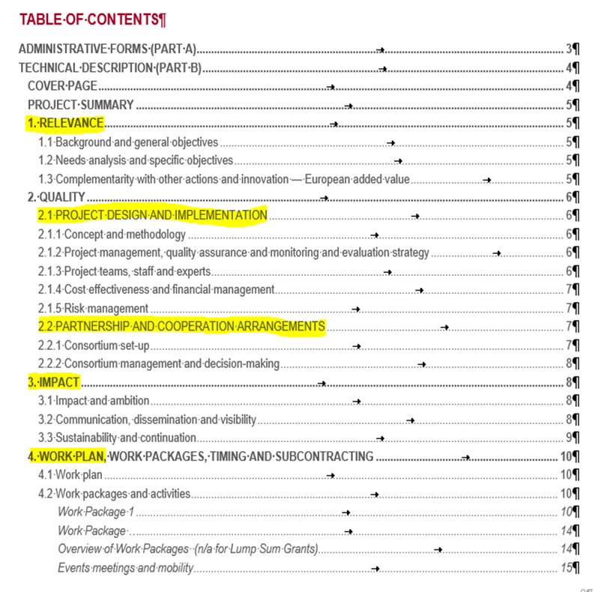
PART B – Technical description of the project
Template to be downloaded by the applicant in the submission system
Completed form to be uploaded in pdf format
Follow the instructions including character and page limits (page 2 of the template)
Maximum 70 pages for LOT 1, excess pages will not be readable
Maximum 120 pages for for LOT 2, excess pages will not be readable
Includes sections corresponding to the 4 award criteria and a section on Work Plan
List of previous projects to be filled at the end of the form (only EU funded projects linked to your application)

Slide 4
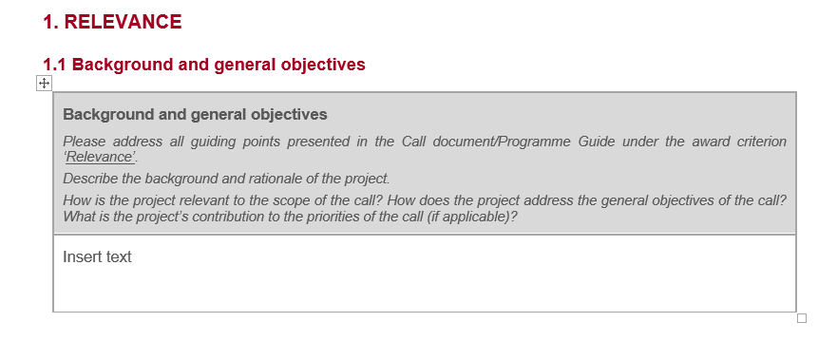
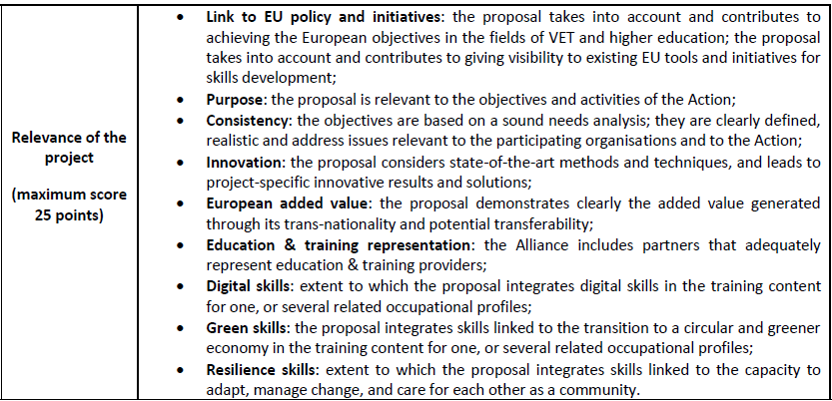
AWARD CRITERIA
1.Relevance
Application form
PART B (Technical Description of the project)
ERASMUS+ PROGRAMME GUIDE
This Award Criteria is applicable for LOT 1, for LOT 2 see Award criteria under LOT 2

Slide 5
AWARD CRITERIA
1.Relevance
Application form
PART B (Technical Description of the project)
ERASMUS+ PROGRAMME GUIDE
This Award Criteria is applicable for LOT 1, for LOT 2 see Award criteria under LOT 2

Slide 6
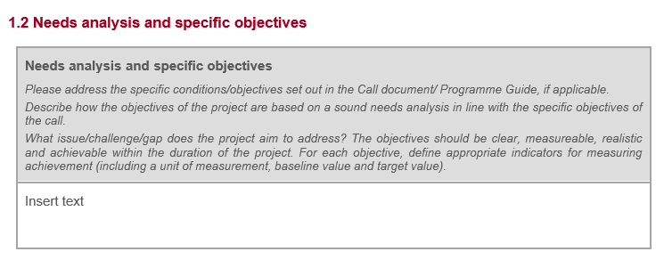
AWARD CRITERIA
1.Relevance
Application form
PART B (Technical Description of the project)
ERASMUS+ PROGRAMME GUIDE
This Award Criteria is applicable for LOT 1, for LOT 2 see Award criteria under LOT 2

Slide 7
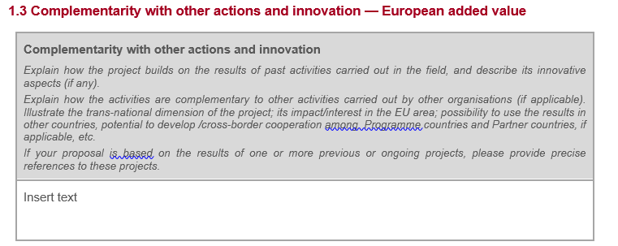
AWARD CRITERIA
1.Relevance
Application form
PART B (Technical Description of the project)
ERASMUS+ PROGRAMME GUIDE
This Award Criteria is applicable for LOT 1, for LOT 2 see Award criteria under LOT 2

Slide 8
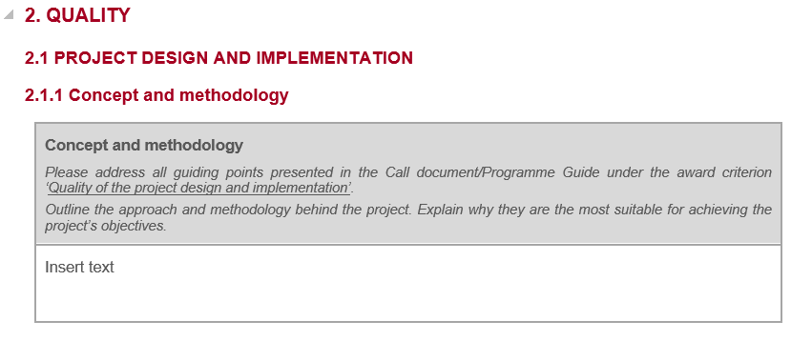
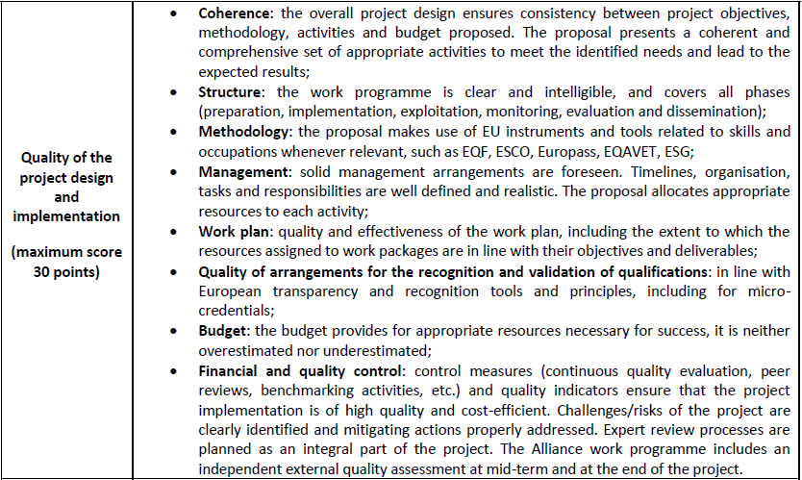
AWARD CRITERIA
2.Project design and implementation
Application form
PART B (Technical Description of the project)
ERASMUS+ PROGRAMME GUIDE
This Award Criteria is applicable for LOT 1, for LOT 2 see Award criteria under LOT 2

Slide 9
AWARD CRITERIA
2.Project design and implementation
Application form
PART B (Technical Description of the project)
ERASMUS+ PROGRAMME GUIDE
This Award Criteria is applicable for LOT 1, for LOT 2 see Award criteria under LOT 2

Slide 10
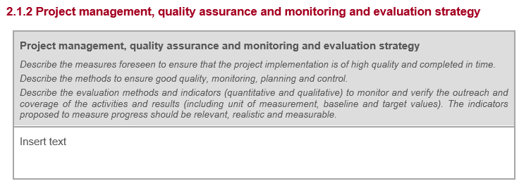
AWARD CRITERIA
2.Project design and implementation
Application form
PART B (Technical Description of the project)
ERASMUS+ PROGRAMME GUIDE
This Award Criteria is applicable for LOT 1, for LOT 2 see Award criteria under LOT 2

Slide 11
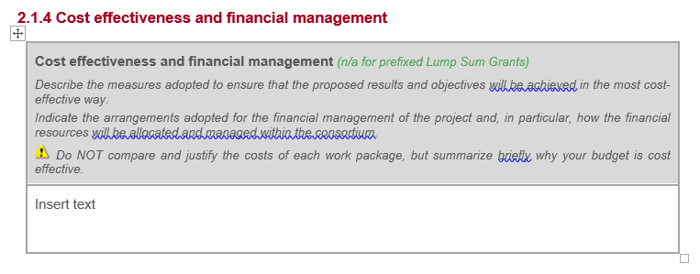
AWARD CRITERIA
2.Project design and implementation
Application form
PART B (Technical Description of the project)
ERASMUS+ PROGRAMME GUIDE
This Award Criteria is applicable for LOT 1, for LOT 2 see Award criteria under LOT 2

Slide 12
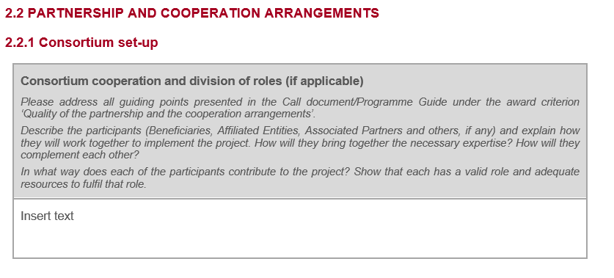
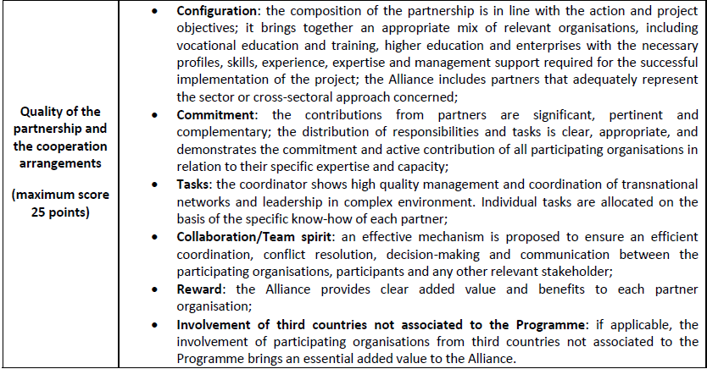
AWARD CRITERIA
3.Partnership and cooperation arrangements
Application form
PART B (Technical Description of the project)
ERASMUS+ PROGRAMME GUIDE
This Award Criteria is applicable for LOT 1, for LOT 2 see Award criteria under LOT 2

Slide 13
AWARD CRITERIA
3.Partnership and cooperation arrangements
Application form
PART B (Technical Description of the project)
ERASMUS+ PROGRAMME GUIDE
This Award Criteria is applicable for LOT 1, for LOT 2 see Award criteria under LOT 2

Slide 14
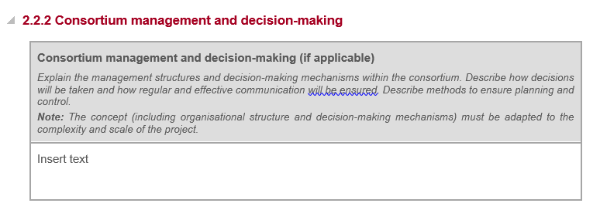
AWARD CRITERIA
3.Partnership and cooperation arrangements
Application form
PART B (Technical Description of the project)
ERASMUS+ PROGRAMME GUIDE
This Award Criteria is applicable for LOT 1, for LOT 2 see Award criteria under LOT 2

Slide 15
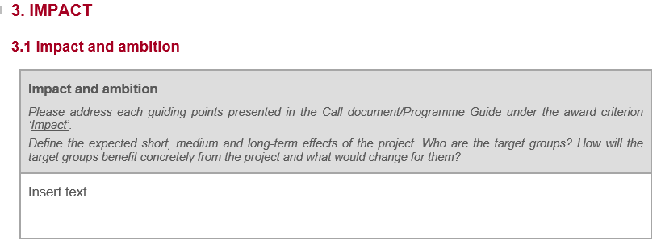
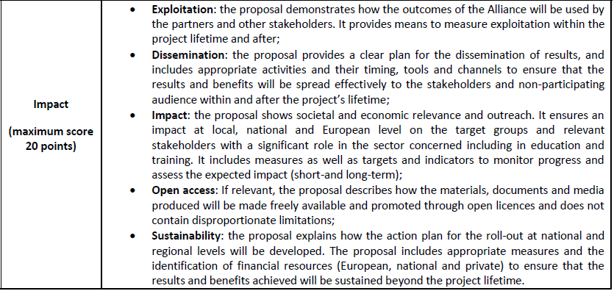
AWARD CRITERIA
4.Impact
Application form
PART B (Technical Description of the project)
ERASMUS+ PROGRAMME GUIDE
This Award Criteria is applicable for LOT 1, for LOT 2 see Award criteria under LOT 2

Slide 16
AWARD CRITERIA
4.Impact
Application form
PART B (Technical Description of the project)
ERASMUS+ PROGRAMME GUIDE
This Award Criteria is applicable for LOT 1, for LOT 2 see Award criteria under LOT 2

Slide 17
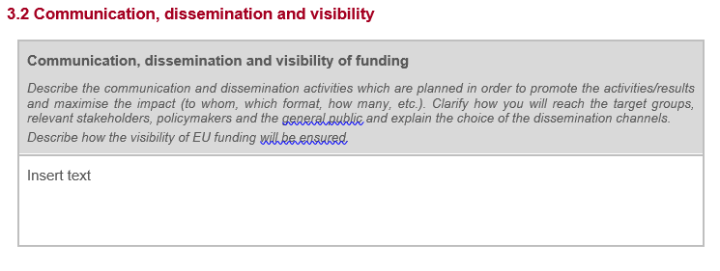
AWARD CRITERIA
4.Impact
Application form
PART B (Technical Description of the project)
ERASMUS+ PROGRAMME GUIDE
This Award Criteria is applicable for LOT 1, for LOT 2 see Award criteria under LOT 2

Slide 18
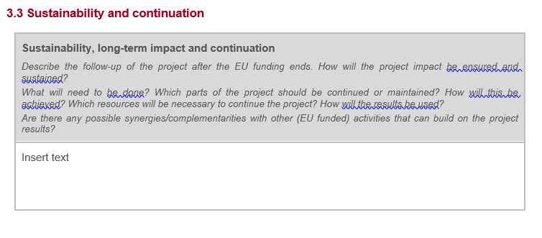
AWARD CRITERIA
4.Impact
Application form
PART B (Technical Description of the project)
ERASMUS+ PROGRAMME GUIDE
This Award Criteria is applicable for LOT 1, for LOT 2 see Award criteria under LOT 2

