Slide 1
Anja MANTHEY Project Officer European Education and Culture Executive Agency (EACEA)
Online Info-Session 10 June, 2021, 14:00 – 17:00, Brussels time #TeacherAcademies

Slide 2
Where to apply for the call Partnership for Excellence E+ Teacher Academies
European Education and Culture Executive Agency

Slide 3
Basic 4 Technical Steps for Applicant Coordinator:
4. Fill in the
e-application form & submit
3. Find your funding opportunity call on the F&TOP (Funding & Tender Opportunities Portal.
2. Ensure that applicant & partner organisations have a PIC (Participant Identification Code)
1. Applicant coordinator has to have an EU Login account (formerly ECAS)

Slide 4
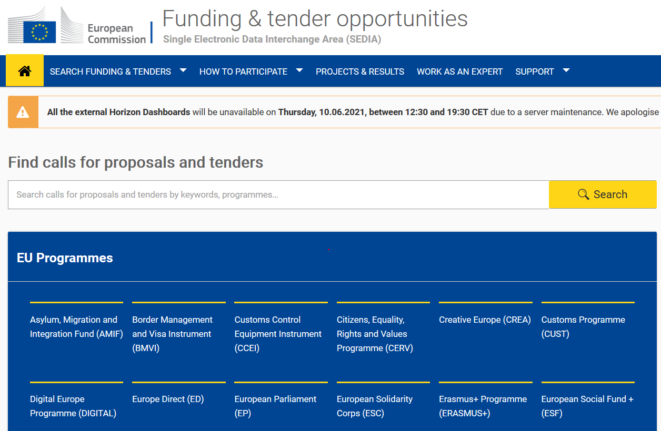
The Portal F&TOP https://ec.europa.eu/info/funding-tenders/opportunities/portal/screen/home

Slide 5
Steps 1-2
1. Applicant coordinator has to have:
EU Login account (= formerly ECAS account)
2. Organisation of applicant coordinator and partner organisations must have:
9-digit PIC (Participant Identification Code)
https://ec.europa.eu/info/funding-tenders/opportunities/portal/screen/how-to-participate/how-to-participate/1

Slide 6
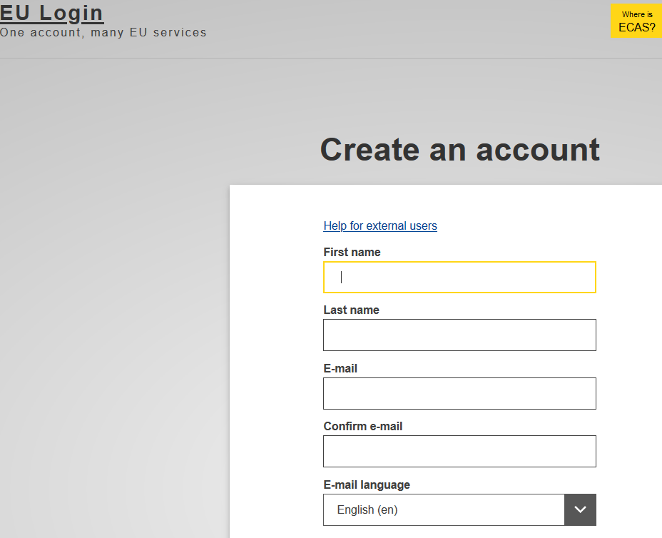
EU Login
Use or create your unique identifier for individuals with work e-mail address.

Slide 7
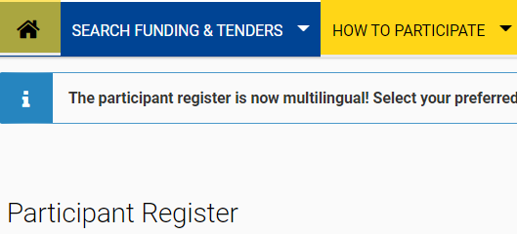
9-digit PIC = Participant Identification Code of organisation
Check & find the 9-digit PIC of the applicant coordinator‘s organisation
or
Or register your organisation for the first time to get the 9-digit PIC

Slide 8
3. Find the funding opportunity call on the F&TOP (Funding & Tender Opportunities Portal).
EACEA’s funding opportunity calls are also published on the European Commission’s
Funding & Tender Opportunities Portal (F&TP)
Funding opportunities are made available through ‘calls for proposals’.
https://ec.europa.eu/info/funding-tenders/opportunities/portal/screen/home

Slide 9
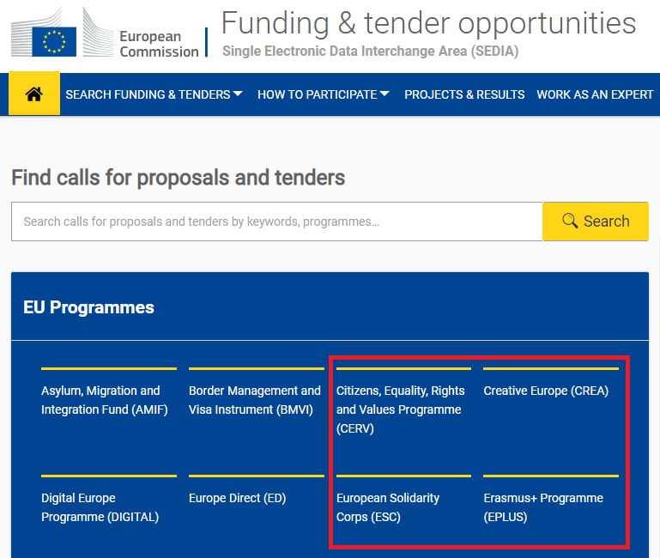
EACEA’s funding programmes
Funding programmes are subdivided by calls for proposals.
EACEA’s 4 funding programmes :
Erasmus+ Programme (EPLUS)
Creative Europe
European Solidarity Corps
Citizens, Equality, Rights and Values programme

Slide 10
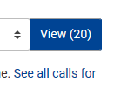
Where to find E+ Teacher Academies call
EU Programmes
Erasmus+ Programme (ERASMUS+)
Find the call:
Partnership for Excellence – Erasmus+ Teacher Academies

Slide 11
Where to find E+ Teacher Academies call
Find the call Partnership for Excellence – Erasmus+ Teacher Academies
under Erasmus+ Programme (EARSMUS+).
CLICK the call link!

Slide 12
Use of PIC
The applicant coordinator needs to enter all participating organisations’ PICs into the application form Part A:
of the applicant coordinator.
of the full partners, and
of the associate partners
Check the Online Manual for more information on the PIC
The application can be submitted without a valid PIC.
The validation of the PIC is compulsory before the signature of the Grant Agreement
A set of documents is needed to validate a PIC ➔ takes time
It is recommended to prepare in advance the documentation which will be requested for the validation of your PIC

Slide 13
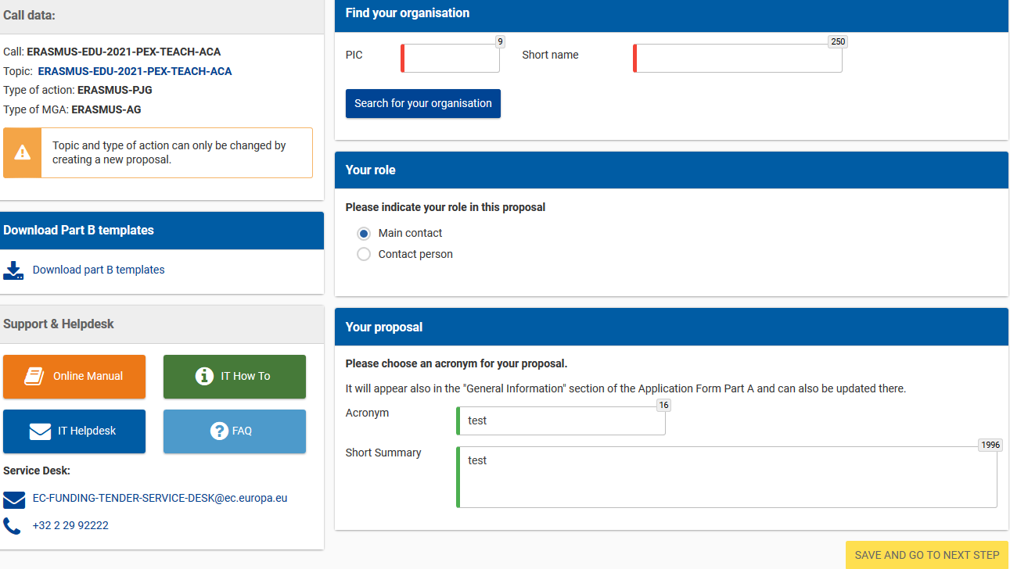
Example Start:

Slide 14
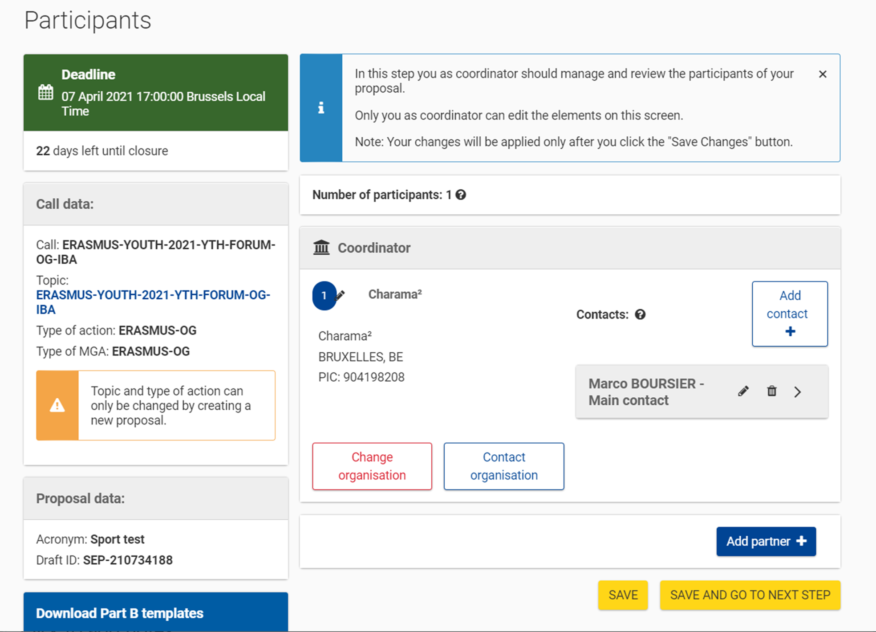
Example: adding partners
Follow the same steps as before.
Add partners by searching for them using their PIC.

Slide 15
TIPs
If in doubt, you can access support resources at any moment from the portal.
Carefully read all the information related to the call. This should give you all the information you need in order to apply.

Slide 16
Useful links
F&TP online manual: | https://webgate.ec.europa.eu/funding-tenders-opportunities/display/OM/Online+Manual
Key steps “how to participate”: | https://ec.europa.eu/info/funding-tenders/opportunities/portal/screen/how-to-participate/how-to-participate/1
F&TOP support section: | https://ec.europa.eu/info/funding-tenders/opportunities/portal/screen/support/support
EACEA website ‘How to get a grant’: | https://www.eacea.ec.europa.eu/grants/how-get-grant_en

