Slide 1

Erasmus+ Virtual Exchanges
InfoDay – 30 November 2021
How to Prepare an Application

Slide 2
Erasmus+ Virtual Exchanges
InfoDay – 30 November 2021
Róisín Mc Cabe
European Education & Culture Executive Agency

Slide 3

How to prepare an application for
Erasmus+ Virtual Exchanges 2021
European Education and Culture
Executive Agency
EACEA-EPLUS-VIRTUAL-EXCHANGES@ec.europa.eu
Notes:
Good afternoon ladies and gentleman,
The aim of this presentation is to help you prepare your application by giving you the basic information you need.
It will also give you an insight into the selection process carried out by our internal experts and the criteria they use to assess your application.
This presentation is aimed at those with no prior knowledge of EU funding processes so is quite basic but everyone is welcome to post questions in Slido that we will try and address in our Q&A sesssion at the end of the infoday.
I’ll make the presentation in English but applications are of course welcome in the official EU languages.

Slide 4

In this presentation
Introduction
Eligibility criteria
Exclusion criteria
Selection criteria
Award criteria
Application forms: A, B & C
1
2
3
4
5
Notes:
These criteria are the Eligiblity, Exclusion, Selection and Award Criteria.
We’ll also go through the application forms and part A, B and C.

Slide 5
Introduction
Timetable
Budget
Types of Partners
Notes:
First I’m going to start with a brief introduction of the basics; the timeline, budget and what types of partners can participate.

Slide 6
1
Timetable
Deadline
22 February 2022
(17:00 - Brussels time)
Information to applicants
August 2022
Start of project
November 2022
Evaluation
March – July 2022
Grant agreements signed
September – November 2022
Notes:
So as you can see, the Call deadline is on 22 February at 5pm Brussels-time.
The evaluation of proposals takes place from March to July by external experts.
Applicants will be informed in August.
Grant agreements signed between September and November which means your project if selected, can start in November 2022.

Slide 7

2
Budget
Budget based
MAX. EU GRANT PER PROJECT
500 000 €
MAX. EU CO-FINANCING
95%
Budget available
4 Mio €
Notes:
Budget based grant – based on the estimated real costs of the project. Grants are based on the reimbursement of the eligible costs which have actually been incurred by the beneficiaries for carrying out the activities in question.

Slide 8
What is the role of participating organisations
Coordinator: A participating organisation that submits the project proposal on behalf of all the partners
Full partners: Participating organisations which contribute actively to the accomplishment of the Erasmus+ Virtual Exchanges. They are listed in the financial table (budget). Nb. Called ‘applicants’ in Erasmus+ jargon even though they are not the coordinator.
Associated partners: Organisations which contribute to the activities of the Erasmus+ Virtual Exchange that for contractual management aspects are not considered to be beneficiaries. They do not receive any funding from the Programme (they do not have the right to charge any costs). They do not included in any way in the financial budget table.
Notes:
There are three different types of roles an organisation can have in a project.
- The Coordinator is the participating organisation that submits the project proposal on behalf of all the partners.
- Full partners are participating organisations which contribute actively to the accomplishment of the Erasmus+ virtual exchanges. They appear in the financial budget table and can receive part of the grant. In Erasmus+2021 jargon, they are called ‘applicants’ even though they are not the coordinator.
- Associated partners are partners from the public or private sector that contribute to the activities or support the promotion and sustainability of the project, but do not receive any funding for their participation in the project (they do not have the right to charge costs or claim contributions.). They do not appear in the financial budget table.

Slide 9
Admissibility
Deadline | 22 February, 2022 - 17:00:00 (Brussels time)
How to apply | Funding and tenders opportunities portal Call ID: ERASMUS-EDU-2021-VIRT-EXCH All parts of the application forms must be complete. A maximum of 70 pages
Notes:
Proposals must be submitted before the Call deadline. Given that it takes some time to fill in the forms, we recommend that you don’t leave it to the last day to do this.
They must be submitted via the Funding and Tenders Portal, what we call FTOP. Erik is going to take you on a tour of that later.
Your proposal must be complete. All of Part A, B and C must be filled in.
The proposal is limited to 70 pages. Additional pages appear blank in the system so we cannot read them.

Slide 10

Evaluation Criteria
4
Eligibility criteria
Exclusion criteria
Selection criteria
Award criteria
Notes:
In this next part of the presentation, we’re going to look at how your application will be assessed. These are the four criteria that are used to assess it. All of these criteria will be rigorously applied to every application received.
So you need to make sure your proposal respects these criteria when developing your project. All of these can be found in the Call document but we can go through them here.
First of all, in order to be eligible for an Erasmus+ grant, the proposals must comply with some eligibility criteria.
Secondly, an applicant will be excluded from participating if it is found to be in one of the exclusion situations described in the Programme Guide (in accordance with the Financial Regulations).
Thirdly, through the selection criteria, the Executive Agency assesses the applicant's financial and operational capacity to complete the proposed project.
Finally, the 4 award criteria allow the Executive Agency to evaluate the quality of the project proposals submitted. Proposals that pass the individual thresholds and the overall quality threshold will be considered for funding, within the limits of the available call budget.
The rest of the proposals will be unsuccessful. The full set of award criteria applying to the Erasmus+ virtual exchanges are described in Part B of the Erasmus+ Programme Guide . You can also find them under the Call specific information on the Funding and Tender Opportunities Portal.

Slide 11
Eligibility Criteria
Notes:
So lets start with the Eligibility Criteria. These are on page 11 of the Call document.
These are the first criteria we look at after the application deadline and are used to decide if an applicant is eligible to go through to the next stage of the application process.
If it appears at implementation or final report stage that these criteria have not been fulfilled, the activities may be considered ineligible with a consequent recovery of the EU grant initially awarded to the project.

Slide 12
Eligiblity Criteria: Duration
Duration: normally 3 years - 36 months when no extension is granted.
Notes:
Duration: normally 3 years (36 months) when no extension is granted.
extensions are possible, if duly justified and through an amendment

Slide 13
Eligibility Criteria: Which regions of the world can participate?
Erasmus+ Programme Countries (EU Member States + Iceland, Norway, Liechtenstein, North Macedonia, Serbia and Turkey)
Western Balkans
Eastern Neighbourhood
Southern Mediterranean
Russia (Territory of Russia as recognised by international law)
Sub-Saharan Africa
Nb. A list of the countries in these regions can be found in the Call text.
Nb. Only applicants from Erasmus+ Programme Countries can take the role of coordinator.
Notes:
The next eligibilty criteria are geographical. Which regions of the world can particiate?
These are EU regions. The precise countries in each one can be found on page 11 of the Call. Please check this carefully.
I should stress here because we are talking about virtual exchanges that organisations and activities should be based in these countries.
Every project must have Erasmus+ Programme Country partners and then partners in one other region.
Those regions include Western Balkans, Eastern Neighbourhood, Southern Mediterranean, Russia and Sub-Saharan Africa.
However, the applicant must come from an Erasmus+ Programme Country

Slide 14
Eligibility Criteria: Who can apply as Coordinator?
Public or private organisations active in the field of higher education or youth (non-formal education) in Programme Countries
Higher education institutions, associations or organisations of higher education institutions, as well as legally recognised national or international rector, teacher or student organisations, established in Programme Countries
Nb. Higher education institutions (HEIs) established in Erasmus+ Programme Countries must be holders of the ECHE certificate (Erasmus Charter for Higher Education)All partners can be involved as full partners or associated partn
Notes:
In order to be eligible as coordinator, an organisation must be;
A public or private organisation active in the field of higher education or youth based in a Programme Country.
A HEI, associations or organisations of HEIs, as well as legally recognised national or international rector, teacher or student organisations.
Any HEIs in Erasmus+ Programme Countries must hold and Erasmus Charter for Higher Education.

Slide 15
Eligibility Criteria: Who can participate as partner?
Public or private organisations active in the field of higher education or youth (non-formal education) in Programme Countries or the relevant Partner Countries
Higher education institutions, associations or organisations of higher education institutions, as well as legally recognised national or international rector, teacher or student organisations, established in Programme Countries or the relevant Partner Countries.
Nb. All partners can be full partners or associated partners.
Nb. All organisations should be legal entities. All partners can be involved as full partners or

Slide 16
Eligibility Criteria: Eligible activities
2. Online facilitated discussions between young people of youth organisations based in different countries, as part of youth projects.
3. Online facilitated discussions between students of Higher Education institutions based in different countries, as part of higher education degrees.
1. Training of youth workers to develop a virtual exchange project with colleagues in another country
4. Training for university professors/staff willing to develop a virtual exchange project with colleagues from other countries.
5. Interactive open online courses including traditional course materials such as filmed lectures, readings and problem-sets (MOOCs).
Notes:
And then we have the list of eligible activities that can be funded.
As you can see, we are looking at virtual exchanges in the broadest sense. This list can be read in detail on page 8 of the Call.

Slide 17
Eligibility Criteria: What must the partnership look like?
A minimum of 2 higher education institution from 2 or more different Erasmus+ Programme Countries
A minimum of 2 higher education institutions from 2 or more different Partner Countries within the same Erasmus+ region (except for the Russia region which only comprises of one country)
and
OR
A minimum of 2 youth organisations from 2 or more Partner Countries within the same Erasmus+ region (except for the Russia region which only comprises of one country)
A minimum of 2 youth organisations from 2 or more different Erasmus+ Programme Countries
and
The number of organisations from the Programme Countries may not be higher than the number of organisations from the Partner Countries.
Notes:
The last eligiblity critieria is the composition of the consortium. Many organisations go to all the work of preparing a proposal and trip up on this so please pay attention to this when selecting your partners.
The consortium must have a minimum of 2 HEIs from 2 or more different Erasmus + Programme countries and a minimum of 2 HEIs from 2 or more different Partner Countries within the one same region.
Or the consortium could be made up of youth organisations and have a minimum of 2 youth organisations from 2 or more different Erasmus + Programme countries and a minimum of 2 youth organisations from 2 or more different Partner Countries within the one same region.
The last rule is that the number of organisations from the Programme Countries may not be higher than the number of organisations from the Partner Countries.

Slide 18
Exclusion Criteria
Notes:
The next set of criteria are the exclusion criteria.

Slide 19

Exclusion criteria
Exclusion situations linked to legal issues
Fields to tick in application form + declaration on honour if selected
Notes:
An applicant will be excluded from participating in calls for proposals under the Erasmus+ Programme if it is found to be in one of the situations described in articles 136-141 of the Financial Regulation. These are outlined on page 15 of the Call. Eg. bankrupt, in breach of social security obligations, guilty of grave professional misconduct, having committed fraud, etc.
In part A of the Application form, you have to tick boxes declaring that you are not in one of these situations.

Slide 20
Selection Criteria
Notes:
The next set of criteria are the selection criteria.

Slide 21
Selection criteria
OPERATIONAL CAPACITY Appropriate professional competencies and qualifications | FINANCIAL CAPACITY Stable and sufficient sources of funding
Insert in Part B of application form: Description of relevant skills and experience of project staff (no CVs) List of previous and running projects | Provide upon request and upload in Funding and Tender Opportunities portal: Profit and loss account Balance sheet Other documents if requested
Does not apply to public organisations
Notes:
Through the selection criteria, the Executive Agency assesses the applicant's financial and operational capacity to complete the proposed project.
Financial capacity means that the applicant has stable and sufficient sources of funding to maintain its activity throughout the period during which the project is being carried out project and the grant is awarded and has sufficient capacity to co-fund. Financial capacity is checked after the award, during grant preparation. It does not apply to public organisations. As you can see, we use financial documents from the organization to assess this.
The operational capacity will be assessed in parallel to the ‘Quality’ award criterion which we will come to later. It is assessed on the basis of the competence and experience of the applicants and their project teams and their operational resources (human, technical and other). We use the description of relevant skills and experience of staff in part B, part 2.1.3. on Project Teams, Staf and Experts to assess this.

Slide 22
Award Criteria
Notes:
And now onto the Award Criteria. A team of external experts will use these four sets of criteria to assess your application.

Slide 23
Award criteria
Criteria | Maximum points | Threshold
Relevance of the project | 15 | 30
Quality of project design and implementation | 10 | 20
Quality of project consortium and cooperation arrangements | 10 | 20
Impact | 15 | 30
Minimum total score 60 points (out of 100 points in total)
Notes:
These four criteria are ‘relevance of the project’, ‘quality of project design and implementation’, ‘quality of project consortium and cooperation arrangements’ and ‘impact’.
To be considered for funding, applications must score at least 60 points (out of 100 points in total). For each of the four criteria,
there is a minimum threshold they must also reach for each one. Otherwise, the project is automatically deemed ineligible.
A minimum of 15 points out of 30 for the “relevance of the project” category;
A minimum of 10 points out of 20 for the “quality of the project design and implementation;”
A minimum of 10 points out of 20 for the “quality of the partnership and the cooperation arrangements;”
A minimum of 15 points out of 30 for “impact”.
You can find these on page 19 of the Call document.
So lets go through each of these four award criteria in detail.
In ex aequo cases i.e. where two projects have the same score, priority will be given to highest scores for "relevance of the project" and then “impact”.

Slide 24
Award criteria: Relevance
Relevance: relevant to the objectives of the Call
Consistency: different parts of the application consistent with each other.
Scaling up: potential for scaling up its practice(s) at different levels (e.g. local, regional, national, EU) and its transferability to different sectors
European added value: the project brings added value at EU level, through results that would not be achieved at country level alone
Notes:
Each award criteria is divided into sub-criteria. I should state here that there are no individual points for each of the sub-criteria but you should try and address as many as possible that are relevant for your proposal. There are all mentioned in detail on page 17 of the Call document.
Under ‘Relevance’
Relevance: The application is relevant to the chosen general and specific objectives of the call. The project proposal is consistent with the requirements of the call. The proposal is clearly explained.
Consistency: The different components of the application are coherent and consistent. The application is based on an adequate analysis of challenges and needs; the objectives are realistic and address issues relevant to participating organisations and the direct and indirect target groups. Evidence of the effectiveness of the proposed virtual exchange approach is provided.
Scaling up: The application demonstrates the potential for scaling up its practice(s) at different levels (e.g. local, regional, national, EU) and its transferability to different sectors. The scaling up is likely to generate impact not only at the level of the different partner organisations but also at system and/or policy level. The proposal has the potential to develop mutual trust and enhance cross-border cooperation.
European added value: The application brings added value at EU level, through results that would not be achieved at country level alone, and there is potential for transferring results to countries not involved in the project. The project outcomes have the potential to feed into relevant EU policy agendas

Slide 25
Award criteria - Quality of project design and implementation
  Strategic plan: A clear strategy based on feasibility analysis & identifies the necessary activities for testing, adapting, and/or scaling up the virtual exchange practice(s)
  Needs: Needs of different partners identified and taken into account & how these different needs will be managed.
  Structure: The work programme is clear and intelligible and covers all project phases. Indicators of achievement and means of verification have been clearly defined for each outcome.
  Management: The project management plan is sound, with adequate resources allocated to the different tasks. Budget shows cost effectiveness and value for money.
  Evaluation: Measures for monitoring deliverables (i.e. Indicators of achievement and means of verification) Learning outcomes are evaluated and recognised.
Notes:
The second of our 4 Award Criteria is Quality of Project Design and Implementation. Page 17 and 18 of the Call document.
Strategic plan: The application establishes a clear strategy, building on a feasibility analysis and identifies the necessary activities for testing, adapting, and/or scaling up the virtual exchange practice(s) in the new context of the project partnership.
Needs: The different needs of the different partners have been identified and are well taken into account. A clear concept of how these different needs will be managed has been developed. The pedagogical approach(es) chosen are also in keeping with these different needs.
Structure: The work programme is clear and intelligible and covers all project phases. Indicators of achievement and means of verification have been clearly defined for each outcome.
Management: The project management plan is sound, with adequate resources allocated to the different tasks. Effective cooperation and decision-making processes have been put in place, that are comprehensible for all stakeholders. The budget shows cost effectiveness and value for money. There is coherence between tasks, roles and financial resources allocated to partners. The financial management arrangements are clear and appropriate.
Evaluation: Specific measures for monitoring processes and deliverables (i.e. Indicators of achievement and means of verification) ensure that the project implementation is of high quality. Learning outcomes are evaluated and recognised. There is a clear quality assurance plan which also covers project management adequately. The monitoring strategy includes risk identification and a mitigating action plan.

Slide 26

Award criteria - Quality of the partnership and the cooperation arrangements
  Configuration:consortium has all the necessary skills, expertise and experience in the areas covered by the project. Adequate allocation of time and input among the partners is ensured.
  Commitment: Each participating organisation demonstrates full involvement
  Cooperation: Effective mechanisms are proposed to ensure coordination, decision-making and communication between the participating organisations, stakeholders and any other relevant party.
Notes:
Heavy information but we’re going through it in detail as each of these points is what we are asking you to address in your proposal. Our external experts who assess your proposal will be looking for evidence of these in your proposal.
The next of the 4 Award Criteria is These are all of the sub-criteria Quality of the partnership and the cooperation arrangements and it has three sub-criteria.
Configuration: The partnership is capable of ensuring full achievement of the project's objectives. The consortium has all the necessary skills, expertise and experience in the areas covered by the project. Adequate allocation of time and input among the partners. Skills and competences of the partnership are complementary.
Commitment: Each participating organisation demonstrates full involvement corresponding to its capacities and specific area of expertise.
Cooperation : Effective mechanisms are proposed to ensure coordination, decision-making and communication between the participating organisations, stakeholders and any other relevant party.

Slide 27
Award criteria - Impact
  Dissemination: A clear awareness raising, dissemination and communication strategy, plans for making any produced materials accessible through open license.
  Exploitation: the selected virtual exchange approach(es) can be successfully disseminated and/or scaled up, that it creates a wider impact and influences systemic change.
  Impact: measures are in place to ensure that the impact can be achieved and evaluated.
  Sustainability: appropriate measures and resources to ensure that the results and benefits can be sustained
Notes:
These are all of the sub-criteria for Impact:
Dissemination: A clear awareness raising, dissemination and communication strategy ensures reaching the relevant target groups, as well as the general stakeholders and the public during the lifetime of the project. This strategy includes plans for making any produced materials accessible through open licenses.
Exploitation: The application demonstrates that the selected virtual exchange approach(es) can be successfully disseminated and/or scaled up, that it creates a wider impact and influences systemic change. The exploitation approach is clearly described and the proposed measures to exploit the project results are potentially effective.
Impact: The foreseeable impact, notably for the identified target groups is clearly defined and measures are in place to ensure that the impact can be achieved and evaluated. Learning outcomes are clearly defined before each virtual exchange activity and measured after each activity, progress recorded and achievements recognised. The results of the activities are likely to be significant. The project outcomes have the potential to support long-term changes, improvements, or developments for the benefit of the target groups and systems concerned. The application also explains how the impact of learning (learning outcomes) through virtual exchange will be evaluated in order to make (data) informed recommendations to improve virtual exchange teaching & learning beyond the project.
Sustainability The application includes appropriate measures and resources to ensure that the results and benefits can be sustained beyond the project lifetime

Slide 28
Award Critieria: Tips
Be concrete in the description of your objectives and activities
Pay attention to the integration of activities and consistency with the objectives
Pay equal attention to all award criteria. Scoring below the threshold in one award criteria makes the project automatically ineligible
Quality indicators not considered
Impact often described in terms of participation in events rather than in terms of changes in knowledge, behaviour or skills
Notes:
Given of the importance of the award criteria for your proposal, some tips to bear in mind.
Be concrete in the description of your objectives and activities. There must be a direct link between the two. Thing SMART when writing these.
Pay attention to the integration of activities and consistency with the objectives
Pay equal attention to all award criteria. Scoring below the threshold in one award criteria makes the project automatically ineligible
Make sure to include quality indicators. We want to know how you are going to measure change and be able to prove that its taken place.
Impact often described in terms of participation in events rather than in terms of changes in knowledge, behaviour or skills.

Slide 29
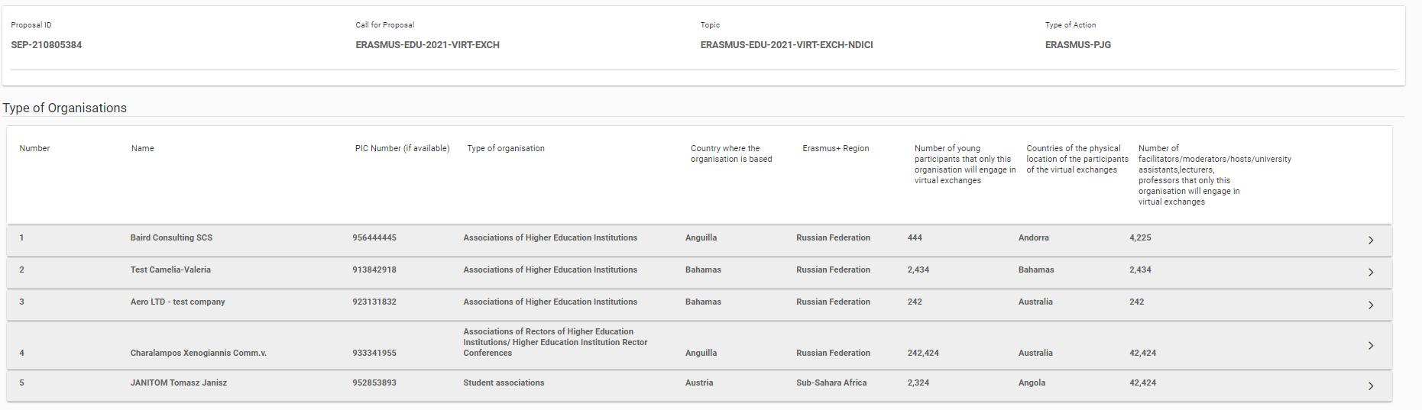
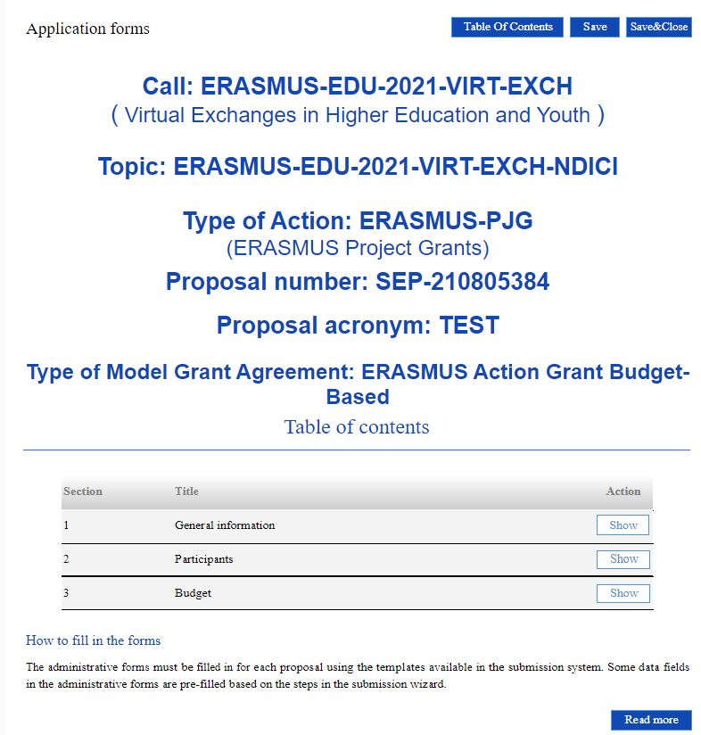
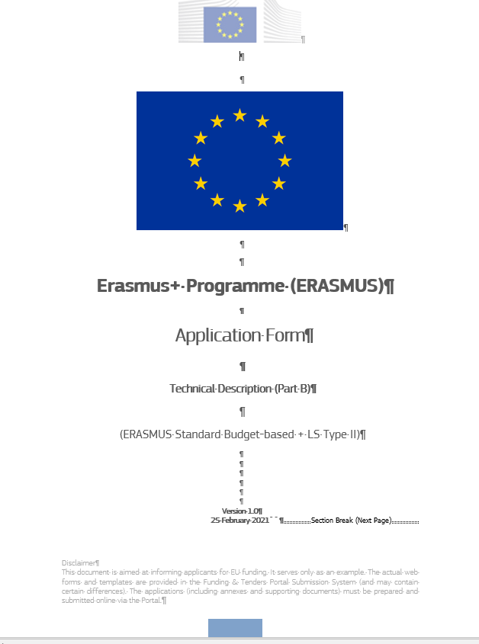
In Funding and tenders opportunities portal
5
Application forms
  eForm (Part A) – General information entered by the participants – generated by the IT system
Part B - Technical description and estimated budget of the proposal
Part C - Short annex on type of organisation
Notes:
So now we are on to the more practical part which is the actual application forms.
They are on the Funding and Tenders Portal. There are three of them.
eForm (Part A) contains general information entered by the participants.
Part B is the technical description and estimated budget of the proposal.
Part C is a short annex on type of organisation. This will be used to assess the application against the eligibility criteria as presented in the Programme Guide.

Slide 30
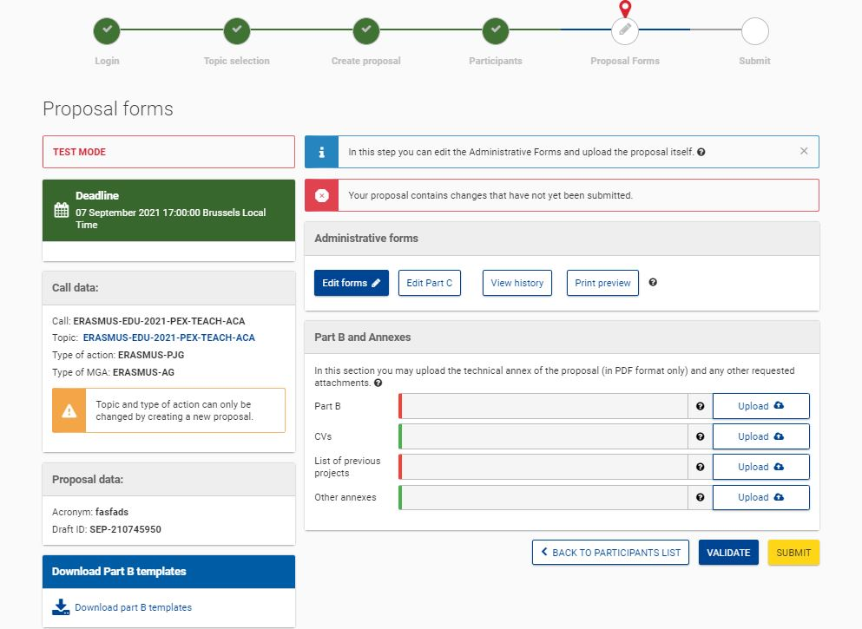
APPLICATION FORM
Overview - eForm (Part A)
Notes:
The eForm (Part A) is online. When you go into the FTOP, you click on ‘edit forms’ and part A appears.
It has to filled out online.

Slide 31
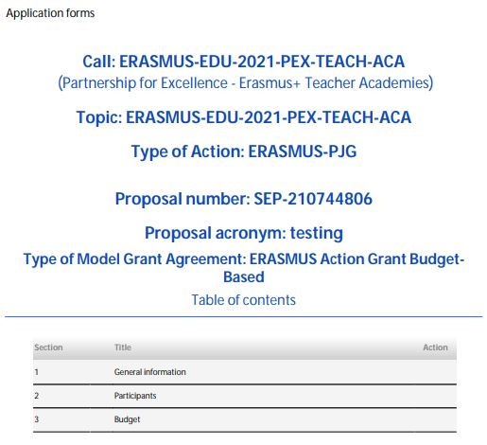
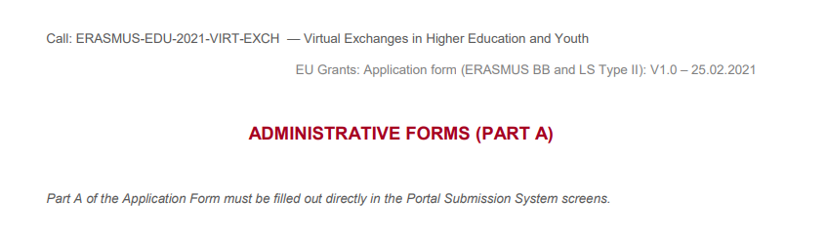
Application form
eForm (Part A)
General information – structured administrative forms with data on the participants, abstract, legal declarations and programme priorities.
Participants – list of participating organisations, organisational data and contact persons
Budget – requested grant
Notes:
3 parts to be filled in:
General information- data on the participants, abstract of your proposal, legal declarations and which programme priorities your Call corresponds to.
Participants - list of participating organisations, organisational data and contact persons
Budget – requested grant

Slide 32
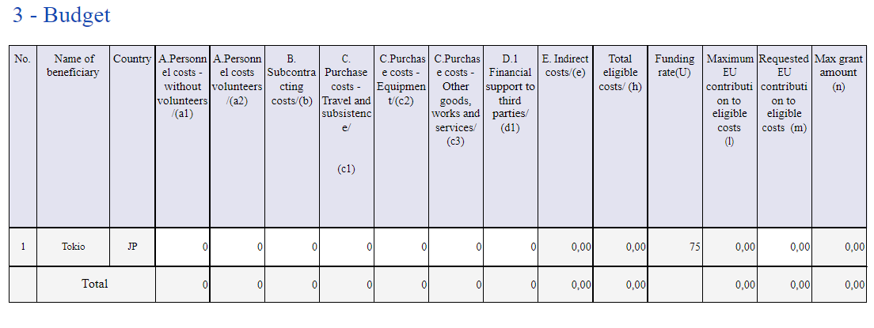
eForm (Part A)
Budget
Notes:
The budget table should be filled in with information from all full partners (co-beneficiaries), one beneficiary per line.
There are two budget tables: this online budget table in the eForm (part A) and another budget table in the application form (part B).
This online table will prevail in case of differences between Part A and B but please try and ensure the information is the same in both.

Slide 33

APPLICATION FORM
Overview – Part B
Notes:
Part B is a Word document that has to be downloaded and filled in.
Click on download Part B template. Once filled in and saved in PDF, it’s uploaded in the system.
Click on download Part B templates to download the application form in Word.

Slide 34
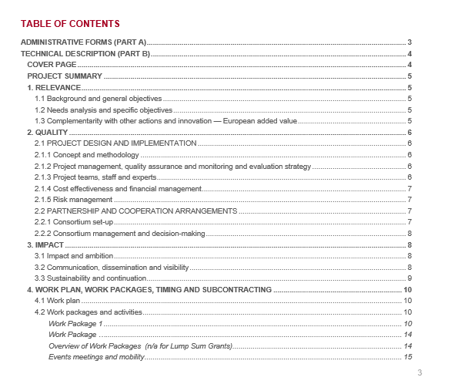
Application form
Part B – Technical Description
Template to be downloaded by the applicant in the submission system.
Completed form to be uploaded in pdf format.
Includes sections corresponding to the 4 award criteria, a section on Work Packages and the estimated budget
No CVs required but description of profiles and expertise of staff
Notes:
Part B is the technical description.
Includes sections corresponding to the 4 award criteria we mentioned, a section on Work Packages and the estimated budget
No CVs required but description of profiles and expertise of staff

Slide 35
Application form – Part B
Estimated budget — Resources (n/a for prefixed Lump Sum Grants)
Participant | Costs
 | A. Personnel |  | B. Subcontracting | C.1a Travel |  |  | C.1b Accomodation | C.1c Subsistence | C.2 Equipment | C.3 Other goods, works and services | D.1 Financial support to third parties |  | E. Indirect costs | Total costs
[name] | X person months | X EUR | X EUR | X travels | X persons travelling | X EUR | X EUR | X EUR | X EUR | X EUR | X grants | X EUR | X EUR | X EUR
[name] | X person months | X EUR | X EUR | X travels | X persons travelling | X EUR | X EUR | X EUR | X EUR | X EUR | X prizes | X EUR | X EUR | X EUR
Total | X person months | X EUR | X EUR | X travels | X persons travelling | X EUR | X EUR | X EUR | X EUR | X EUR | X grants X prizes | X EUR | X EUR | X EUR]
For certain Lump Sum Grants, see detailed budget table/calculator (annex 1 to Part B; see Portal Reference Documents).
Notes:
The is what the Estimated Budget in Part B looks like. It’s a breakdown of costs per participant.

Slide 36
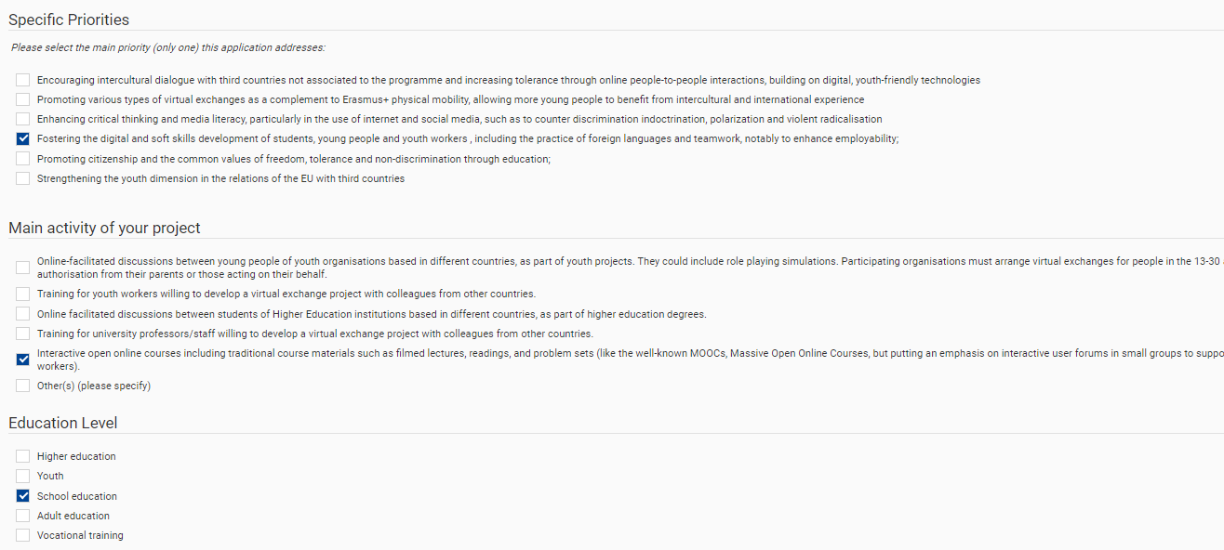
Application Form: Part C
Notes:
Part C is also an online form. This is part of what it looks like.

Slide 37
Application Form: Part C
A webpage that you open in FTOP and fill in online.
Must be filled in accurately as it will be used for statistics.
All mandatory fields must be filled in.
Nb. Countries in which activities will take place must be the same as the countries of origin of the partner organisations.
Don’t forget to ‘save’ information
Notes:
You click on it and a webpage opens. Its a tick box form.
You also have to fill in number of participants. These are used for statistics so please fill them in accurately.
A number of fields in this form are mandatory and the form will block if you don’t fill them in.
Countries in which activities will take place must be the same as the countries of origin of the partner organisations. For example an organisation based in Belgium and South Africa cannot be organising virtual exchanges for participants based in the US or even Poland, if there is no Polish partner in the project.
Here you need to ‘save’ your information.

Slide 38
Tips
There are two ‘topics’ for this Call. Make sure you fill in the correct one for the regions your partners are based in.
ERASMUS-EDU-2021-VIRT-EXCH-IPA = EU Programme Countries + Western Balkans Region
ERASMUS-EDU-2021-VIRT-EXCH-NDICI =
EU Programme Countries + Southern Mediterranean Region
or
EU Programme Countries + Eastern Neighbourhood Region
or
EU Programme Countries + Russia (Territory of Russia as recognised by International Law)
or
EU Programme Countries + Sub-Saharan Africa
Notes:
Before I conclude, some general tips from past experience of common mistakes applicants make and potential pitfalls.
There are two topics for this Call. Make sure you fill in the topic that is relevant for the region your partners are in.
IPA (which is an EU funding mechanism for the Western Balkans) is for projects with partner in the Western Balkans only.
NDICI (which is an EU funding mechanism for many other regions outside the EU) is for projects with partners between Erasmus+ Programme Countries and the
Southern Mediterranean Region
Or
Southern Mediterranean Region
Or
Russia (Territory of Russia as recognised by International Law)
Or
Sub-Saharan Africa

Slide 39
Tips
The purpose of a project is to bring about change. Your proposal needs to tell us what change you intend to bring about, how you will measure the change and how you will be able to demonstrate if you have achieved this change.
It is not required to provide a log frame matrix in annex but it’s a useful tool for you to synthesise your project concept before you start writing the proposal. It is also useful for your project management.
All partners in Partner Countries must be legally established entities that can receive funds via bank accounts. Choose your partners wisely.
Make sure you meet the partnership composition requirements.
Notes:
The purpose of a project is to bring about change. Your proposal needs to tell us what change you intend to bring about, how you will measure the change (indicators) and how you will be able to demonstrate if you have achieved this change (means of verification).
It is not required to provide a logical framework matrix in annex but many of those applying will be familiar with it from an international development context and it’s a useful tool for you to synthesise your project objectives, indicators and means of verification before you start writing the proposal. It is also useful for your project management afterwards. This cannot be uploaded and sent to us.
All partners in Partner Countries must be legally established entities that can receive funds via bank accounts. Choose your partners wisely.
Make sure you meet the partnership composition requirements.

Slide 40
Tips
A project must have participants from one sector only; youth or Higher Education
The exchanges are virtual but participants must be based in the country of origin of the partner organisation.
We have run a virtual exchange pilot project for the last three years. Have a read of the final impact report for inspiration but do not forget to innovate.
Word count is a maximum of 70 pages (FTOP limit) so please do not exceed this limit.
You will need 2 days to submit your application in eGrants so please do not wait until the last day to submit.
Notes:
Virtual exchanges can draw participants from both sectors. Depending on the specific project, they can involve participants from either only one of them or from both.
The exchanges are virtual but participants must be based in the country of origin of the partner organisation.
We have run a virtual exchange pilot project for the last three years. Have a read of the final impact report for inspiration but do not forget to innovate.
Word count is a maximum of 70 pages (FTOP limit) so please do not exceed this limit.
You will need 2 days to submit your application in eGrants so please do not wait until the last day to submit.

Slide 41

Thank you!
© European Union 2021
Unless otherwise noted the reuse of this presentation is authorised under the CC BY 4.0 license. For any use or reproduction of elements that are not owned by the EU, permission may need to be sought directly from the respective right holders.

