Slide 1

Erasmus+ Virtual Exchanges
InfoDay – 30 November 2021

Slide 2


Slide 3

Erasmus+ Virtual Exchanges
InfoDay – 30 November 2021

Slide 4

Agenda

Slide 5
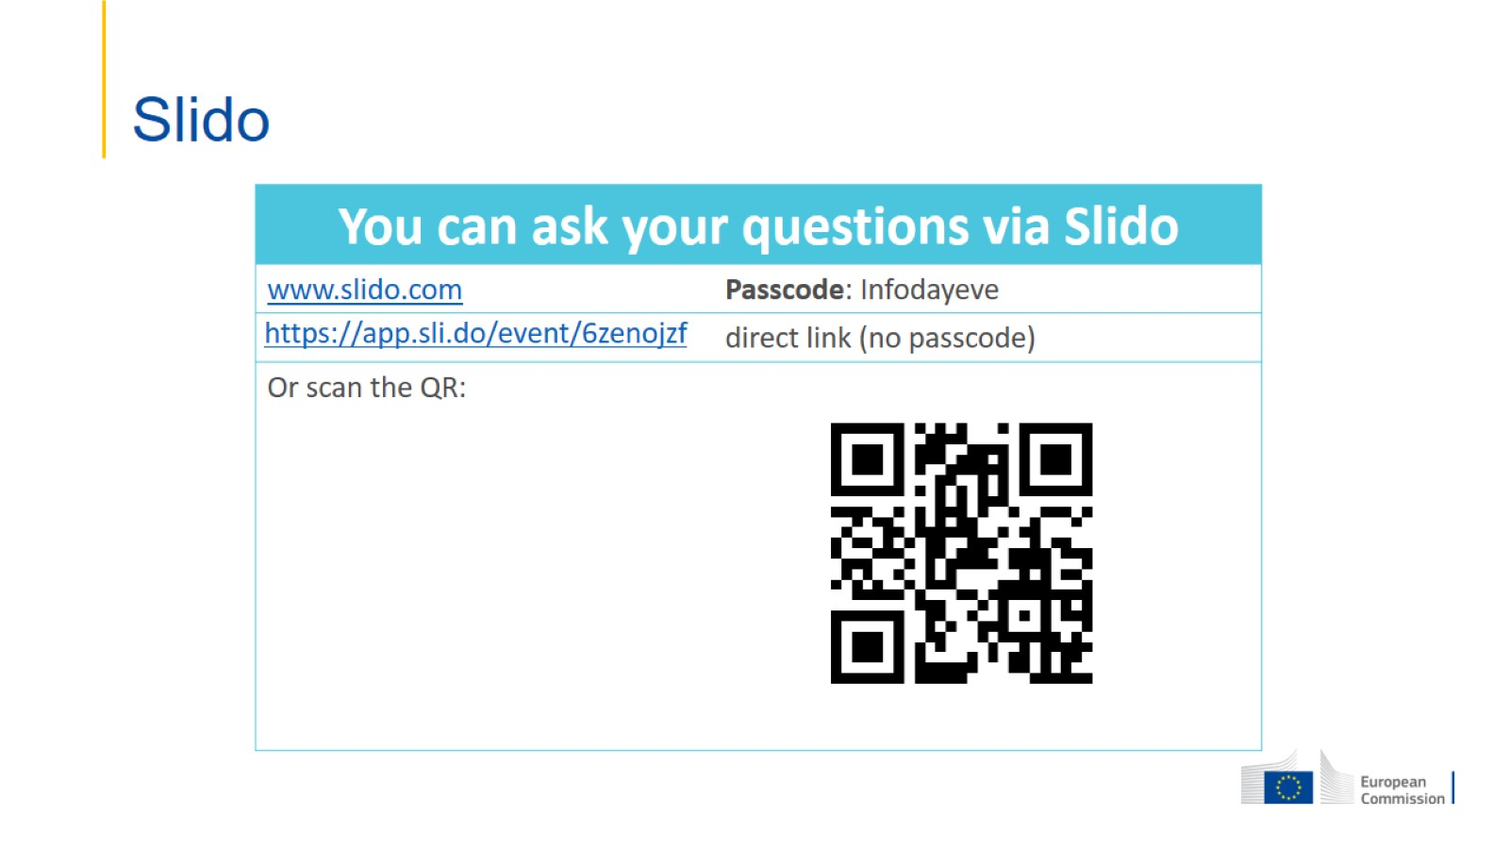
Slido

Slide 6

Thank you!

