Slide 1
Erasmus+ Virtual Exchanges InfoDay – 30 November 2021
How to Fill in an Application in the FTP system
Notes:
Good afternoon ladies and gentleman,
The aim of this presentation is to help you prepare your application by giving you the basic information you need.
It will also give you an insight into the selection process carried out by our internal experts and the criteria they use to assess your application.
This presentation is aimed at those with no prior knowledge of EU funding processes so is quite basic but everyone is welcome to post questions in Slido that we will try and address in our Q&A sesssion at the end of the infoday.
I’ll make the presentation in English but applications are of course welcome in the official EU languages.

Slide 2
Erasmus+ Virtual Exchanges InfoDay – 30 November 2021
Erik Ballhausen
European Education & Culture Executive Agency

Slide 3
4 Main Steps
1. Applicant coordinator has to have an EU Login account (formerly ECAS)
2. Ensure that applicant & partner organisations have a PIC (Participant Identification Code)
3. Find your funding opportunity call on the F&TOP (Funding & Tender Opportunities Portal.
4. Fill in the
e-application form & submit
Notes:
Be aware its a process
Make sure that you are aware of each step
4 Main steps
Remeber you apply on behalf of all PARTs
Collect all INFO required – plan this!

Slide 4
Steps 1 & 2
1. Applicant coordinator must have: EU Login account
2. Applicant organisation & all partner organisations must have: Participant Identification Code - PIC
Notes:
EU Login – do you have one / test to access / how do you mange a back-up
Participant Identification Codes =>for all PARTs
Affiliated = yes Associated = no

Slide 5
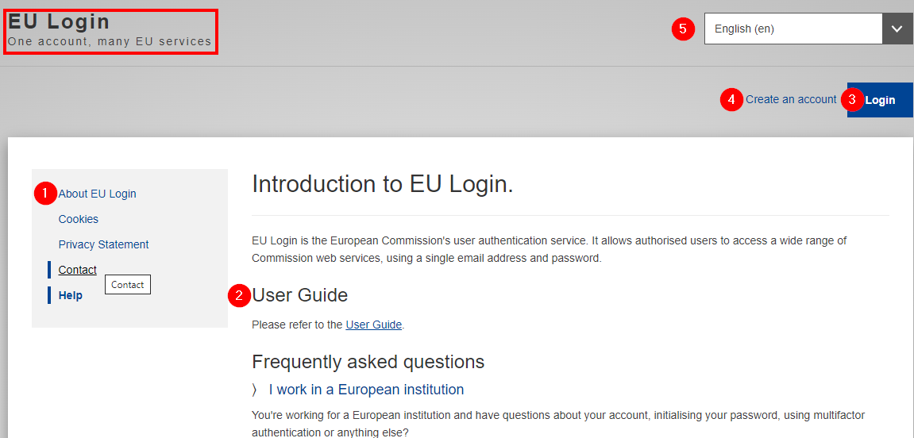
Step 1
Notes:
1 There is always Guidance
2 User Guides for each tool / part of the process
3 Login – one & personal account (FMB email not allowwed)
5 Note EU languages are available to ease usage

Slide 6
Step 2
a) Check to find the PIC of your applicant organisation
b) Or register your organisation for as a first timer to obtain a PIC
Notes:
PIC you have them all / make sure they are up-to-date / validated Yes/No?
Tip: Search with PIC code
Some PARTs = no? => PARTs have to create PIC

Slide 7
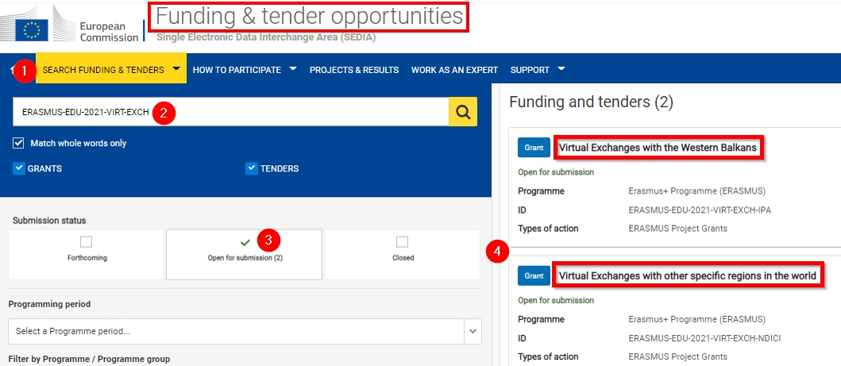
Step 3
Notes:
1 Search function – many fiilters
2 Tip: use the reference code to find the call
3 Limit by « open » only
4 Chose your topic – linked to the region you have chosen

Slide 8
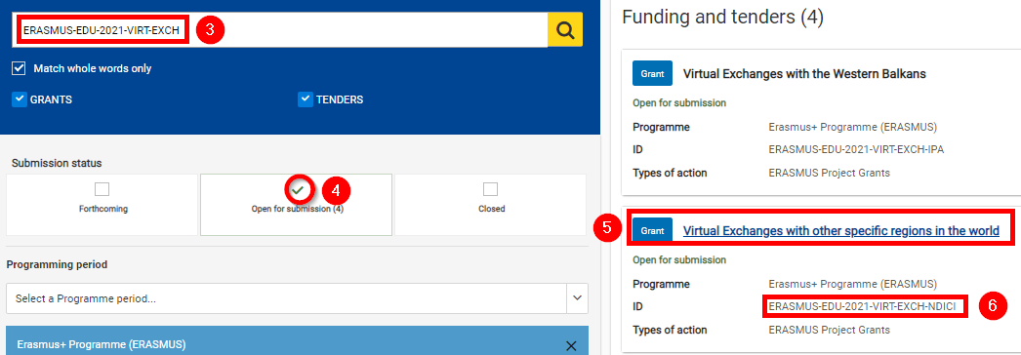
Step 4
Notes:
Make sure you chose the right topic!

Slide 9
Step 4
Notes:
Information in the call itself

Slide 10
Step 4
Notes:
You still need to select the topic & start the submission process
Get link from browser
Save to favourites
Save during inputting
Draft saved = can be re-opned
Even after submission one can re-open to re-submit until deadline!

Slide 11
Step 4
Note: EU Login required at this stage

Slide 12
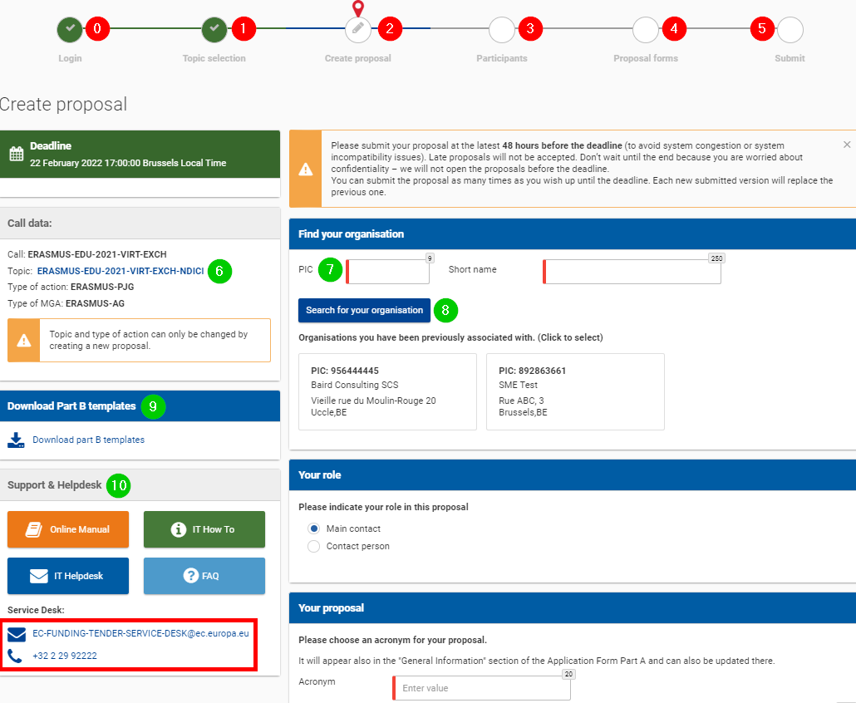
Step 4

Slide 13
Step 4
eForm - Part A
structured Administrative Forms with data on the participants, legal declarations and contact persons, programme priorities and grant requested
Documents - Part B (attached to eForm)
Detailed description of the project
Statistics - Part C
Important statistical data and application typology

Slide 14
Useful links
Support | Link
How to participate | https://ec.europa.eu/info/funding-tenders/opportunities/portal/screen/how-to-participate/how-to-participate/1
F&TP online manual | https://webgate.ec.europa.eu/funding-tenders-opportunities/display/OM/Online+Manual
F&TP for beginners | https://ec.europa.eu/research/participants/docs/h2020-funding-guide/other/event210527.htm
F&TP support section | https://ec.europa.eu/info/funding-tenders/opportunities/portal/screen/support/support
Video tutorials | https://www.eacea.ec.europa.eu/grants/how-get-grant_en
Short guide submission system | https://webgate.ec.europa.eu/funding-tenders-opportunities/display/IT/Submission+system
EACEA events page | https://www.eacea.ec.europa.eu/news-events/events/online-info-session-30-november-2021-erasmus-virtual-exchanges-funding-opportunities_en

Slide 15
Thank you!
© European Union 2021
Unless otherwise noted the reuse of this presentation is authorised under the CC BY 4.0 license. For any use or reproduction of elements that are not owned by the EU, permission may need to be sought directly from the respective right holders.

