Slide 1

Anders STJERNBERG
Call Coordinator
European Education and Culture Executive Agency (EACEA)
Online Info-Session
10 June, 2021, 14:00 – 17:00, Brussels time
#TeacherAcademies

Slide 2

How to prepare a good application
Criteria for success
European Education and Culture
Executive Agency
EACEA-EPLUS-TEACHER-ACADEMIES@ec.europa.eu

Slide 3

In this presentation
Timetable
Budget
Where to find information
Evaluation criteria
Application form
Advice for applicants
1
2
3
4
5
6
Notes:
In this presentation I will:
Take you through the planned timetable as it currently stands,
Disclose the overall budget which has been allocated to the Erasmus+ Teacher Academies call in 2021,
Describe where you can find the relevant information that you need in order to make a successful application,
Present the evaluation criteria which will be used to assess your application,
Show you and explain the application form and annexes that you need to fill in,
Finish off with some advice for applicants.

Slide 4
1
Timetable
Deadline
7 September 2021
(17:00 - Brussels time)
Information to applicants
January 2022
Start of project
1 March / 1 April / 1 May 2022
Evaluation
September – December 2021
Grant agreements signed
February 2022
Notes:
As it stands now, this is the planned timetable for the Erasmus+ Teacher Academies.

Slide 5

2
Budget
Budget based
MAX. EU GRANT PER PROJECT
1.5 Mio €
MAX. EU CO-FINANCING
80%
Budget available
15 Mio €
Notes:
Budget based grant – based on the estimated real costs of the project. Grants are based on the reimbursement of the eligible costs which have actually been incurred by the beneficiaries for carrying out the activities in question.

Slide 6


3
Where to find information
Funding and tenders opportunities portal
Programme Guide
Notes:
It is very important that you read the Erasmus+ Programme Guide. This document contains key information in relation to the Call. Part A contains general (but very important) information about the Erasmus+ Programme as a whole. Part B (p. 208-214) contains all the essential and specific information about Erasmus+ Teacher Academies. Part C presents important information for applicants and Part D gives a glossary of terms and definitions which you should also be aware of.
The Funding and tenders opportunities portal is where you will find all relevant information about the Call as well as all the necessary references and supporting documents. You can also make a partner search on the Funding and tenders opportunities portal to look for collaborating partners and there is a section on support for the applicants in preparing their proposals. And finally, this is where you will actually start preparing your proposal and where you will submit your application when you are ready to do so.

Slide 7

Evaluation Criteria
4
Eligibility criteria
Exclusion criteria
Selection criteria
Award criteria
Notes:
This is a very important section because these are the criteria which will be used to evaluate the applications received. All of these criteria will be rigorously applied to every application received. When developing the project and before applying for EU funding, participants must verify that they and their project respect the following criteria: eligibility, exclusion, selection and award.
First of all, in order to be eligible for an Erasmus+ grant, the proposals must comply with some eligibility criteria.
Secondly, an applicant will be excluded from participating if it is found to be
in one of the exclusion situations described in the Programme Guide (in accordance with the Financial Regulations).
Thirdly, through the selection criteria, the Executive Agency assesses the applicant's financial and operational capacity to complete the proposed project.
Finally, the award criteria allow the Executive Agency to evaluate the quality of the project proposals submitted. Proposals that pass the individual thresholds and the overall quality threshold will be considered for funding, within the limits of the available call budget. The rest of the proposals will be unsuccessful. The full set of award criteria applying to the Erasmus+ Teacher Academies action are described in Part B of the Erasmus+ Programme Guide . You can also find them under the Call specific information on the Funding and Tender Opportunities Portal.

Slide 8
Eligibility Criteria
In Programme Guide page 209-210
Deadline | 7 September 2021 - 17:00:00 (Brussels time)
Duration | 3 years
How to apply | Funding and tenders opportunities portal Call ID: ERASMUS-EDU-2021-PEX-TEACH-ACA
Notes:
The eligibility criteria are used to determine whether the applicant is allowed to participate in a call for proposals and to submit a proposal for an action. They apply to the applicants and to the activities for which the grant is requested: (e.g. type of project or/and activities, implementation period, profile and/or the number of participants involved).
If the project does not meet the eligibility criteria at application stage, it will be rejected without being further evaluated. If it appears at implementation or final report stage that these criteria have not been fulfilled, the activities may be considered ineligible with a consequent recovery of the EU grant initially awarded to the project.
The specific eligibility criteria applying to each of the Actions implemented through the Erasmus+ Programme Guide are described in Part B of the Guide (p.209-210).
The application must be submitted within the deadline 7 September 2021 - 17:00:00 (Brussels time), for a duration of 3 years and the application must be submitted through the Funding and Tender Opportunities Portal.

Slide 9

Who can apply?
Any nationally recognised organisation established in a Programme Country can be the applicant.
This organisation
applies on behalf of all participating organisations involved in the project.
Notes:
Further on the eligibility criteria: who can apply?
The applicant is the participating organisation that submits the project proposal on behalf of all the partners.

Slide 10
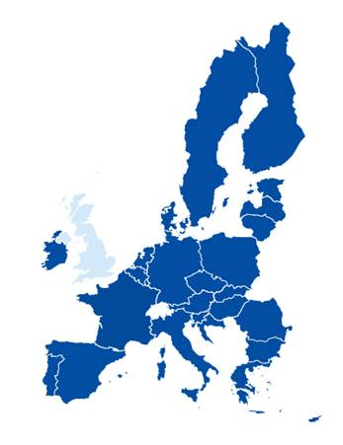
Which countries can participate as partners?
Non-EU - Erasmus+ Programme countries
Iceland, Liechtenstein, Norway, Republic of North Macedonia, Serbia, Turkey
27 EU Member States
List in Programme Guide part A
All partners can be involved as full partners or associated partners
Notes:
The following countries, established in Programme countries (see section "Eligible Countries" in Part A of the Programme Guide) can be involved as full partners or associated partners.
Full partners are participating organisations which contribute actively to the accomplishment of the Erasmus+ Teacher Academies. They appear in the financial budget table.
Associated partners are organisations that contribute to the activities or support the promotion and sustainability of the project, but that for contractual management aspects are not considered to be beneficiaries, and do not receive any funding from the Programme as part of the project (they do not have the right to charge costs or claim contributions). They do not appear in the financial budget table. Associated partners are explained in detail in Part C of the PG on page 315.

Slide 11
What types of organisations are eligible to participate in the project?
Teacher Education Institutions for teachers at ISCED level 1-3, including VET teachers;
Ministries or similar public bodies responsible for school education policies;
Public and private bodies responsible for developing policies and offer for teacher education as well as defining standards for teachers’ qualifications;
Notes:
The following organisations can be involved as full partners or associated partners:
Teacher Education Institutions (colleges, institutes, universities providing initial teacher
education and/or continuing professional development) for teachers at ISCED level 1-3,
including VET teachers;
Ministries or similar public bodies responsible for school education policies;
Public (local, regional or national) and private bodies responsible for developing policies
and offer for teacher education as well as defining standards for teachers’ qualifications.

Slide 12
What types of organisations are eligible to participate in the project? (2)
Teacher associations or other nationally recognised providers of teacher education and continuous professional development;
Authorities responsible for education and training of teachers and supervision of their continuous professional development and qualifications;
Schools working with teacher education providers to allow for practical training as part of teacher education;
Other schools or other organizations relevant for the project.
Notes:
Teacher associations or other nationally recognised providers of teacher education and
continuous professional development;
Authorities responsible for education and training of teachers and supervision of their
continuous professional development and qualifications;
Schools working with teacher education providers to allow for practical training as part of
teacher education;
Other schools (from primary schools to initial VET) or other organisations (e.g. NGOs,
teacher associations) relevant for the project.

Slide 13
What is the role of participating organisations
Applicant: A participating organisation that submits the project proposal on behalf of all the partners
Full partners: Participating organisations which contribute actively to the accomplishment of the Erasmus+ Teacher Academies. They are listed in the financial table (budget).
Associated partners: Organisations which contribute to the activities of the Erasmus+ Teacher Academies but that for contractual management aspects are not considered to be beneficiaries. They do not receive any funding from the Programme as part of the project (they do not have the right to charge costs or claim contributions). They do not appear in the financial budget table.
Notes:
The applicant is the participating organisation that submits the project proposal on behalf of all the partners.
Full partners are participating organisations which contribute actively to the accomplishment of the Erasmus+ Teacher Academies. They appear in the financial budget table.
Associated partners are partners from the public or private sector that contribute to the activities or support the promotion and sustainability of the project, but that for contractual management aspects are not considered to be beneficiaries, and do not receive any funding from the Programme as part of the project (they do not have the right to charge costs or claim contributions.). They do not appear in the financial budget table. Associated partners are explained in detail in Part C of the PG on page 315.

Slide 14
What should the partnership look like?
at least 3 full partners from a minimum of 3
Programme Countries (including at least 2 EU Member States)
At least one practice/training school as full partner or associated partner
and
involving:
At least two nationally recognised providers of initial teacher education from 2 different Programme countries
At least one nationally recognised provider of continuing professional development (in-service training) for teachers
and
The partnership may also include, as full partners or associated partners, other organisations
with relevant expertise in teacher education and/or bodies defining standards, qualifications or quality assurance for teacher education.
Minimum number of partners is 4: minimum 3 full partners and one practice/training school as full partner or associated partner.
Notes:
The minimum number of partners is 4, out of which minimum 3 must be full partners and the 4th one must be the practical training school which may be an associated partner or a full partner.

Slide 15
Eligible activities
1. Collaborate and establish networks and communities of practice
3. Develop joint learning offer with a strong European dimension
2. Develop learning modules on teacher education
Notes:
1. Collaborate and establish networks and communities of practice with teacher education providers, teacher
associations, public organisations involved in teacher education and other relevant actors to create innovative
strategies and programmes for initial and continuous professional development for teachers and schools.
2. Develop and deliver joint, innovative and effective learning modules on teacher education and for teacher
competences on challenging and/or new pedagogical matters of common concern. They shall address the distinct needs of student teachers (as part of their initial education) and serving teachers (as part of continuous professional development).
3. Develop joint learning offer with a strong European dimension that includes mobility activities in all its forms,
setting up, for instance summer schools, study visits for students and teachers as well as other forms of cross-campus collaboration, both physical and virtual.

Slide 16
Eligible activities (2)
6. Undertake research, surveys or collections of effective practices
7. Promote the existing Erasmus+ tools
such as eTwinning and School Education Gateway
5. Involve training schools to experiment innovative ways of teaching
4. Increase the number and quality of mobility and its inclusion
Notes:
4. Identify effective ways to remove obstacles of mobility and identify conditions, including practical
arrangements and recognition of learning, in order to increase the number and quality of mobility and its
inclusion as an integral part of initial and continuous learning offer for teachers.
5. Involve schools and in particular training schools to experiment and share innovative new ways of teaching
(including for distance and blended approaches to teaching and learning).
6. Undertake, in line with the objectives of this call, studies, research and/or surveys or collections of effective
practices to produce summaries, discussion papers, recommendations etc. to stimulate discussion and to
inform policies on teacher education.
7. Promote and give preference to the existing Erasmus+ tools, such as eTwinning and School Education
Gateway, for virtual mobility, collaboration, communication for testing and sharing results.

Slide 17

Exclusion criteria
Exclusion situations linked to legal issues
Part C of Programme Guide
Fields to tick in application form + declaration on honour if selected
Notes:
p. 294 of PG (part C) An applicant will be excluded from participating in calls for proposals under the Erasmus+ Programme if it is found to be in one of the exclusion situations described in articles 136-141 of the Financial Regulation:

Slide 18
Selection criteria
See part C of Programme Guide
OPERATIONAL CAPACITY Appropriate professional competencies and qualifications | FINANCIAL CAPACITY Stable and sufficient sources of funding
Insert in Part B of application form: Description of relevant skills and experience of project staff (no CVs) List of previous and running projects | Provide upon request and upload in Funding and Tender Opportunities portal: Profit and loss account Balance sheet Other documents if requested
Does not apply to public and international organisations
Notes:
Through the selection criteria, the Executive Agency assesses the applicant's financial and operational capacity to complete the proposed project.
Financial capacity means that the applicant has stable and sufficient sources of funding to maintain its activity throughout the period during which the project is being carried out or the year for which the grant is awarded and to participate in its funding. Financial capacity is checked after the award, during grant preparation. Does not apply to public and international organisations.
The operational capacity will be assessed in parallel to the ‘Quality’ award criterion, on the basis of the competence and experience of the applicants and their project teams, including operational resources (human, technical and other).

Slide 19
Award criteria
More details on each criteria in Programme Guide page 212
Criteria | Maximum points | Threshold
Relevance of the project | 35 | 18
Quality of project design and implementation | 25 | 13
Quality of project consortium and cooperation arrangements | 20 | 11
Impact | 20 | 11
Minimum total score 60 points (out of 100 points in total)
Notes:
To be considered for funding, applications must score at least 60 points (out of 100 points in total), also taking into
account the necessary minimum pass score for each of the four award criteria:
18 points for the “relevance of the project” category;
13 points for the “quality of the project design and implementation;”
11 points for the “quality of the partnership and the cooperation arrangements;”
11 points for “impact”.
In ex aequo cases, priority will be given to highest scores for "relevance of the project" and then “impact”.

Slide 20

Award criteria: Relevance
Link to policy
Consistency
Innovative approach
Cooperation and partnerships
European added value
Internationalisation
Digital skills
Green skills
Social dimension
Gender sensitivity
Notes:
These are all of the sub-criteria for relevance.
Each of these sub-criteria is explained in further details on pages 212-214 in the PG.
You can also find these explanations under the Topic Description of the Call in the F&TP.
Make sure that you read these explanations carefully, since your application will be assessed against these award criteria.
Link to policy: the extent to which the proposal establishes and develops a European partnerships of teacher education and training providers to set up Erasmus+ Teacher Academies with innovative learning offer to teachers;
Consistency: the extent to which the proposal is based on an adequate needs analysis; clearly defined and realistic goals, and addresses issues relevant to the participating organisations and to the action;
Innovative approach: the proposal considers state-of-the-art methods and techniques, and leads to innovative results and solutions for its field in general, or for the geographical context in which the project is implemented (e.g. content; outputs produced, working methods applied, organisations and persons involved or targeted);
Cooperation and partnerships: the extent to which the proposal is suitable of realising a strong and on-going relationship at both local, national and transnational levels between providers of initial teacher education (pre-service for future teachers) and providers of continuing professional development (in-service), in which interactions are reciprocal and mutually beneficial;
European added value: the proposal clearly demonstrates the added value at the individual (learner and/or staff), institutional and systemic levels, generated through results that would be difficult to attain by the partners acting without European cooperation; the proposal uses and promotes the existing tools at EU level such as eTwinning and School Education Gateway for collaboration, communication, and for testing and sharing results;
Internationalisation: the proposal demonstrates its contribution to the international dimension of teacher education, including the development of joint models of mobility (virtual, physical and blended) and other learning offer in initial teacher education and teachers’ continuous professional development;
Digital skills: the extent to which the proposal foresees activities related to digital skills development (e.g. the design of innovative curricula and teaching methodologies, effective learning modules, etc.);
Green skills: the extent to which the proposal foresees activities (e.g. innovative curricula and teaching methodologies, effective learning modules etc.) linked to European priorities on environmental sustainability and the transition to a circular and greener economy;
Social dimension: the proposal includes a horizontal concern throughout the various actions to address diversity and promote shared values, equality, non[1]discrimination and social inclusion, including for people with special needs/fewer opportunities and working in multilingual and multicultural contexts;
Gender sensitivity: the extent to which the proposal addresses gender equality and helps to find solutions to effectively foster gender sensitive teaching in schools.

Slide 21
Award criteria - Quality of project design and implementation
  Coherence
  Methodology
  Structure
  Management
  Budget
  Risk management
  Quality Assurance
  Monitoring tools
Notes:
These are all of the sub-criteria for Quality of project design and implementation.
Coherence: the overall project design ensures consistency between project objectives, activities and the budget proposed. The proposal presents a coherent and comprehensive set of appropriate activities and services to meet the identified needs and lead to the expected results;
Methodology: the quality and feasibility of the methodology proposed and its appropriateness for producing the expected results;
Structure: the clarity, completeness and quality of the work programme, including appropriate phases for preparation, implementation, monitoring, exploitation, evaluation and dissemination;
Management: solid management arrangements are foreseen. Timelines, organisation, tasks and responsibilities are well defined and realistic. The proposal allocates appropriate resources to each activity;
Budget: the budget provides for appropriate resources necessary for success, it is neither overestimated nor underestimated;
Risk management: Challenges/risks of the project are clearly identified and mitigating actions properly addressed;
Quality Assurance: control measures (continuous quality evaluation, peer reviews, benchmarking activities, etc.) are adequately put in place;
Monitoring tools: indicators are set to ensure that the project implementation is of high quality and cost-efficient.

Slide 22

Award criteria - Quality of the partnership and the cooperation arrangements
  Configuration
  Upward convergence
  Geographical dimension
  Virtual collaboration and mobility
  Commitment
  Tasks
  Collaboration
Notes:
These are all of the sub-criteria for Quality of the partnership and the cooperation arrangements:
Configuration: the project involves an appropriate mix of complementary participating organisations with the necessary profile, competences, experience and expertise to successfully deliver all aspects of the project.
Upward convergence: the extent to which the partnership establishes networks and communities of practice with teacher education providers, public authorities involved in teacher education and other relevant actors, and allows for an effective exchange of expertise and knowledge among those partners;
Geographical dimension: the extent to which the partnership includes relevant partners from different geographical areas, as well as the extent to which the applicant has justified the geographical composition of the partnership and demonstrated its relevance to the achievement of the objectives of the Erasmus+Teacher Academies; as well as the extent to which the partnership includes a wide and appropriate range of relevant actors at local and regional levels;
Virtual collaboration and mobility: the extent to which the cooperation is linked to existing Erasmus+ tools, such as eTwinning and School Education Gateway;
Commitment: the distribution of responsibilities and tasks is clear, appropriate, and demonstrates the commitment and active contribution of all participating organisations in relation to their specific expertise and capacity;
Tasks: the coordinator shows high quality management, ability to coordinate transnational networks and leadership in complex environment; individual tasks are allocated on the basis of the specific know-how of each partner;
Collaboration: an effective mechanism is proposed to ensure a good coordination, decision-making and communication between the participating organisations, participants and any other relevant stakeholder.

Slide 23

Award criteria - Impact
  Exploitation
  Dissemination
  Impact (on participants and outside the organizations)
  Sustainability and continuation
Notes:
These are all of the sub-criteria for Impact:
Exploitation: the proposal demonstrates how the outcomes of the project will be used by the partners and other stakeholders. It provides means to measure exploitation within project lifetime and after;
Dissemination: the proposal provides a clear plan, during the project lifetime and after the project’s termination, for the dissemination of results, and includes appropriate targets, activities, relevant timing, tools and channels to ensure that the results and benefits will be spread effectively to stakeholders, policy makers, teacher education providers, public authorities etc. within and after the project’s lifetime; the proposal also indicates which partners will be responsible for dissemination and demonstrates the relevant experience that they have in dissemination activities; the proposal sets out the means used for dissemination, with preference to the Erasmus+ tools such as eTwinning and School Education Gateway.
Impact: the proposal demonstrates the potential impact of the project:
On participants and participating organisations, during and after the project lifetime;
Outside the organisations and individuals directly participating in the project, at local, regional, national and/or European levels.
The proposal includes measures as well as targets and indicators to monitor progress and assess the expected impact (short- and long-term);
Sustainability and continuation: the proposal explains how the Erasmus+ Teacher Academies will be rolled out and further developed. The proposal includes the design of a long-term action plan for the progressive roll-out of project deliverables after the project has finished. This plan shall be based on sustained partnerships between providers of initial teacher education (pre-service for future teachers) and providers of continuing professional development (in-service). It should include the identification of appropriate governance structures, as well as plans for scalability and financial sustainability, including the identification of financial resources (European, national and private) to ensure that the results and benefits achieved will have a long-term sustainability.

Slide 24
Fulfilling the Evaluation Criteria
Successful Application
1. Eligibility Criteria
3. Selection Criteria
4. Award Criteria
2. Exclusion Criteria
Notes:
To summarise, a successful application fulfills the following criteria:
Eligibility criteria
Exclusion criteria
Selection criteria
Award criteria

Slide 25
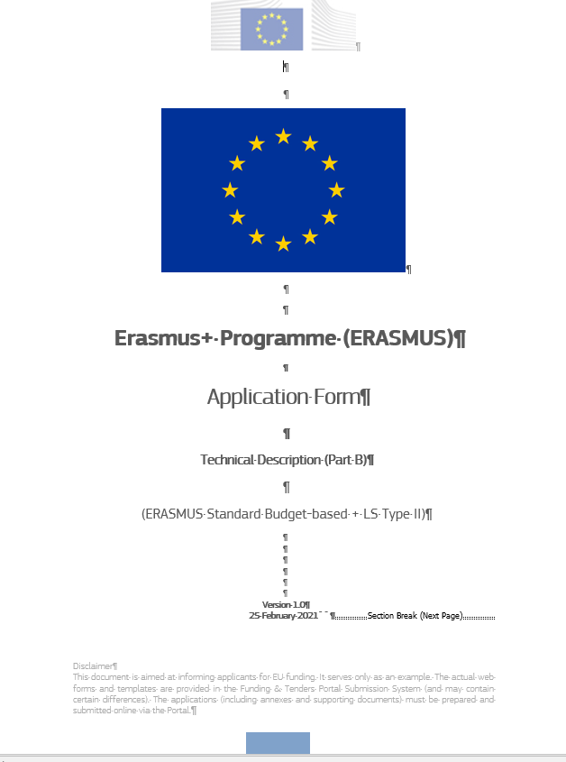
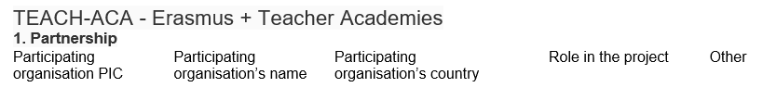
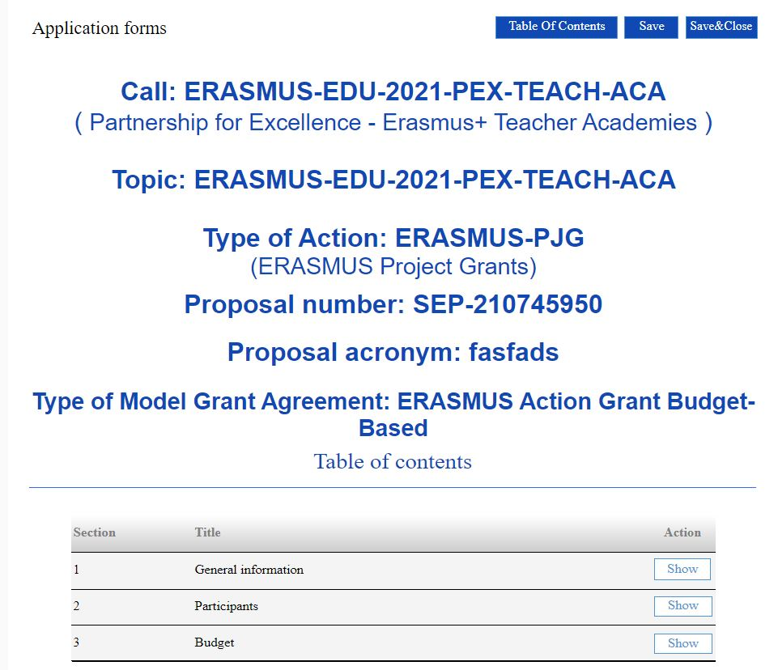
In Funding and tenders opportunities portal
5
Application form
  eForm (Part A) – General information entered by the participants – generated by the IT system
Part B - Technical description and estimated budget of the proposal
Part C - Short annex on type of organisation
Notes:
The application form which you have to fill in from the Funding and Tender Opportunities Portal contains a part A (eForm), Part B and Part C.
eForm (Part A) contains general information entered by the participants.
Part B is the technical description and estimated budget of the proposal.
Part C is a short annex on type of organisation. This will be used to assess the application against the eligibility criteria as presented in the Programme Guide.

Slide 26
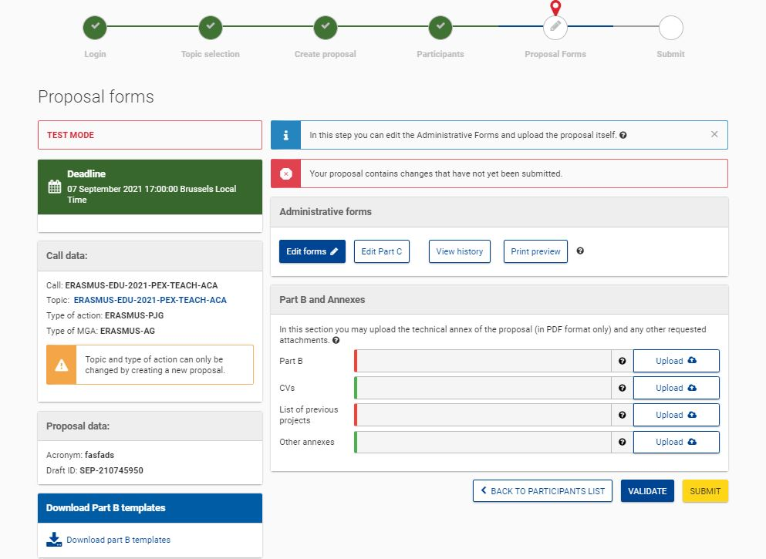
APPLICATION FORM
Overview - eForm (Part A)
Notes:
The eForm (Part A) contains administrative forms which the applicant has to fill out online.
Click on edit forms.

Slide 27
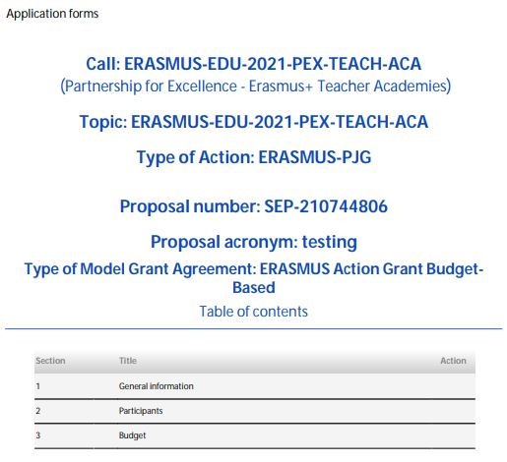
Application form
eForm (Part A)
General information – structured administrative forms with data on the participants, abstract, legal declarations and programme priorities.
Participants – list of participating organisations, organisational data and contact persons
Budget – requested grant
Notes:
the eForm (part A) is to be completed online.
The administrative forms must be filled in for each proposal using the templates available in the submission system. Some data fields in the administrative forms are pre-filled based on the steps in the submission wizard.
3 parts to be filled in:
General information- structured administrative forms with data on the participants, abstract, legal declarations and programme priorities
Participants - list of participating organisations, organisational data and contact persons
Budget – requested grant

Slide 28
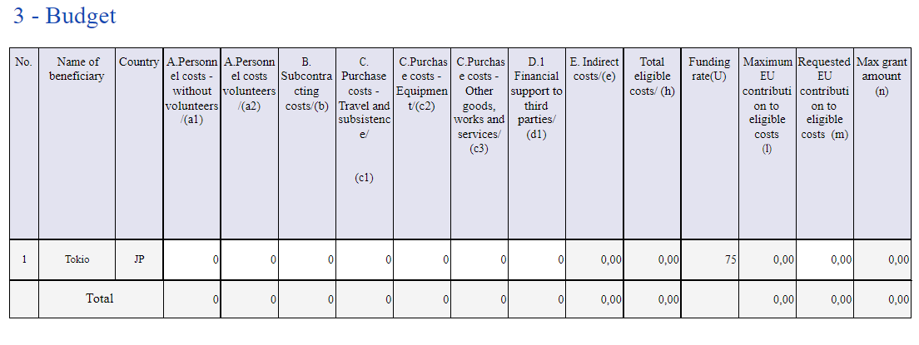
eForm (Part A)
Budget
Notes:
The budget table should be filled in with information from all full partners, one beneficiary per line.
There are two budget tables: this online budget table in the eForm (part A) and another budget table in the application form (part B).
This online table will prevail in case of differences with the budget table in Part B.

Slide 29

APPLICATION FORM
Overview – Part B
Notes:
Click on download Part B templates to download the application form in Word.

Slide 30
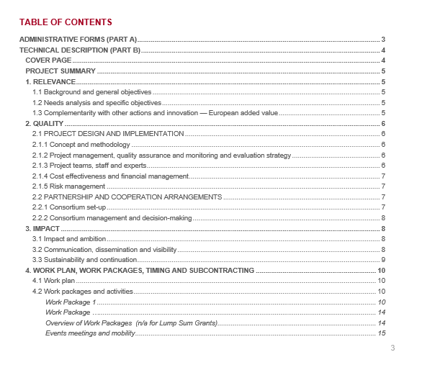
Application form
Part B – Technical Description
Template to be downloaded by the applicant in the submission system.
Completed form to be uploaded in pdf format.
Includes sections corresponding to the 4 award criteria, a section on Work Packages and the estimated budget
No CVs required but description of profiles and expertise of staff
List of previous projects to be filled at the end of the form
Maximum 120 pages, pages in excess of 120 pages will not be read.
Notes:
Part B is the technical description. To be completed in Word format and uploaded in PDF format for submission.
(Each project should have a minimum of 2 WPs).

Slide 31
Application form – Part B
Estimated budget — Resources (n/a for prefixed Lump Sum Grants)
Participant | Costs
 | A. Personnel |  | B. Subcontracting | C.1a Travel |  |  | C.1b Accomodation | C.1c Subsistence | C.2 Equipment | C.3 Other goods, works and services | D.1 Financial support to third parties |  | E. Indirect costs | Total costs
[name] | X person months | X EUR | X EUR | X travels | X persons travelling | X EUR | X EUR | X EUR | X EUR | X EUR | X grants | X EUR | X EUR | X EUR
[name] | X person months | X EUR | X EUR | X travels | X persons travelling | X EUR | X EUR | X EUR | X EUR | X EUR | X prizes | X EUR | X EUR | X EUR
Total | X person months | X EUR | X EUR | X travels | X persons travelling | X EUR | X EUR | X EUR | X EUR | X EUR | X grants X prizes | X EUR | X EUR | X EUR]
For certain Lump Sum Grants, see detailed budget table/calculator (annex 1 to Part B; see Portal Reference Documents).
Notes:
Part B – estimated budget
Does not include the columns total eligible costs, funding rate, maximum EU contribution as the online budget table in the eForm (part A).
In case of differences between online budget table eForm (part A) and budget table Part B, the online table will prevail.

Slide 32
APPLICATION FORM
Overview – Annexes to Part B
Notes:
The Part B application form which you filled in with Word, should be uploaded in PDF format only.
The only mandatory Annex is the list of previous projects (you have had with the EC) in PDF format as well.
All mandatory annexes are marked in red, the optional ones are marked in green.
Concerning the list of previous projects, there is no standard template for this. We advise you to provide the list based on the projects, and to include all the necessary information such as title of the project, reference number, start and end date, EC programme or initiative concerned, name of the coordinating organization, website.
Further, we ask you to summarise the project’s outputs and describe how the new proposal seeks to build on them and how ownership / copyright issues are to be dealt with (Recommended limit: 500 characters)

Slide 33
6
Advice for applicants (1)
Build a strong and committed partnership in which interactions are mutually beneficial
Provide evidence of innovation
Establish a strong and experienced coordination team
Be concrete in the description of your objectives and activities
Pay attention to the integration of activities and consistency with the objectives
Pay attention to all award criteria

Slide 34
Advice for applicants (2)
Common mistakes:
Quality indicators not considered
Impact often described in terms of participation in events rather than in terms of changes in knowledge, behaviour or skills

