Slide 1



Erasmus + KA2
Alliances for innovation 2022
Toolkit
How to fill in the budget
© European Union, 2021 (CC BY-NC-ND 4.0) — source: iStockphoto.comn, 2016
© European Union, 2021 (CC BY-NC-ND 4.0) — source: iStockphoto.comn, 2016
© European Union, 2021 (CC BY-NC-ND 4.0) — source: iStockphoto.comn, 2016
© European Union, 2021 (CC BY-NC-ND 4.0) — source: iStockphoto.comn, 2016
© Odua Images, Rawpixel.com, Myvisuals, Africa Studio & popcorner / Shutterstock.com

Slide 2
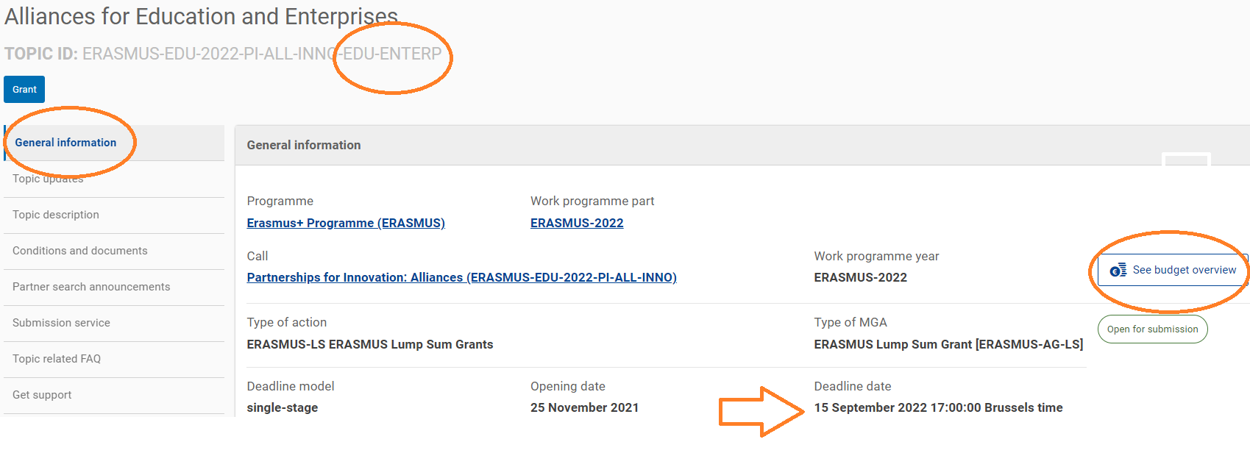
General information – Lot 1
LOT 1
-
CLICK HERE

Slide 3
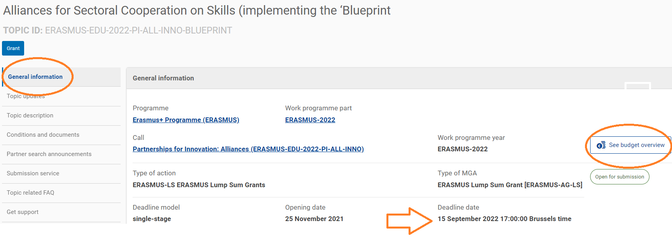
General information – Lot 2
LOT 2
-
CLICK HERE

Slide 4
Available fund
Don’t be mislead: the total budget for both lots is 62 000 000 millions EUR.
Lot 1 + Lot 2 = 62 000 000 millions EUR total funding

Slide 5
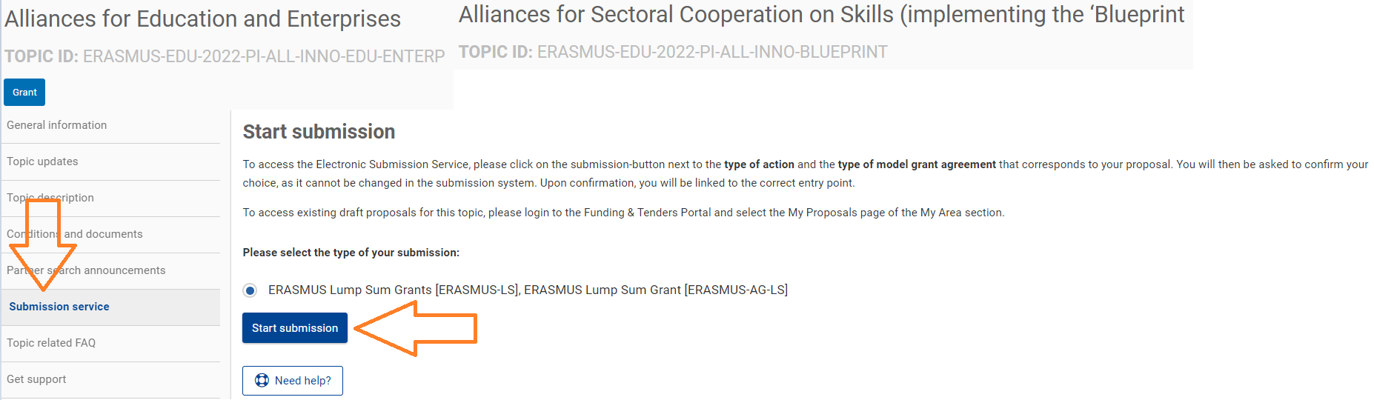
Where to find your Budget table (Excel)

Slide 6
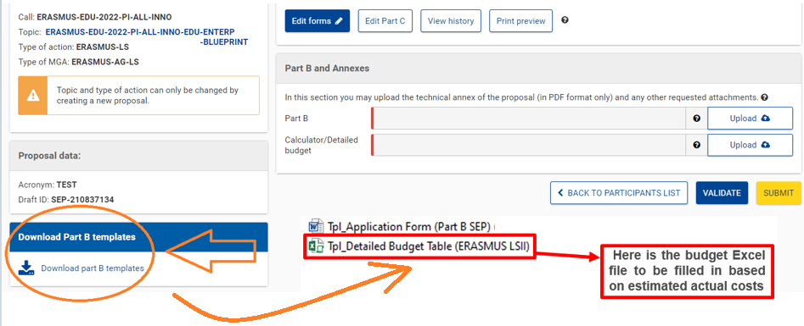
Where to find your Budget table (Excel)

Slide 7
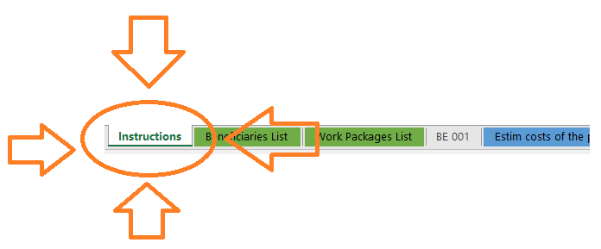
Saving your Excel document
First thing to do: READ THE INSTRUCTIONS

Slide 8
Saving your Excel document
THE INSTRUCTIONS:
  Row 19 reads: The format of this Excel workbook is .xlsm
  Why? Because it uses MACROS to generate automatically some data
  Start by saving it as .xlsm
  Fill in the budget
  Finished preparing your application and ready for submission?
  Then, please, save another copy of your Excel as « .xlsx » and upload this .xlsx in the Submission tool

Slide 9
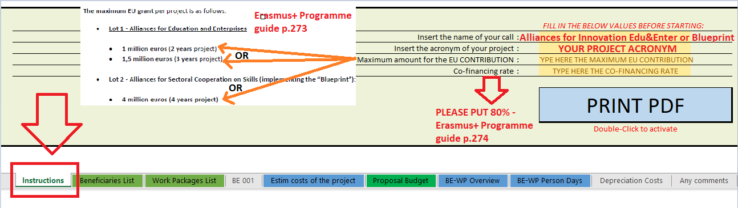
Let’s start filling in the Excel budget table – First essential step!

Slide 10
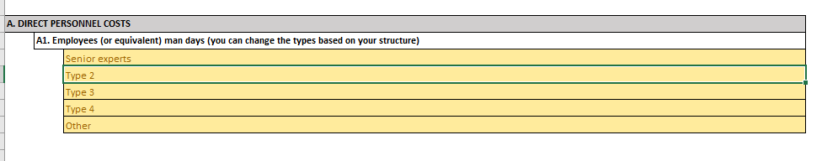
Presentation of the Excel table – Staff types
You can put your own specific staff: i.e. Director, Project Manager, Senior Expert, Assistant, Researcher, etc… These titles will apply for all the partners. If you put as « Type 1 » → « Senior expert », this will appear for all the partners the same.

Slide 11
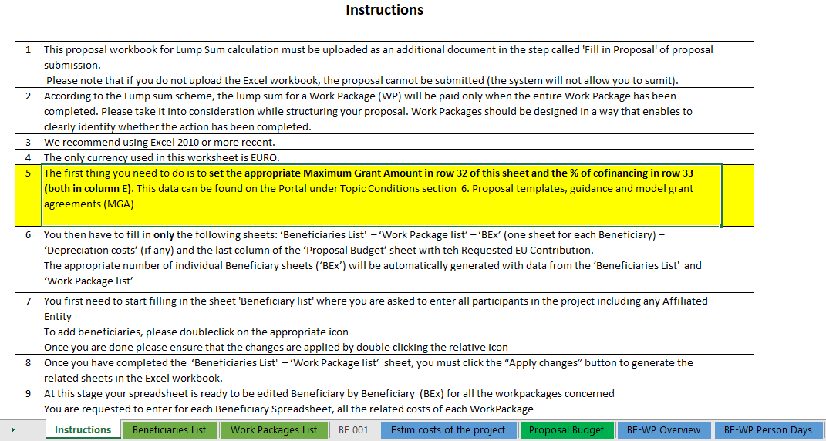
Presentation of the Excel table: Beneficiaries List, WP List and Proposal Budget
These 4 tabs will have to be filled in, in order for your detailed budget table to be complete, before uploading it into the Submission system.

Slide 12
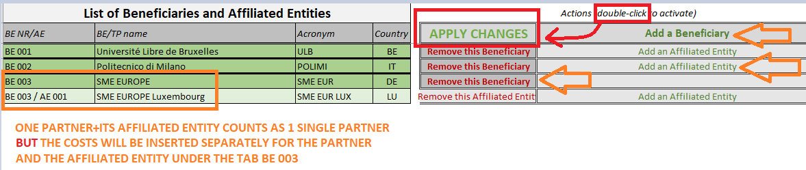

Beneficiaries list

Slide 13
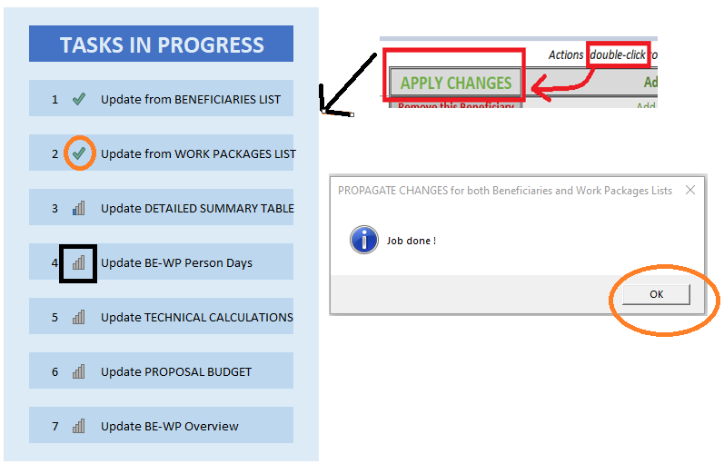
Apply changes
When you DOUBLE CLICK on « Apply changes », a box « Tasks in progress » will appear, wait the update finalisation and when the windows « Job done! » appears, click on OK and regularly SAVE
your work.

Slide 14
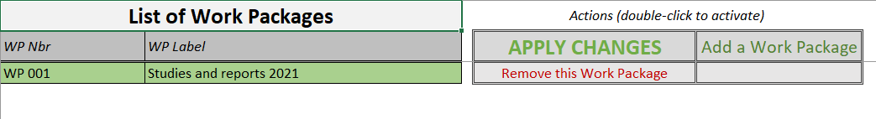

Work Packages list
Complete the information related to your different work packages.
(See Part B for the different work packages; it is recommended to use a limited number of work packages)

Slide 15
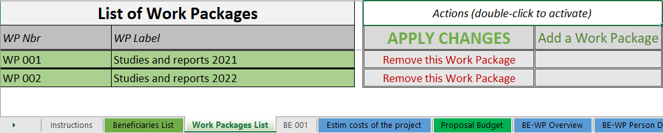
Work Packages list
Double click here to add a Work Package
Double click here to remove the Work Package

Slide 16
Work Packages list
Double click on « apply changes » once the information is duly completed or after any change

Slide 17
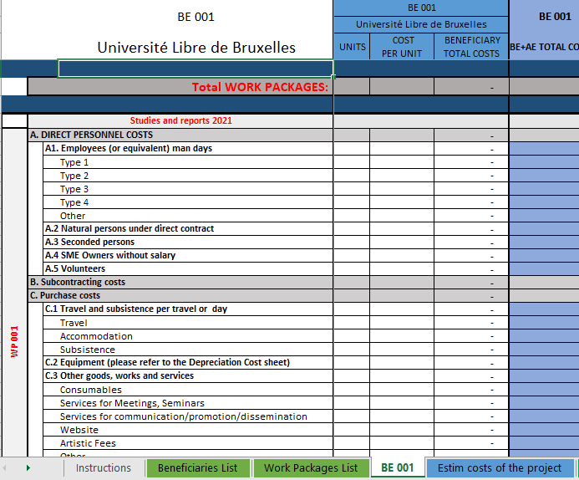
Estimated actual costs
Cells that need to be filled in
For each cost (line) both columns have to be filled in
The other columns will be automatically calculated
Reference to the Work Package
Just go down in the Excel sheet to see the other Work Packages
You have to fill in the estimated actual costs per Work Package
Reference to the Beneficiary
All costs linked to this Beneficiary have to be put in this tab

Slide 18
Estimated actual costs
If you have a cost (line) with different cost per unit, you have first to calculate an average amount in order to fill in the cells.
You have to estimate the eligible costs of your proposal using the same methodology as if these costs should be declared under an actual cost-based grant agreement
For additional information, please refer to the Annotated Model Grant Agreement
Then repeat this procedure for the other Work Packages below

Slide 19
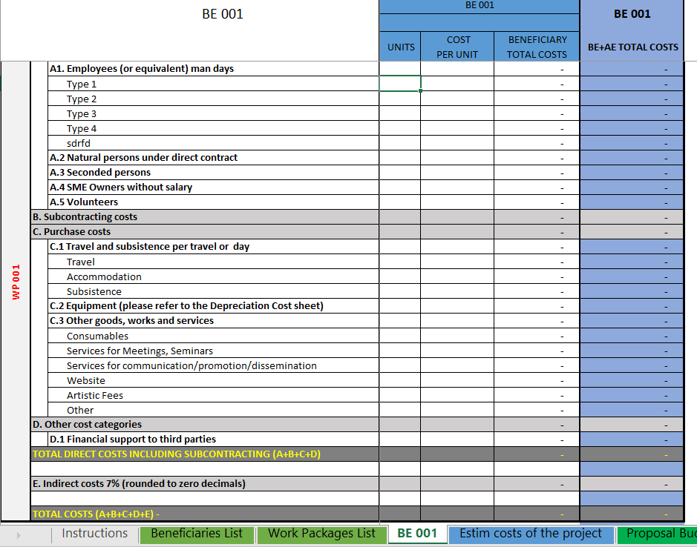
Estimated actual costs
Most of the projects cannot declare equipment costs as they are already included in the indirect costs.
However, for some projects, the purchase, rent or lease of equipment that are specific and necessary for the project are accepted (See later in this presentation)
The indirect costs are automatically calculated and are intended to cover all costs linked to the general administration of the project (PCs, laptops, supplies, paper, electricity, etc.)

Slide 20
Estimated actual costs
Financial support to 3rd parties should not occur under Erasmus+ as neither legal base nor call foresees that. Please do not include any cost under this item.

Slide 21
Estimated actual costs
See initial slides ‘Instructions' to update the type of staff.
You have to encode your costs using the following unit: 1 unit is 1 person-day
You first have to calculate average amounts if you have different costs per staff member

Slide 22
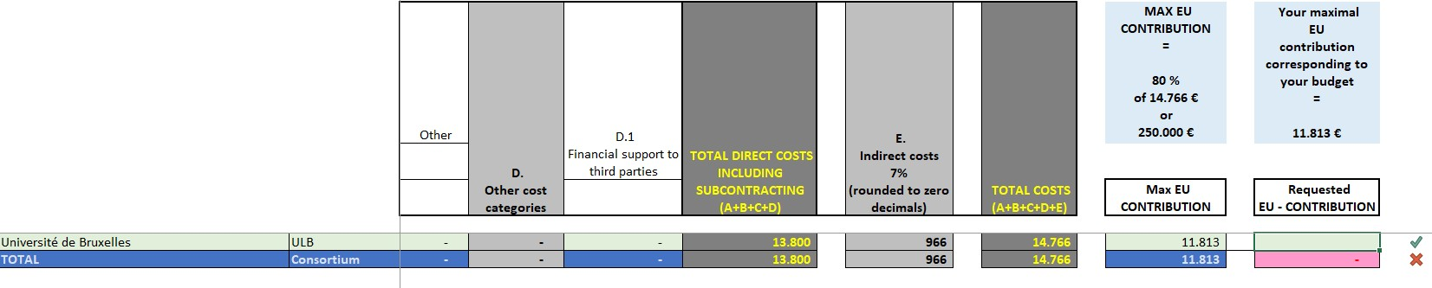
Proposal Budget
Complete this cell and put the requested EU contribution amount
You need to have 2 green ticks and no red cross in order to go to the next step (See next page)

Slide 23
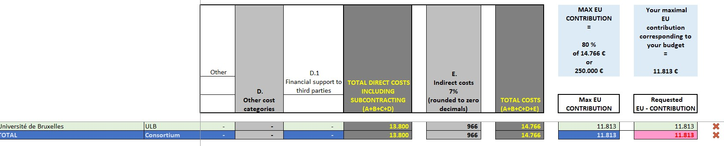
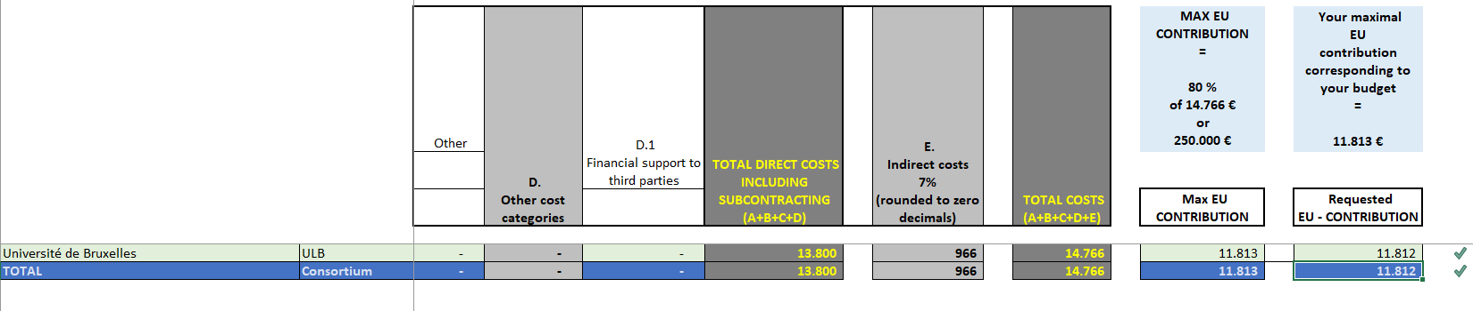
Proposal Budget
Due to decimals and rounded amounts you could have to slightly update the amount (withdrawing 1 €) in order to respect the maximal contribution

Slide 24
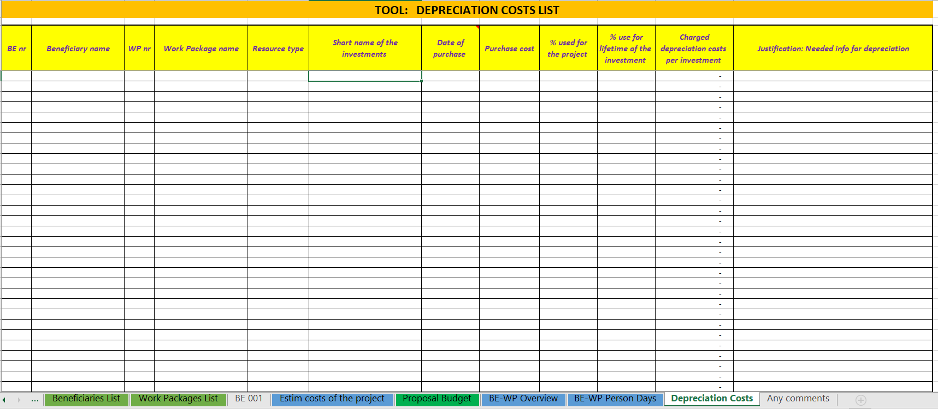
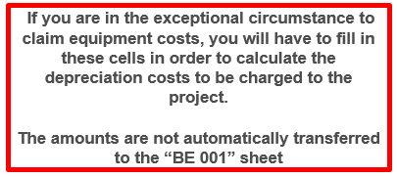
Complementary information

Slide 25
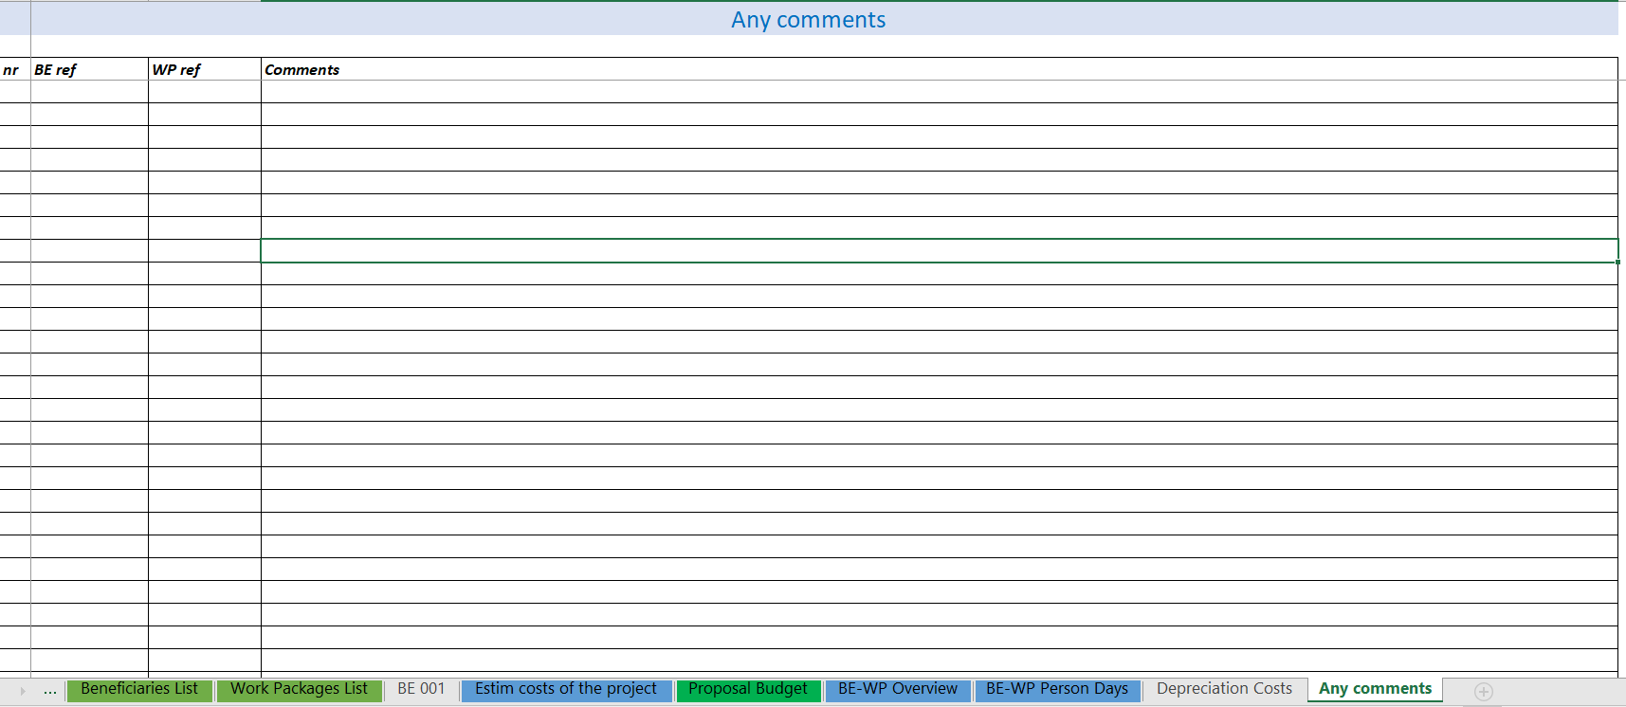

7. Complementary information

Slide 26
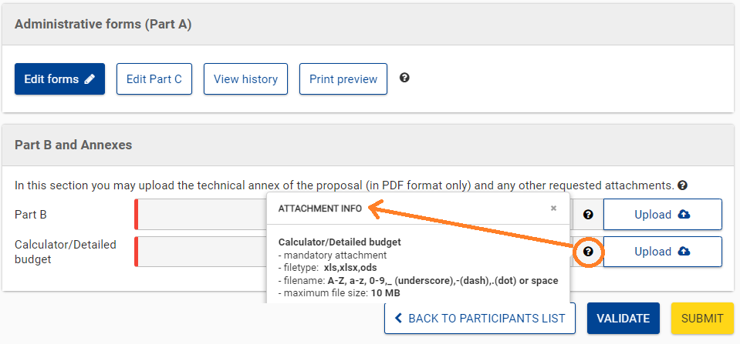
Upload the file in the submission system

Slide 27
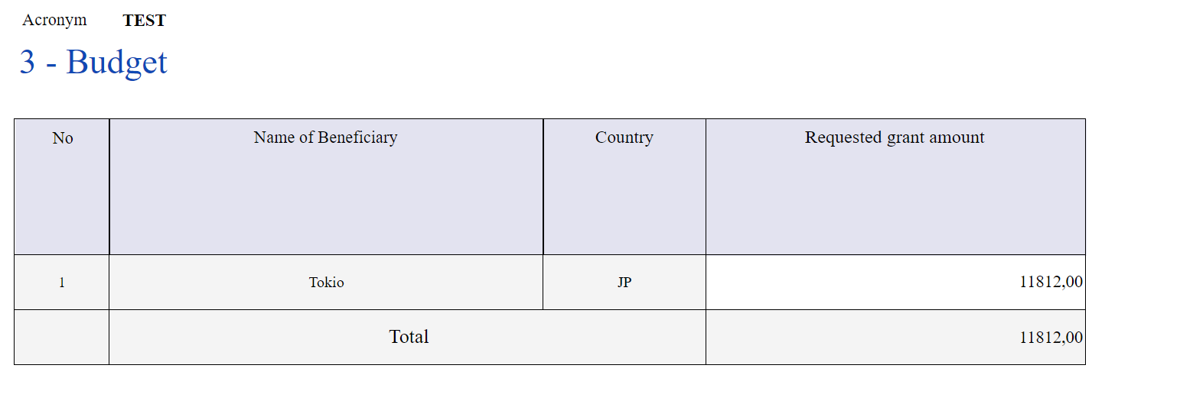
LAST STEP: Report the amount in PART A
The IDENTICAL total amount has to be reported in
« PART A » of
the application (Edit forms /
3. Budget)

