Slide 1
Capacity Building in Higher
Education
How to submit a competitive proposal
EACEA A4
European Education and Culture
Executive Agency

Slide 2
Agenda
10:00-10:30 | Capacity Building in the field of Higher Education: what is new?
10:30-11:15 | How to prepare a competitive project proposal? Award criteria Tips and lessons learnt
11:15-11:45 | Financing and submission
11:45-12:30 | Questions and answers
2

Slide 3

What should I know?

Slide 4
Purpose
Focus on the needs of the third countries not associated to the E+ programme
Targeting the priorities of the third countries not associated to the programme and matching them with the EU priorities for these countries
Maximising benefit to third countries not associated to the Programme

Slide 5
Strand 1. Fostering access to cooperation in Higher Education
Enhance management or administrative capacities
Ensure high quality and relevant education
Reforming and modernising university governance
Quality Assurance
Capacity (mobility, evaluation, planning, etc.)
International Relation Offices
modules or study programmes, technical or professional orientations of programmes
developing capacities for postgraduate student and academic staff as well as promoting postgraduate students and/or staff mobility;
implementing training courses for HEI staff
Increasing the accessibility of individuals with fewer opportunities
HEIs from least developed countries
Target groups
HEIs located in remote regions
Individuals with fewer opportunities.
Newcomers or less experienced
Notes:
Reforming and modernising university governance
reforming and modernising the university governance, including the enhancement of services in particular for the benefit of students (student guidance, counselling and job orientation etc.);
International Relation Offices
establishing or strengthening international relations offices and elaborating internationalisation strategies;
Quality Assurance
establishing new or developing existing quality assurance units and processes/strategy within HEIs;
Capacity
creating or increasing the capacity of planning and evaluation units;
Mobility
building capacities to support students and staff mobility activities.
Developing remote and inclusive learning pathways by relying on digital technology and e-learning for vulnerable students;
Updating the digital technology to develop specific services aiming at ensuring equal and fair learning opportunities to students with disabilities;
Promoting initiatives aiming at positive discrimination by empowering women and ethnic/religious minorities;
Develop initiatives addressing and reducing barriers faced by disadvantaged groups in accessing learning opportunities;
Contributing to creating inclusive environments that foster equity and equality, and that are responsive to the needs of the wider community

Slide 6
Strand 2. Partnerships for transformation in HE
Innovation in higher education
Promoting reforms of HEIs
Design of innovative curricula
Innovative learning and teaching methods
Active engagement with the business world and with research
Introduction of Bologna type reforms at institutional level
Reform of governance and management systems and structures at institutional level
HEIs
Local actors with a link to industry and business sectors
Individuals: students, staff, learners in general
Bodies responsible for HE at local and national level
Target groups
Notes:
Design of innovative curricula or introducing innovative elements in the existing curricula
Innovative learning and teaching methods (i.e. learner-centred and real problem-based teaching )
Active engagement with the business world and with research: organisation of educational programmes and activities with and within enterprises
Network effectively on the international scene on scientific and technological innovation

Slide 7
Strand 3. Structural reform projects
Mutual learning between public authorities of the countries involved
Promote inclusive Higher Education systems
Increase capacities of bodies in charge of Higher Education
Identify synergies with ongoing EU initiatives
Foster national ownership
Efficient and effective policy making
Foster common regional strategies in Higher Education
Introduction of funding mechanisms
Promoting reforms and innovation of HE system
HEIs
Target groups
National Ministry for higher education (HE)
Research institutions
Other relevant authorities and stakeholders in the field of HE
Notes:
Reforming and modernising university governance
reforming and modernising the university governance, including the enhancement of services in particular for the benefit of students (student guidance, counselling and job orientation etc.);
International Relation Offices
establishing or strengthening international relations offices and elaborating internationalisation strategies;
Quality Assurance
establishing new or developing existing quality assurance units and processes/strategy within HEIs;
Capacity
creating or increasing the capacity of planning and evaluation units;
Mobility
building capacities to support students and staff mobility activities.
Developing remote and inclusive learning pathways by relying on digital technology and e-learning for vulnerable students;
Updating the digital technology to develop specific services aiming at ensuring equal and fair learning opportunities to students with disabilities;
Promoting initiatives aiming at positive discrimination by empowering women and ethnic/religious minorities;
Develop initiatives addressing and reducing barriers faced by disadvantaged groups in accessing learning opportunities;
Contributing to creating inclusive environments that foster equity and equality, and that are responsive to the needs of the wider community

Slide 8
Overarching priorities
Green deal
Digital transformation
Integration of migrants
Governance, peace, security and human development
Sustainable growth and jobs
8
Notes:
Green Deal: Contribute to a successful green and sustainable global economic recovery (including climate change, environment and energy), awareness-raising, green jobs.
Digital transformation: Performing digital education eco-systems, improving digital skills and competences, connectivity, teacher training.
Integration of migrants: Recognition of qualifications, legal pathways, integration of migrants and displaced persons, education access, scholarships, language education.
Governance, peace, security and human development: Human rights, social and economic rights, democracy, fundamental values, governance, citizenship, health, youth, gender, access and inclusion.
Sustainable growth and jobs: Skills, entrepreneurship, employability, links to the labour market and jobs creation, job opportunities, rural areas, private sector involvement.

Slide 9
Overarching priorities – example of topics
Green Deal
environment
ecosystems and biodiversity
forestry
sustainable agri-food systems
climate resilience & disaster risk reduction
Digital transformation
information technology engineer
business process analysis
artificial intelligence
process automation/robotic
big data analytics
data and digital security
Integration of migrants
social sciences
equity, diversity, and inclusion
human rights
global governance and diplomacy
Governance, peace, security and human development
health: access to vaccines, medicines & health technology products
poverty studies
political economy
security and strategic studies
Sustainable growth and jobs
social, ecological, and economic studies
sustainability studies
social equity
economic governance
knowledge economy
energy
academic mobility facilities
peace and conflict
…
...
…
…
…
biodiversity, land, water, oceans & forests
digital transition
transport
African economic integration & diversification
public policy
skills development
sustainable finance for sustainable transitions
entrepreneurship

Slide 10
Erasmus+ CBHE Promotion activities
- The international dimension of the Erasmus+ Programme: focus on newcomers (25/11/2022)
https://www.eacea.ec.europa.eu/news-events/events/online-info-session-international-dimension-erasmus-programme-2022-11-25_en
- The international dimension of the Erasmus+ Programme: focus on Latin America and Caribbean (29/11/2022):
https://www.eacea.ec.europa.eu/news-events/events/online-info-session-international-dimension-erasmus-programme-focus-latin-america-and-caribbean-2022-11-29_en
- The international dimension of the Erasmus+ Programme: focus on Sub-Saharan Africa (01/12/2022):
https://www.eacea.ec.europa.eu/news-events/events/online-info-session-international-dimension-erasmus-programme-focus-sub-saharan-africa-2022-12-01_en
- Infoday on Erasmus+ Capacity Building in Higher Education (09/12/2022):
https://www.eacea.ec.europa.eu/news-events/events/online-info-session-erasmus-programme-capacity-building-higher-education-2022-12-09_en

Slide 11
Useful links for preparing an application
Erasmus+ Call and Programme Guide:
https://erasmus-plus.ec.europa.eu/erasmus-programme-guide
Funding & tender opportunities portal (FTOP):
https://ec.europa.eu/info/funding-tenders/opportunities/portal/screen/programmes/erasmus2027
Application form template:
https://ec.europa.eu/info/funding-tenders/opportunities/docs/2021-2027/erasmus/temp-form/af/af_erasmus-bb-lsii_en.pdf
Logical Framework Matrix:
https://www.eacea.ec.europa.eu/erasmus-capacity-building-higher-education-cbhe_en

Slide 12
What worked well
Most of the Regions had sufficient number of applications
Sufficient number of applications per each overarching priority
Good/very good quality of applications in some regions
Efforts to introduce innovation/newcomers

Slide 13
What can be improved
Eligibility :
min 2 HEIs from each third country not associated to the programme
min 1 HEI from each from countries associated to the programme
Budget :
Incoherence budget Part A and Table XLS
excessive increase of staff costs/ unbalanced distribution among partners
overestimated budget compared to the outcomes
Some items not justified

Slide 14
What can be improved
Discrepancies between KPI in part B and part C
Confusion between tasks/milestones/deliverables
LFM missing or not completed as requested
Weak needs analysis
Innovation not visible
Missing or too little newcomers / not well justified
No equipment for new comers and to support specific needs of the institutions
Huge networks => high number of partners in partnerships

Slide 15
What’s NEW
Eligibility
Min. 1 third country from Latin America and another one from Caribbean when both regions are involved
Budget
Subcontracting max 10%
Equipment max 35% - no depreciation
XLS table improved

Slide 16
Strenghtening the education digital environment for Ukraine
Part of the Erasmus+ CBHE new Call, under Strand 3
It will support the creation of an open education digital environment to offer quality higher education for students fleeing from Ukraine or internally displaced students - as well as educational opportunities for the wide Ukrainian community abroad - based on cooperation between Ukrainian and other European universities and academic staff
The EU grant will be EUR 5 000 000 for only one project
For more information, please read the Erasmus+ Programme Guide and the CBHE Call information in FTOP Search Funding & Tenders (europa.eu).

Slide 17
Few messages
A number of African countries still to participate in CBHE
Ensure participation for Pacific and Caribbean
Focus on LDC countries in Asia and LA
Feasibility of CBHE projects in countries with complexe political situation
Overarching priorities to cover in particular: Governance, peace, security and human development and Migration and Mobility
Enlarge the range of themes – ex: humanities

Slide 18
Points to consider when writing a proposal in HE

Slide 19
What is a succesful application ?
It is not just succeeding in being selected, but in delivering the expected results
leading to an effective implementation
producing the expected changes
keeping the results alive after the funding period
Smooth implementation highly depends on the amount of time you invest in the preparation, as at this stage you are able to wipe out many potential obstacles
Notes:
If the perspective is the correct one, it will be immediatly clear that the application is the crucial moment where you gather all the elements allowing you to properly carry out the project. You need to invest the necessary time for operating without significant obstacles, for a smooth implementation.
Exemple: You may be tempted to write in the application that there will be interniships for students in companies and entrerprises. Before doing so you need to have the companies on board, and to have clearly discussed with them your expectations in terms of timing, duration, student supervision, etc. If the companies have not been contacted or nothing more than a vague exchange took place, there may be problems at the implementation stage; delays for sure and probably modifications have to be requested to the Agency and may not be accepted.

Slide 20
A COMPETITIVE APPLICATION…
Demonstrates that the combination of all its elements will produce concrete and sustainable results for the benefit of all the parties concerned and in particular for third countries partners
has been prepared and agreed jointly by all consortium partners
has received the full institutional commitment and support of all consortium partners
is ready to start immediately after the selection decision

Slide 21
Ask and answer the following questions
WHY is the proposal of interest?
WHAT exactly is your idea?
WHO will do the work (are you credible)?
HOW will you do it?

Slide 22
What are we looking for ?
Simple / ambitious proposals that correspond to the needs of third countries not associated to the Programme and regional priorities
Results that make a difference on several levels: impact
Coherence and effectiveness of the work plan executed by a competent team

Slide 23
How to write and plan your application
Start early
Read the call text thoroughly
Understand the context of the call
Discuss your idea with your colleagues
Involve your administration

Slide 24
Networking
Without EU partners is an impossible arena
Use your network
Conferences
Find the right partners
Consult the Erasmus+ National Agencies, the National Erasmus+ Offices, National Erasmus focal points and the EU Delegations

Slide 25
Terminology
Objectives is what you will achieve in the project period
Implementation is how you will do your project in the project period
A task refers to any work that has a definite outcome associated with it
Deliverables are the products/results of your project
A milestone is a significant step in the successful production of a deliverable
Impact is spreading (dissemination) and use (exploitation) of your results during and after project
Communication is everything you do to inform about and get attention to your project during the project period

Slide 26
Innovation
The successful exploitation of project results which when used produce benefits and satisfy needs
Innovation potential – how much benefit?
Innovation capacity – can your results stimulate further innovation or be used in other areas?
Innovation management – what does it take to successfully implement your results?

Slide 27
Innovation in higher education
Design of innovative curricula or introducing innovative elements in the existing curricula
Innovative learning and teaching methods (i.e. learner-centred and real problem-based teaching )
Active engagement with the business world and with research: organisation of educational programmes and activities with and within enterprises
Network effectively on the international scene on scientific and technological innovation

Slide 28
Award criteria
Relevance of the project
max 30 points
Quality of the project design and implementation
max 30 points
Quality of the partnership and the cooperation arrangements
max 20 points
Sustainability, impact and dissemination of the expected results
max 20 points
To be considered for funding, proposals must score at least 60 points in total and at least half of the maximum points for each award criterion.
In case of ex aequo proposals, priority will be given to projects scoring highest under the criterion "Relevance of the project" and then “Sustainability, impact and dissemination of the expected results”.
28

Slide 29
Award criteria
Relevance of the project
Purpose
Objectives
Link to EU policy and initiatives
EU added value
Relevant to objectives and activities of CBHE and specificities of the Strand,
Based on a sound needs analysis; clearly defined, specific, measurable, achievable, realistic,
The proposal takes into account and enhances complementarity/synergies with other interventions funded by the EU and other entities.
The proposal demonstrates that similar results could not be achieved without the cooperation of HEIs from the EU Mem.
Adequate response to current needs of the target country(ies) or Region(s) and of the target groups,
The extent to which the proposal addresses the EU overarching priorities.
They address issues relevant to the participating organisations and development strategies for higher education in the eligible third countries not associated to the programme.
Notes:
Purpose: the proposal is relevant to the objectives and activities of the CBHE action and specificities of the Strand. It constitutes an adequate response to the current needs and constraints of the target country(ies) or Region(s) and of the target groups and final beneficiaries. The needs of the targeted participants with fewer opportunities (where applicable) are taken into account. The extent to which the proposal addresses the EU overarching priorities.
Objectives: the objectives are based on a sound needs analysis; they are clearly defined, specific, measurable, achievable, realistic and time bound. They address issues relevant to the participating organisations (in line with the modernisation, development and internationalisation strategy of the targeted HEIs), and development strategies for higher education in the eligible third countries not associated to the programme.
Link to EU policy and initiatives: the proposal takes into account and enhances complementarity/synergies with other interventions funded by the EU and other entities (donors, public and private), where appropriate.
EU added value: The proposal demonstrates that similar results could not be achieved without the cooperation of HEIs from the EU Mem

Slide 30
Relevance
Set the Stage – Lay Out the Problem (“Who Cares?”)
Get the reviewer interested at the outset
Identify the importance—stress the need per country and institution in third country
Summarize the state of the art
Describe technical challenges to solving the problem and potential benefits
State the theme – Your Solution
Describe the concept and establish credibility
Describe your project’s fundamental purpose
Create a Vision (“So What?”)
Show how your work will advance the field

Slide 31
Award criteria
Quality of the project design and implementation
Coherence
Methodology
Work plan
Budget
Consistency between project objectives, methodology, activities and the budget proposed,
The logic of the intervention is of good quality, planned outputs and outcomes are coherent and feasible, and key assumptions and risks have been clearly identified.
Quality and effectiveness of the work plan are in line with their objectives and the deliverables,
Cost efficiency and appropriate financial resources for a successful implementation of the project,
Quality control
Environmental sustainability
Control measures (continuous quality evaluation, peer reviews, benchmarking activities, mitigating actions etc.) and quality indicators ensure a project implementation of high quality.
The project is designed in an eco-friendly way.
Coherent and comprehensive set of appropriate activities to meet the identified needs and the expected results.
The relation between the resources and the expected results is adequate and the work plan is realistic, with well-defined activities, time-lines, clear deliverables and milestones.
The estimated budget is neither overestimated nor underestimated.
Notes:
Coherence: the overall project design ensures consistency between project objectives, methodology, activities and the budget proposed. The proposal presents a coherent and comprehensive set of appropriate activities to meet the identified needs and the expected results.
Methodology: the logic of the intervention is of good quality, planned outputs and outcomes are coherent and feasible, and key assumptions and risks have been clearly identified. The structure and content of the Logical Framework Matrix (LFM) is adequate, i.e. the choice of objectively verifiable indicators, data availability, baseline data, target values, etc;
Work plan: quality and effectiveness of the work plan, including the extent to which the resources assigned to work packages are in line with their objectives and the deliverables; the relation between the resources and the expected results is adequate and the work plan is realistic, with well-defined activities, time-lines, clear deliverables and milestones.
Budget: the proposal is cost efficient and allocates the appropriate financial resources necessary for a successful implementation of the project. The estimated budget is neither overestimated nor underestimated.
Quality control: control measures (continuous quality evaluation, peer reviews, benchmarking activities, mitigating actions etc.) and quality indicators ensure that the project implementation is of high quality.
Environmental sustainability: the project is designed in an eco-friendly way.

Slide 32
Concept and methodology
Clarify your methodology for the different project activities in view of demonstrating it is appropriate to the objectives and feasible:
How the teams will be constituted in the beneficiary countries
Which target groups will be involved
How the teacher training will be implemented (face-to-face, hybrid, T-o-T)
How and when the students will be involved
If you will use surveys, benchmarking, self-assements
Why the chosen methodology would be the most appropriate for your planned goals
How it supports the capacity building process and the third country’s ownership of results

Slide 33
Project Management, Quality assurance and monitoring
You need to demonstrate how the consortium is able to organise and monitor the planned activities, ensure their quality and deliver on time the expected results.
Here you must insert the Logical Framework Matrix (LFM) that is a separate document. You need to complete it and copy/paste in this section

Slide 34
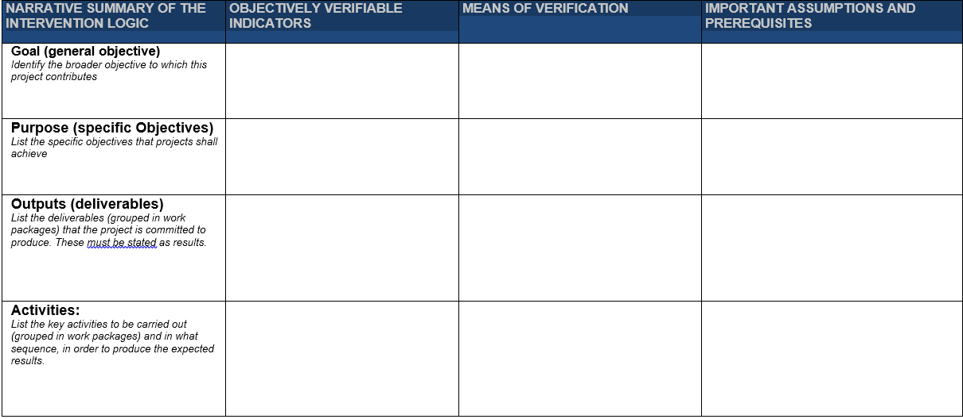
Ensure coherence in LFM intervention logic

Slide 35
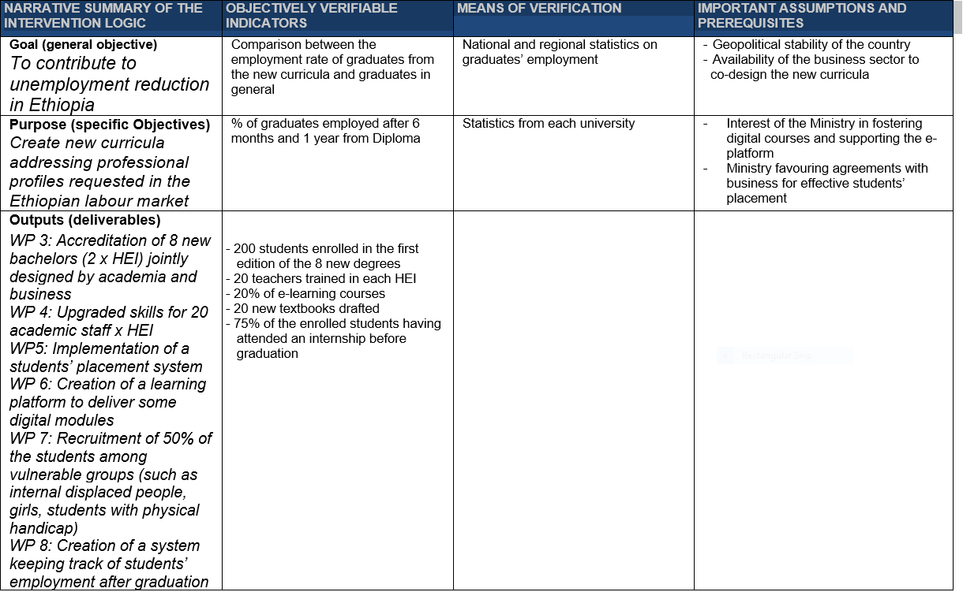


Slide 36
Tasks, milestones and deliverables
For curriculum development proposals
Tasks: preparation of the accreditation file of the new Master for submission to the Ministry
Milestone:
Ministry’s feed-back
Deliverable:
Accredited Master
Milestones occur before deliverables

Slide 37
Tasks, milestones and deliverables
For curriculum development proposals
Task: preparation of the new textbooks: - Mixed groups of teachers dealing with 2 subjects;
- Collection of teaching materials and case studies;
- Workshops led by an expert;
- Team work in the different groups
Milestone:
Peer-review
Deliverable:
New textbooks developed and used by the students
Milestones occur before deliverables

Slide 38
Tasks, milestones and deliverables
For proposals creating a new service/structure/center
Task:
Definition of the mission, allocated staff, operating budget and procedures of the new center
Milestone:
Official decision of the University Council establishing the center
Deliverable:
Center established and running
Milestones occur before deliverables

Slide 39
Please use clear terminology
Curriculum = Study Programme = Degree
Course = Subject = Module
Please provide credits
Indicate total n°of credits for the Study Programmes (ECTS or other systems)
Indicate the n°of credits for each new/updated course

Slide 40
Work Packages
They are the building blocks of the proposal: a correct identification of WPs makes the project manageable and efficient
On average, between 6 and 12
A WP devoted to Quality Assurance is possible, but not compulsory, this aspect can be dealt within the WP Management
A WP devoted to Preparation/Preparatory measures is possible, but not compulsory
Dissemination activities and Sustainibility measures can be grouped in one single WP or form two different WPs
Creating a single WP gathering all travels and mobilities NOT Recommended

Slide 41
Avoid discrepancies between the global timetable and the description of each WP
The same number of Tasks (= activities) listed in a WP must be reported in the global timetable/overview.
The same duration must be reported. Ex: from M 8 to M 24 means that there are NO activities in this WP after months 24, i.e. the last deliverable of this WP is due on M 24.
For the global timetable, please use the correct chart:
  the first one, with Months, is only for projects of 2 years;
  the second one, with Quarters, is for projects of more than 2 years.

Slide 42
Examples of deliverables
WP Management
Partnership Agreement
Project management handbook
Quality Assurance Plan
Dissemination Plan
Report(s) of external expert(s) for QA
at the latest with interim report
at the latest with interim report
at the latest with interim report
towards the end of the project
6 months after signature GA (compulsory)
Reports (RAPINT/RAPFIN) to the Agency linked with a payment
Simple meetings reported as deliverables

Slide 43

Examples of deliverables
WP Preparatory Measures
Surveys of stakeholders
(students, industries, NGOs)
Needs analysis Updated Report(s)
In the first 6-9 months
In the first 6-9 months
Inclusion Strategy

Slide 44

Examples of deliverables
WP Development – ‘Curriculum development’ proposals
New degree
New or updated courses in the existing degree(s)
Official Accreditations
Training for academic staff
Memorandum of Understanding HEI/Industries
List of developed courses, teaching materials, syllabus for all courses, credits
For each course: learning outcomes, teaching materials, credits, exam typology
Document delivered by the competent authority
Training material and learning outcomes
Document describing the students’ internship system
possibly before interim report
possibly before interim report
by the end of year 2
Before starting
with students
At the start of
the new degree

Slide 45
Examples of deliverables
WP Development – ‘HEI Governance’ proposals
Centre/hubs
Reforms, regulatory text, policy reports, changes on legislation
New platforms,
QA units, international offices, strategic planning units
Training for admin/academic staff, senior managers
Memorandum of understanding HEI/industries
Act of establishment, mission statement, organigram, profile and number of allocated staff, operating budget
Functionalities and features.
Mission, staff, budget, planned activities
Innovation and potential for mainstreaming
Training materials, learning outcomes,
satisfaction survey results
For students internships, joint research, etc.

Slide 46
Examples of deliverables
WP Development –‘Higher Education Reform’ proposals
change in legislation, introduction of new policies
services/platforms at national/country level
guidelines, national strategies, papers

Slide 47
Examples of deliverables
WP Dissemination
Website of the project + links in each institutional website
Dissemination Plan/Strategy
Video clips
Report on dissemination activities
Promotion material
Social networks activities
At the latest at months 6
before interim report
Final conference

Slide 48
Examples of deliverables
WP Impact and sustainability
Plan for sustainability (action plan, indicators, available budget)
Report on measurement of KPI in LFM (quantitative and qualitative)
Memorandum of Understanding
with companies, sectoral agencies, NGOs, etc.

Slide 49
Project teams, staff, experts
Do not insert CV, our call does not require it
For European institutions insert the staff who will be actively involved in the project to demonstrate appropriate expertise in the area where the knowledge transfer is necessary
For Third countries HEIs, ensure an appropriate mix of profiles: senior and junior academic staff, researchers.

Slide 50
Cost effectiveness and financial management
Demonstrate why your planned budget is cost-effective
Without entering into many details, explain the measures you will implement to ensure a sound financial management
Pay attention to a balanced mix of presential and on-line activities
Present a fair distribution of the grant among the different partners
Very often Management WP is inflated, too high
For countries participating to the capacity building action since decades, we encourage the acquisition of specialised equipment
Remember that CBHE action does NOT finance long mobilities (more than one semester) neither of students nor of staff

Slide 51
Risk management
We live in uncertain times with a number of unlikely events that did happen
You should demonstrate:
  Realistic analysis in assessing the likelihood (low-medium-high) that a risk occurs
  Anticipation capacities
  Adaptation and flexibility in finding appropriate mitigation strategies

Slide 52
Award criteria
Quality of the partnership and the cooperation arrangements
Management
Composition
Tasks
Collaboration
Solid arrangements are foreseen,
Appropriate mix of organisations with the necessary competences relevant to the objectives of the proposal and to the specificities of the Strand,
Roles and tasks are assigned on the basis of the specific know-how, profiles and experience of each partner.
Effective mechanisms to ensure efficient collaboration, communication and conflict resolution between the partner organisations and any other relevant stakeholders.
Commitment
The contribution from the project partners is significant, pertinent and complementary,
Timelines, governance structures, collaboration arrangements and responsibilities well defined and realistic.
most appropriate and diverse range of non-academic partners.
the proposal demonstrates the partners’ involvement, commitment and ownership of the project’s specific objectives and results, in particular from the third countries not associated to the programme.
Notes:
Management: solid management arrangements are foreseen. Timelines, governance structures, collaboration arrangements and responsibilities are well defined and realistic.
Composition: the partnership gathers an appropriate mix of organisations with the necessary competences relevant to the objectives of the proposal and to the specificities of the Strand; the proposal includes the most appropriate and diverse range of non-academic partners.
Tasks: roles and tasks are assigned on the basis of the specific know-how, profiles and experience of each partner and are appropriate.
Collaboration: effective mechanisms are proposed to ensure efficient collaboration, communication and conflict resolution between the partner organisations and any other relevant stakeholders.
Commitment: the contribution from the project partners is significant, pertinent and complementary; the proposal demonstrates the partners’ involvement, commitment and ownership of the project’s specific objectives and results, in particular from the third countries not associated to the programme.

Slide 53
Management
Management structure and procedures
Describe the organisational structure and the decision-making
Describe how effective innovation management will be addressed in the management structure and work plan.
Consortium as a whole
Describe the consortium. How will it match the project’s objectives? How do the members complement one another? In what way does each of them contribute to the project?

Slide 54
Award criteria
Sustainability, impact and dissemination of the expected results
Exploitation
Dissemination
Impact
Open access
How the outcomes of the project will be used by the partners and other stakeholders; how multiplier effects will be ensured and it provides means to measure exploitation within the project funding time and after.
Clear and efficient plan for the dissemination of results, appropriate activities and their timing, tools and channels to be spread effectively to all relevant stakeholders and non-participating audience, reaching out and attracting relevant stakeholders to the outcomes within and after the project’s funding time.
Tangible impact on its target groups and relevant stakeholders at local, national or regional level,
Materials, documents and media produced freely available and promoted through open licenses and without disproportionate limitations.
Sustainability
How the project results will be sustained financially and institutionally and how the local ownership will be ensured.
Measures, goals and indicators to monitor progress and assess the expected impact at individual, institutional and systemic level.
Notes:
Exploitation: the proposal demonstrates how the outcomes of the project will be used by the partners and other stakeholders, how multiplier effects will be ensured (including scope for replication and extension of the outcome of the action at sectorial, as well as local/regional/national or international level) and it provides means to measure exploitation within the project funding time and after.
Dissemination: the proposal provides a clear and efficient plan for the dissemination of results, and includes appropriate activities and their timing, tools and channels to ensure that the results and benefits will be spread effectively to all relevant stakeholders and non-participating audience, reaching out and attracting relevant stakeholders to the outcomes within and after the project’s funding time;
Impact: the proposal ensures a tangible impact on its target groups and relevant stakeholders at local, national or regional level. It includes measures, as well as goals and indicators to monitor progress and assess the expected impact (short-and longterm) at individual, institutional and systemic level.
Open access: if relevant, the proposal describes how the materials, documents and media produced will be made freely available and promoted through open licenses and without disproportionate limitations;
Sustainability: the proposal explains how the project results will be sustained financially (after the end of project funding) and institutionally (activities and services continuing to be in place) and how the local ownership will be ensured.

Slide 55
Impact
Maximasing impact
Impact on insitutions
modernization of HEIs and reforming HE
Impact on economy
Development of third countries, creation of jobs
Societal impact
public policy and society
Impact and timing
Short term changes in
knowledge, skills, aspirations, attitudes, awareness
Medium term changes in
behaviour, practices, procedures, values, decision making
Long term changes in
policies, legislation, economy, society, technology, environment

Slide 56
Impact
What is the expected impact of the project? And does this answer the expected impact of the call text? Be specific and quantify…
Provide a draft “plan for the dissemination and exploitation” of the project's results during and after its end
Outline the strategy for knowledge management and protection. Include measures to provide Open Access
What is the social and societal benefit of the project?
Communication: How will you bring the results to the audiences (to whom, why, how, and when)?

Slide 57
Dissemination
How are you disseminating your results?
scientific publications, books, website, workshops, conferences, portal, lectures, media (newspapers, magazines, TV, radio), social media
Be as concrete as possible
name the publications/conferences, mention expected dates, types as well as size of audiences
Identify your target groups
academics, students, politicians, public/private sector, organisations, press etc.

Slide 58
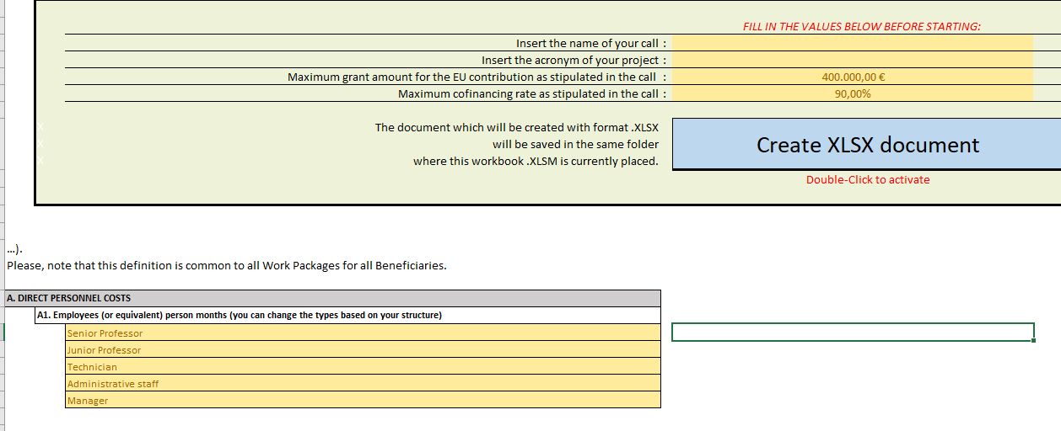
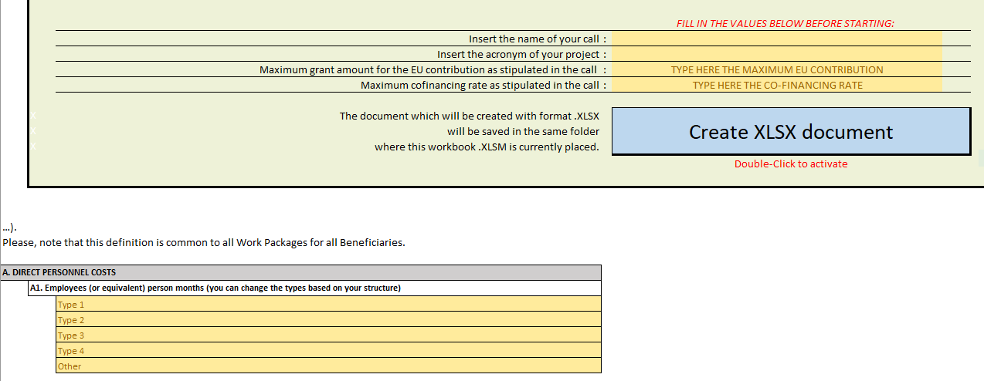
Detailed Budget Table

Slide 59
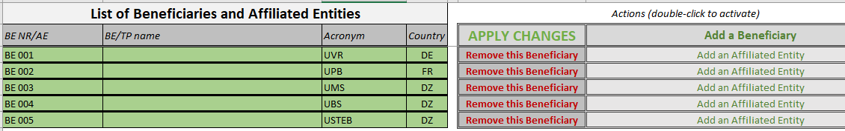
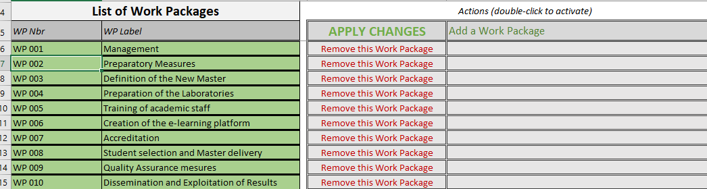
Insert the beneficiaries and the WPs

Slide 60
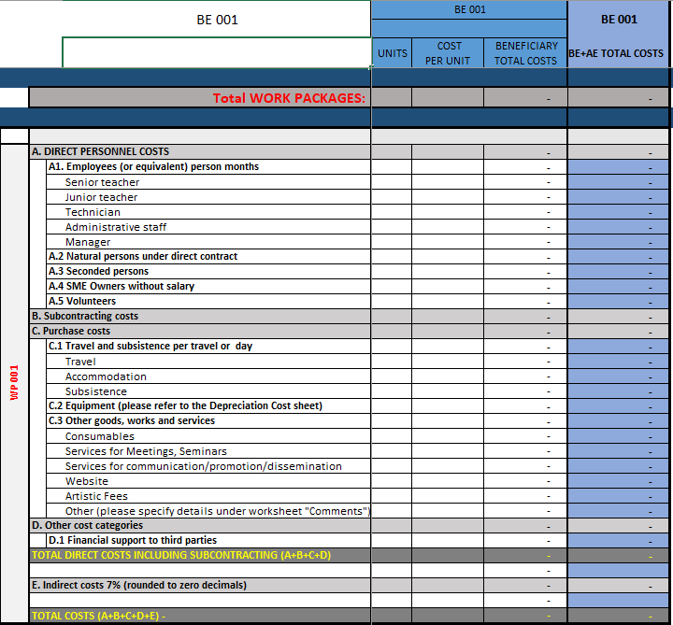

Slide 61
Rates to be used for Volunteers, SME owners, travel, hotel and per diem
You can find them in the following Communications of the European Commission:
Volunteers. See C(2019) 2646
SME owners. See C(2020) 7115
Travel, hotel, per diem. See C(2021) 35

Slide 62
KEY WORDS for a competitive application
Complete
Coherent in its entirety
use examples, justify your statements, bring evidence
follow the questions and answer them in the right order
Simple language
do not take anything for granted; do not assume experts will always understand; avoid abbreviations or explain them the 1st time
the application is the basis on which your project will be implemented; it is also the cornerstone of your partnership commitment
stick to what is asked
avoid contradictions; avoid "patchwork"
Concrete
Clear
also complex subjects can be explained in a plain language. Keep most sentences 10-15 words long.
Explicit
Rigorous
Focused
ensure you have followed all the instructions and that the proposal fulfils all the mandatory requirements

Slide 63
Finally…..
It is all about writing a GOOD STORY
Start in time and structure the writing process!
Involve your administration from start
Remember for whom you’re writing!
Create a logical link between objectives, WPs, deliverables and resources
Identify the users of your results
Pinpoint the social/societal benefits
Recognise connections between your proposal and funding policies

Slide 64



Slide 65


Notes:
The partners role and responsibilities (/rights and obligations);
Finance (budget breakdown, co-funding, payment mechanisms, salary rates, travel and subsistence costs, etc.)
Managing Boards roles, composition, meeting schedules, etc.
Communication means, channels
QA : evaluation and monitoring (/reporting) mechanisms;
Student issues (hosting, tutoring, recognition, degree awarding, etc.)
Decision and Conflict resolution mechanisms

Slide 66

Thank you
© European Union 2021
Unless otherwise noted the reuse of this presentation is authorised under the CC BY 4.0 license. For any use or reproduction of elements that are not owned by the EU, permission may need to be sought directly from the respective right holders.
Slide 11, 12, 13, 14, 15, 16, 17, 18, 19 & 20: Image, source: © European Union, 2021 (CC BY-NC-ND 4.0) — iStockphoto.com, 2016; Slide xx: element concerned, source: e.g. iStock.com
Notes:
Update/add/delete parts of the copy right notice where appropriate.
More information: https://myintracomm.ec.europa.eu/corp/intellectual-property/Documents/2019_Reuse-guidelines%28CC-BY%29.pdf

