Slide 1
Erasmus+ Virtual Exchanges InfoDay – 30 November 2021

Slide 2
Erasmus+ Virtual Exchanges InfoDay – 30 November 2021

Slide 3
Virtual Exchanges in Higher Education and Youth

Slide 5
Forms of financing and budget categories (1)

Slide 6
Forms of financing and budget categories (2)

Slide 7
Main eligibility conditions by form of financing (1)

Slide 8
Main eligibility conditions by form of financing (2)

Slide 10
Unit cost for travel – distance calculator

Slide 11
The unit cost for travel is for return trips

Slide 12
Unit cost for accommodation and subsistence

Slide 13
Calculation of final amount of the grant in 4 steps (in case that your application is selected)

Slide 14
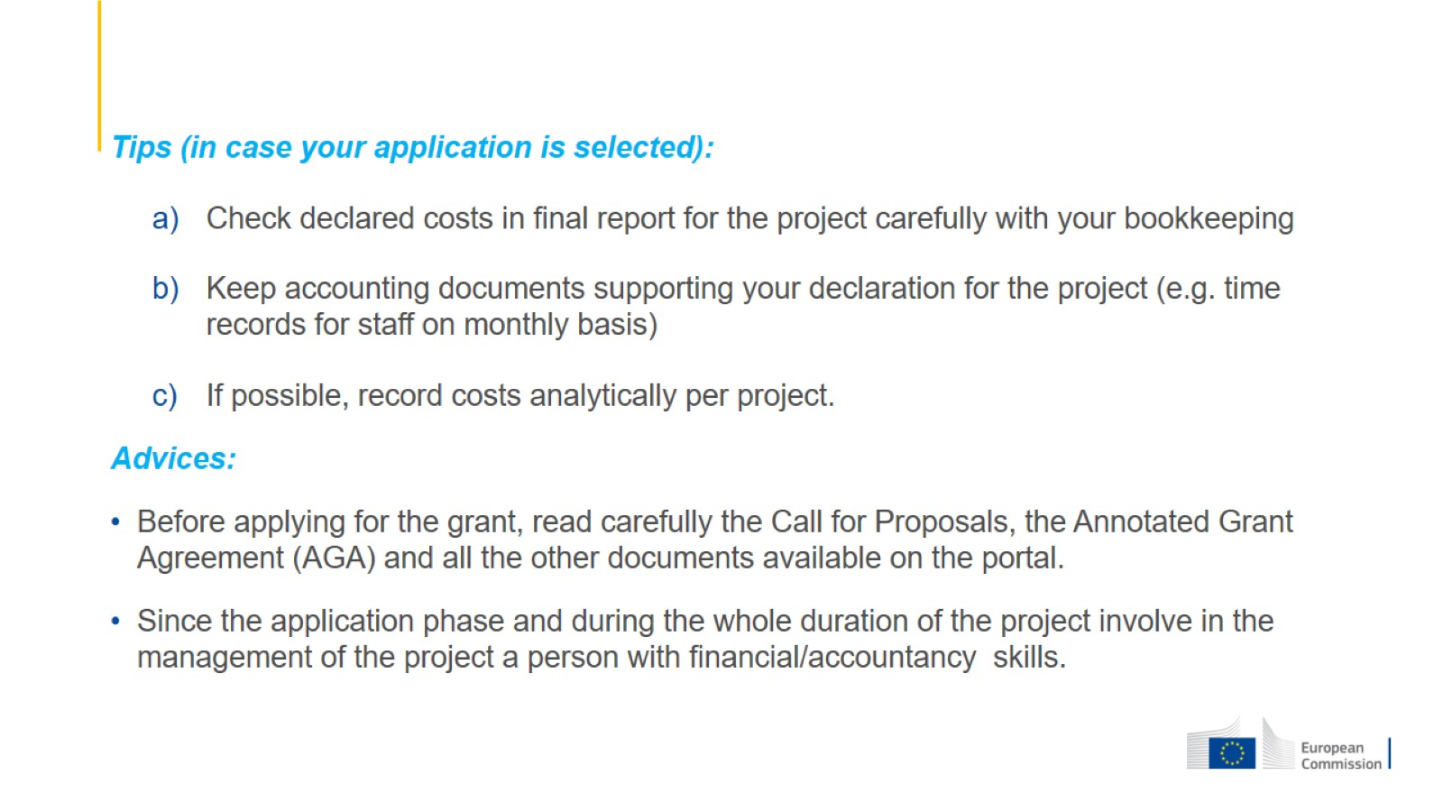

Slide 15
Thank you!

