Slide 1

Michael TEUTSCH
Head of Unit Schools and Multilingualism
European Commission
Online Info-Session
10 June, 2021, 14:00 – 17:00, Brussels time
#TeacherAcademies

Slide 2
Erasmus+ Teacher Academies
Policy background, objectives and expected results

Slide 3
Policy background
Communication on Achieving the European Education Area by 2025 and Council Resolution
Digital Education Action Plan 2021-2027
Council Conclusions on European teachers and trainers for the future
Challenges, Objectives of the Erasmus+ Teacher Academies

Slide 4
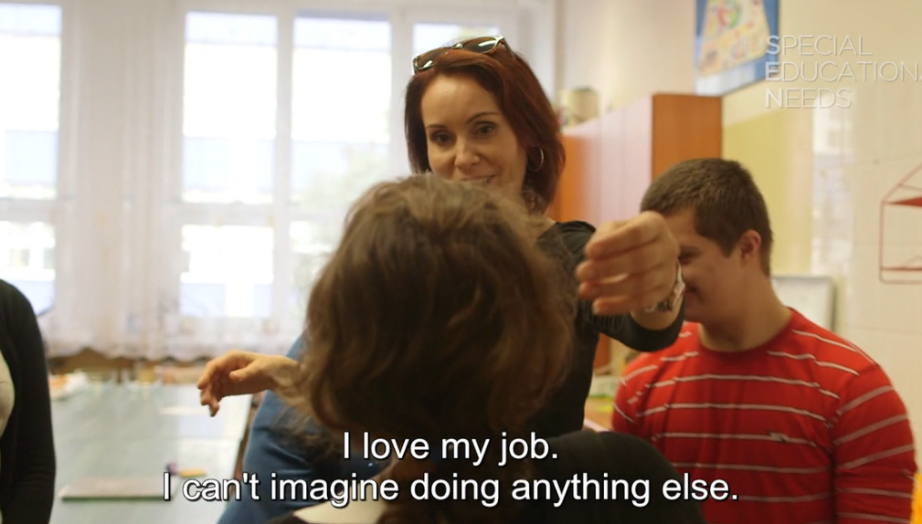


New Erasmus+ programme 2021-2027
Inclusive
Green
Digital
Participatory
Increased budget
https://ec.europa.eu/programmes/erasmus-plus/

Slide 5
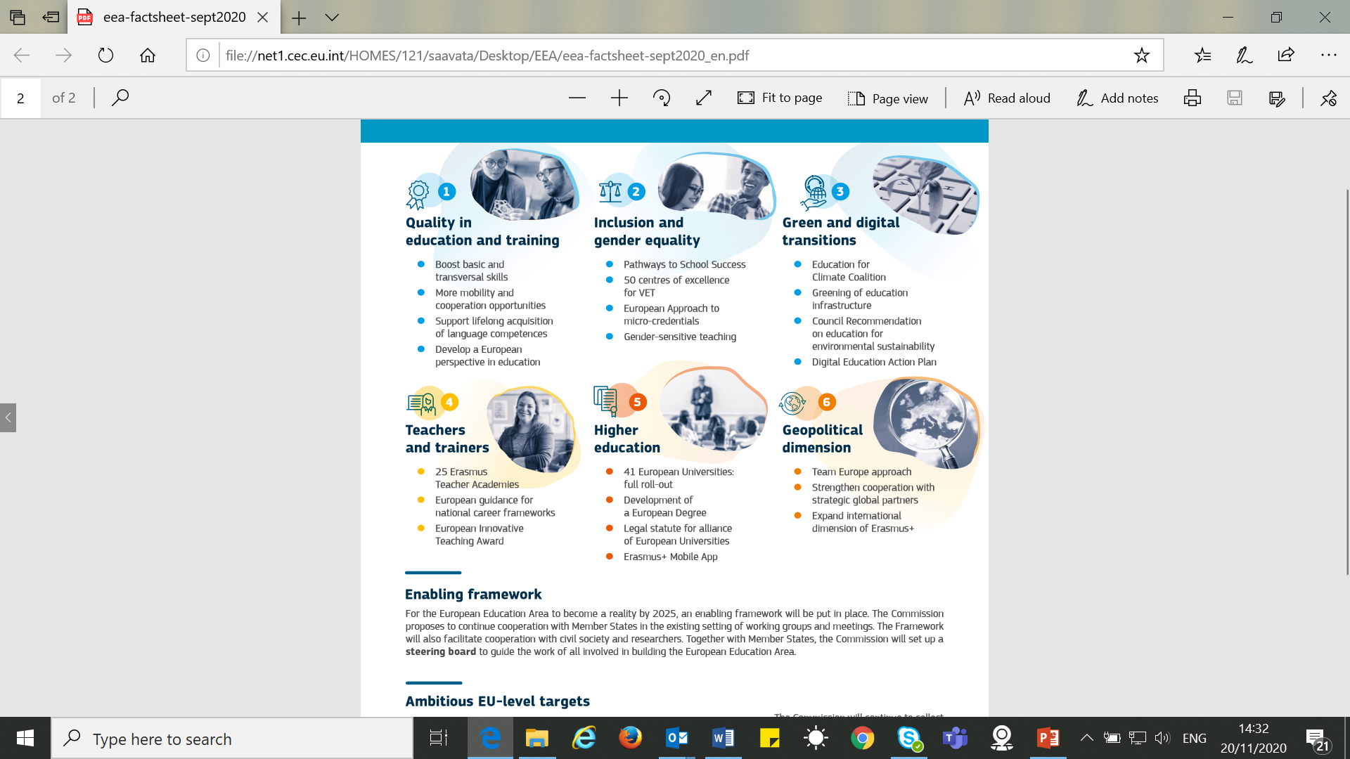
  Achieving the EUROPEAN EDUCATION AREA by 2025

Slide 6
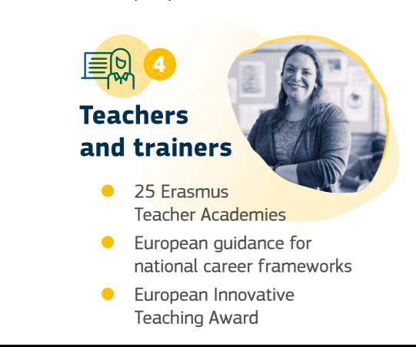
Teachers in the European Education Area

Slide 7

Teachers in the European Education Area
The vision:
….builds on competent and motivated teachers and trainers who benefit from a seamless continuum of a high-quality initial education, effective induction and to-the-point professional development throughout their careers, including participation in professional networks and communities and benefitting from learning mobility abroad.

Slide 8


European initiatives on teachers
Teachers will be supported by:
  Erasmus+ Teacher Academies
  Peer learning on development of national career frameworks
  European Innovative Teaching Award
  SELFIE - tool for digital competences
  Policy framework for learning mobility
  eTwinning and School Education Gateway
  Erasmus+

Slide 9


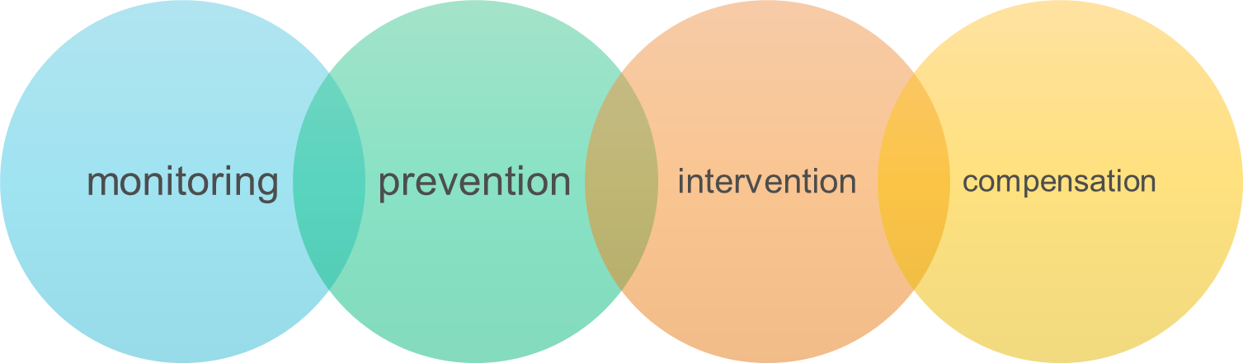
European initiatives on teachers
Teachers are key to the proposals for Council recommendations on:
  Blended learning for high quality and inclusive education
  Education for environmental sustainability
  Pathways for School success

Slide 10

Challenges – shortages of teachers
In the EU, about 25% of principals report an overall shortage of qualified teachers
There is also a shortage of teachers to teach:
  students with special needs.
  students in multicultural or multilingual settings
  students from socioeconomically disadvantaged homes
Ageing: 40% of lower secondary teachers in Europe are 50 or above, so one third will retire in the next decade
Some countries have high drop-out rates
But there is also oversupply of teachers in many countries.

Slide 11
Challenges – image and CPD
Only 18% of lower secondary school teachers think their profession is valued by society
Gender imbalance: in primary education the proportion of female teachers reaches 85% and at secondary level, 64.7%.
Continuous Professional Development (CPD): 92% of teachers participate in further learning, but;
  21% ask for training to work with students with special needs;
  16% ask for more IT training;
  and 13% training in teaching in multilingual and multicultural environments.
(Education and Training Monitor 2019 – based on TALIS 2018)

Slide 12

TEACHERS’ MOBILITY
TALIS 2018: 44% of teachers in the EU have been abroad (22,5% through an EU
programme): 20% solely as a teacher, 8% solely under ITE, 13% both as teacher
and students – with big country variations.
16% points increase compared to TALIS 2013
70% of mobile teachers are language teachers; 30% science teachers; 33% math teachers
Purposes: Accompanied student 51%, Learning language 50%, Studying (ITE) 48%,
Teaching 29,6%, Learning about other subject area 21,6%
  Eurydice: Teachers in Europe, 2021
Benefits | Obstacles
Language learning, cultural understanding, reflection and learning new teaching competences, networking … | Funding, schedules, substitute teachers, languages, matching demand/offer, lack of recognition…

Slide 13
Challenges – teachers and digital competences
COVID-19 crisis: Teachers demonstrated their commitment, flexibility and creativity; and continue to do so!
6 EU Member States have a framework on teacher’s digital competences. In 15, digital competences are in a general teacher competence framework.
  Less than a half of all teachers report that ICT was included in their formal education or training.
  Less than 20% of lower secondary teachers in the EU identified investing in ICT to be of high importance (N.B.: before the pandemic).
(Education and Training Monitor 2019 – based on TALIS 2018)

Slide 14
Erasmus Teacher Academies
What are Erasmus Teacher Academies?
A new action in the new Erasmus+ Programme
Projects creating networks of initial teacher education and continuous professional development providers and other relevant stakeholders
Cooperation on key priorities such as digital learning, sustainability, equity and inclusion, gender equality
Develop joint learning offer for student and serving teachers with strong European dimension and through innovative and practical collaboration
Develop learning mobility (virtual, physical and blended) for teachers
Give ideas and inputs to policy development and encourage the development of sustainable collaborative networks

Slide 15
Benefits of Erasmus Teacher Academies
Teacher education providers:
  Enhanced international and European dimension
  Enriched learning provision with a career long perspective (initial and CPD)
  Coordinated and effective mobility schemes
  Innovation, networking and possibility to impact on policies
Participating students and teachers:
  Unique perspective to European education systems
  Tailored, quality assured and recognised learning courses to support career-long learning
  Access and contributions to peer learning and professional communities
Policy makers/stakeholders
  First hand experiences on effective teacher education

Slide 16

More info…
  Communication on Achieving the European Education Area by 2025
  Digital Education Action Plan 2021-2027
  Council conclusions: European teachers and trainers for the Future
  Eurydice report: Teachers in Europe: Careers, Development and Well-being
  Education and Training Monitor 2020
  Education and Training Monitor 2019
  OECD TALIS surveys 2013, 2018
  Policy guide to improve the support for teacher and school leader careers in Europe (Working group report in the School Education Gateway)

